Slide 1
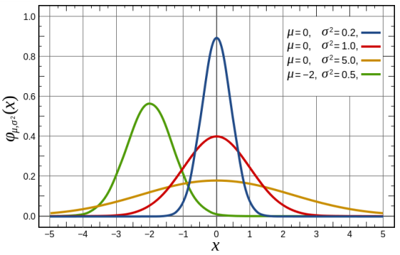
Normal Distributions

Slide 2
Properties of Normal Distributions
The most common type of distribution.
It is continuous & has a “bell” shape.
It is symmetric about the mean.
The mean and median are equal
Ie: the data in this distribution is neither skewed left nor skewed right but rather, symmetric
The total area under the normal curve is 1. Ie: the probability of being anywhere on the distribution=1.

Slide 3
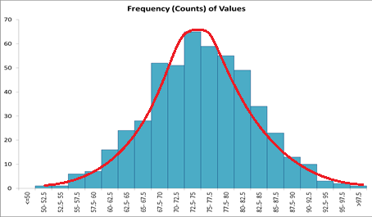
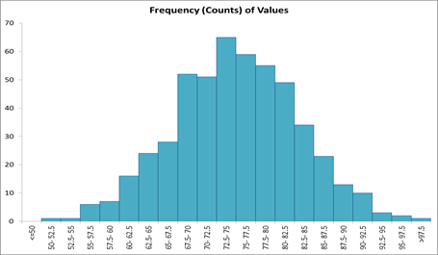
Properties of Normal Distributions
To determine if a data is bell shaped – do a
histogram.
?
To “normalize” a distribution – use the z-score formula:
$$z=\frac{x−μ}{σ}$$
$$z=\frac{x−\overline{x}}{s}$$
or
(populations)
(samples)

Slide 4
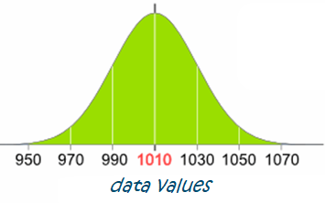
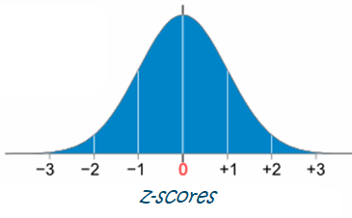
What is a Z-score?
It measures how many standard deviations a data value is away from the mean/average.
2
Example: If the mean is 1010, the standard deviation is 20, how many standard deviations above the mean is 1050?
$z=\frac{1050−1010}{20}=2$

Slide 5
How to Calculate Probabilities?
We can use the Emperical Rule:
68% of all data are within 1 standard deviation
68%
95% of all data are within 2 standard deviations
95%
99.7%
99.7% of all data are within 3 standard deviations
If our data value is beyond 3 standard deviations from the mean, it is called an outlier.

Slide 6
How to Calculate Probabilities?
We can also use functions in excel:
Use norm.dist when you want a probability related to x-values
Use norm.inv when you want the x-value (or percentile) related to a probability
prob = %
prob = ?
x = ?
x = ?

Slide 7
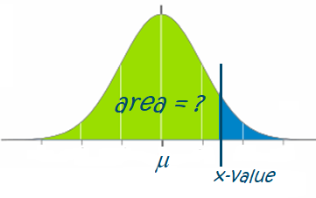
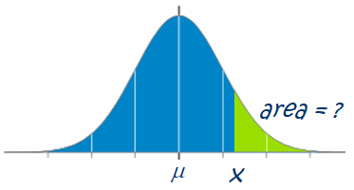
Using Norm.dist:
Norm.dist(x,μ,σ,1) calculates the area to the left of an x-value
1 –norm.dist(x,μ,σ,1) calculates the area to the right of an x-value

Slide 8
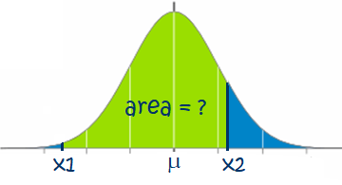
Using Norm.dist:
norm.dist(x2,μ,σ,1) – norm.dist(x1,μ,σ,1) calculates the area between 2 values, x1 and x2

Slide 9
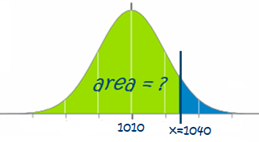
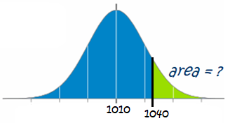
Example 1:
A data set has a mean of 1010 and a st deviation of 20.
What is the probability x is below 1040?
= norm.dist(1040, 1010, 20, 1)
= 0.9332
What is the probability x is above 1040?
= 1- norm.dist(1040, 1010, 20, 1)
= 0.0668

Slide 10
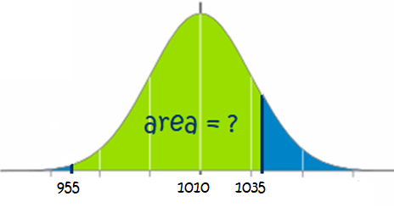
Example 1 Continued:
What is the probability x is between 955 and 1035?
= norm.dist(1035, 1010, 20, 1) - norm.dist(955, 1010, 20, 1)
= 0.8914

Slide 11
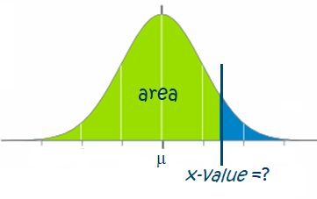
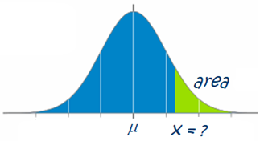
Using Norm.inv:
Norm.inv(area,μ,σ) calculates the x-value (or percentile) required to give a certain area to the left of the x-value
Norm.inv(1-area,μ,σ) calculates the x-value (or percentile) required to give a certain area to the right of the x-value

Slide 12
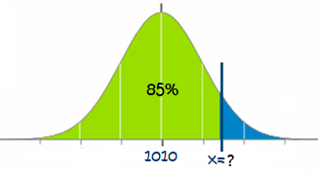
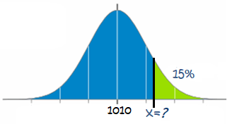
Example 2:
A data set has a mean of 1010 and a st deviation of 20.
85% of the data will be below what amount?
= norm.inv(0.85, 1010, 20)
= 1030.73
15% of the data will be higher than what amount?
= norm.inv(1–0.15, 1010, 20, 1)
= 1030.73

Slide 13
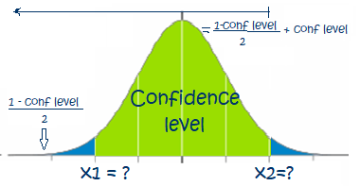
Using Norm.inv for conf Int’s:
To build up a confidence interval, we use the Norm.inv(prob,μ,σ) as well.
Just be careful, the confidence interval is the area in the middle.
To determine the lower and upper x-values for a confidence interval, we must find the area to the left of each one.
$$area to left of x1=\frac{1−confidence level}{2}$$
$$area to left of x2=\frac{1−confidence level}{2}+confidence level$$

Slide 14
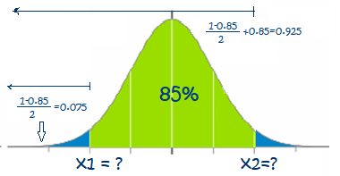
Example 2 Continued:
A data set has a mean of 1010 and a st deviation of 20.
85% of the will be within what amounts? Ie: what is the 85% confidence interval??
x1 = norm.inv((1-0.850)/2, 1010, 20, 1)
= norm.inv(0.075, 1010, 20, 1)
= 981.21
x2 = norm.inv((1-0.850)/2 + 0.85, 1010, 20, 1)
= 1038.79
= norm.inv(0.925, 1010, 20, 1)

Slide 15
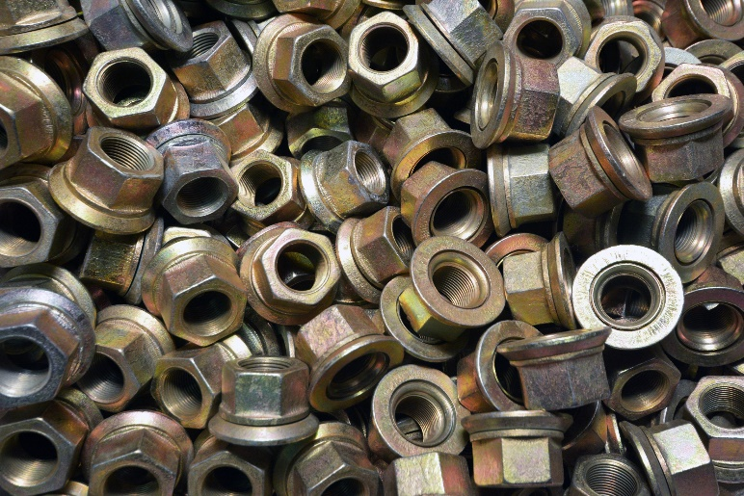
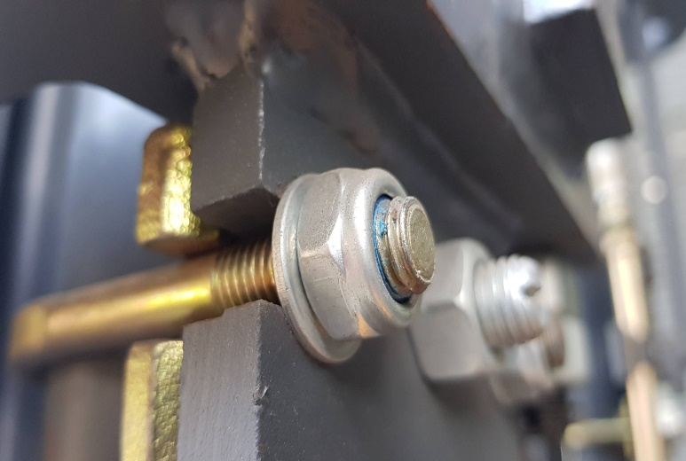
Example 3: An applied example:
You are purchasing a large batch of 20cm nuts for your company from a manufacturer.
Before paying for the nuts – you perform quality control on the batch because you need these nuts to fit onto certain bolts in the product you are making.

Slide 16
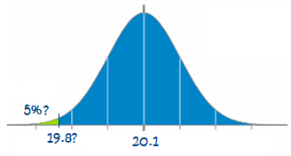
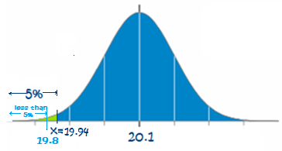
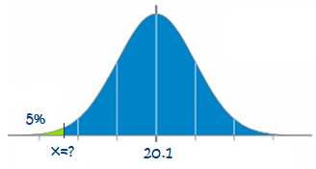
Example 3: An applied example:
For quality control - you take a sample of nuts and find that the average diameter in the sample is 20.1cm with a standard deviation of 0.1cm.
In order to pass quality control, the sample can only have 5% of nuts smaller than 19.8 cm in diameter.
Will you accept this batch from the manufacturer?
x = norm.inv(0.05, 20.1, 0.1) = 19.9355
← Is this okay???
Yes it is. Since we want at most 5% to be less than 19.8, it’s even better if 5% are less than 19.94 instead – this means that less than 5% would be smaller than 19.8.

Slide 17
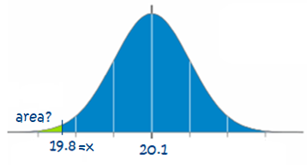
Example 3: Continued…
Let’s look at one more way of solving this problem:
Let’s use norm.dist instead to solve to the percent of nuts below 19.8 cm:
area = norm.dist(19.8, 20.1, 0.1,1)
= 0.00135
← Is this okay???
Yes it is. Since we want at most 5% to be less than 19.8, it’s even better since 0.00135 = 0.135% which is less than 5%

