Slide 1
Persuasion Interactive Lecture
Persuasion is perhaps the trickiest subject that we'll cover. That's because it requires lots of different skills:
Understanding your audience's current stance on the issue and what will be persuasive to them;
Using evidence;
Developing a strategy;
Creating an argument;
Using tone and details strategically.
In this lecture, we'll be exploring persuasion by thinking about a common workplace genre: the resume and cover letter. In this session, you'll think about how you can use your persuasion skills to get hired. But first, let's review what you learned in the readings and reflect on your mindmap.
Photo by Joan Villalon on Unsplash

Slide 2
Mind Map
But first, since this is the beginning of a new module, let’s take a moment to think about the mindmap that you created with your group for Module #4. Hopefully, you were able to find some connections between all of the modules.
For this module, you can consider:
What are the most important ideas that have come up for you so far?
What are your unanswered questions?
How do you think you’ll use the knowledge you gained in other modules to study this topic?
Did everyone in your group make the same connections? Did anyone disagree?
You don’t have to have the perfect answers for these questions, but taking a few moments to reflect will help prepare you for success in Module #5.
Photo by Sunny Liu on Unsplash

Slide 3
Test Your Knowledge
Your friend Jake wants you to open a business with him. He tells you the main reason you should invest is because his business partner has already opened four other successful businesses. Jake is using…
a) Pathos
b) Ethos
c) Logos
Next, Jake shows you a chart that projects the earnings that the business could make within two years. Jake is using…
a) Ethos
b) Pathos
c) Logos

Slide 4
Answers
Ethos. Jake is using the reputation of his partner to get you to agree
Logos. Jake is using facts and data to persuade you.

Slide 5
Test Your Knowledge
You tell Jake that you don’t want to invest. He tells you it has always been his dream to open a business and if you don’t invest, he’ll never be happy. Jake is using….
Logos
b) Pathos
c) Ethos
What is the goal of a Spectrum of Allies analysis?
a) To develop a plan to make everyone agree with you
b) To focus on the people who are most opposed to you
c) To sort people according to how much they agree with your cause so you can develop a strategy to ‘shift’ them slowly towards your cause.

Slide 6
Answers
Pathos.
Spectrum of Allies analysis sorts people according to how much they agree with your cause, so you can develop a strategy to ‘shift’ them slowly towards your cause.

Slide 7
Persuasion is...
Before we start, let’s explore the idea of persuasion a little more thoroughly.
What would be a definition of persuasion?
It is simply convincing someone to change their position or perspective about something. We persuade people every day in big and small ways. For example, you might convince your roommate to watch your favourite movie or your manager to let you have time off.
We can also think about the ethics of persuading someone. Have you ever had someone try to change your mid in a way that made you uncomfortable? Why did it make you uncomfortable?
Photo by Jessica Da Rosa on Unsplash

Slide 8
Writing Job Application Materials
Job application materials like cover letters and resumes are a great way to learn about persuasion. You have a very short space to convince an audience that they should invite you for an interview. When you write a cover letter and resume, you’re doing a couple of types of persuasion.
Persuading an audience that you have the qualifications to do well at the job;
Persuading an audience that you would be a good coworker;
Persuading an audience why you’d do a good job even if you’re not a perfect fit;
Demonstrating your ability to write clearly and concisely;
Demonstrating your ability to organize information.
Before we start writing our cover letter and resume, let’s think about audience analysis.

Slide 9
Understanding Your Audience
When you send in a cover letter and resume, you are often communicating to several difference audiences:
Computer algorithms, which can scan your resume and cover letter for keywords to determine how long you’ve held a particular job, and even determine how positive you are. This section of your textbook gives you more advice about tailoring your resume and cover letter to an algorithm.
Someone who works in HR who may not be an expert in your field. For example, someone might be involved in hiring an administrative assistant, a bookkeeper, and a marketing manager at the same time. They therefore aren’t an expert in these jobs. If you use too much specialized language, they might not realize you’re qualified.
A potential employer, boss or coworker. If you make a shortlist, your resume and over letter will be sent to someone who understands your boss and might even be your boss or coworker. They will usually decide who is going to be interviewed.
Let’s take a look at how to read a job ad to see what else we can learn about our audience.

Slide 10
Activity
Go to Indeed or another job hunting website and find a job that you might be eligible for either right now or after graduation. Read the job posting and perform the following actions:
Underline any keywords that you find. A keyword could be a skill (writing, conducting audits), a piece of software (Microsoft Excel, Quickbooks), or a trait (positive thinker).
Look at these keywords and try to come up with the top 5 most important keywords.
Write down 1 sentence about what you think the company culture might be like: Does the job posting stress that it’s a fun, energetic place to work or does it seem form? What do you think it would be like working there?
Go to the company’s website and write down 1 thing you learned about the company.
Photo by Jessica Da Rosa on Unsplash

Slide 11
Sample Response for a marketing coordinator job
Look at these keywords and try to come up with the top 5 most important keywords
Marketing plan
Generate online paid campaigns
Strong writing skills
Create marketing collateral
Five years progressive experience.
Write down 1 sentence about what you think the company culture might be like. The job ad is written in quite formal language and uses the term “excellence,” data-driven” and “responsibility.” This makes me suspect they are more on the formal side.
Go to the company’s website and write down 1 thing you learned about the company. The website gave me a sense that they’re an older company with quite a few older employees. Their website doesn’t appear to be up-to-date, which makes me wonder about the role that marketing currently plays in their strategy.
By now, your research might have led you to realize this is not the ideal job for you. That’s the point of doing a little research. You’re going to be spending 40 hours a week at a job, so it’s best to know early if it’s the right fit.

Slide 12
Reflection
Now, look over what you found out. With your current experience, do you meet some of the criteria or all of the criteria? Even if you don’t meet all of the criteria, it’s okay to still apply. When a company writes a job posting, they’re imagining their dream employee. They might not find someone with everything on the list. Look over what you wrote and ask yourself:
How can I determine that I have the top qualifications they’re looking for? Make a note of how your past experiences (school or work) shows that you have the top 5 qualifications that you identified.
Why would I want to work for this company? We’ll need the information when we write a cover letter.
Is there anything about my experience that might confuse my audience? For example, maybe you’ve been a bookkeeper in the hospitality industry and you’ll need to show how you could be a bookkeeper in the retail sector. Or maybe your title was technically a bookkeeper, but you took on a lot of extra responsibilities because it was a small company.
Make some notes about what you learned.

Slide 13
Customization is Key
One of the major mistakes that people make with their cover letter and resume is sending out the same one to everyone. As you can see from the previous exercises, however, every company will have a different criteria, a different company culture, etc.
It’s better to customize five job applications than to send out 100 of the same application.
Now, we’ll learn how to take our audience analysis skills and use them to make our job materials persuasive.
Photo by Spencer Davis on Unsplash

Slide 14
Focus on Your Accomplishments, Not Your Job Duties
According to popular HR blogger Alison Green of Ask a Manager, you should focus on “what you did beyond the job description.” Thinking about your work experience this way allows you to be more persuasive, and also more specific.
For example, most people who work as a marketing coordinator update a website, but not everyone redesigns a website using SEO (Search Engine Optimization) best practices to generate a 300% increase in traffic. Everyone who works at a gas station deals with customers, but not everyone is called upon to resolve conflicts, or communicates in multiple languages, or won an Employee of the Month award for their customer service.
Thinking about what you accomplished, rather than just the job duties you performed, will help you decide what to put in your cover letter and resume.

Slide 15
Show don’t Tell
A common principle of good writing is show, don’t tell. Often it can be tempting to write phrases like “I’m a good writer” or “I’m a strong leader.” But this isn’t very persuasive. I could say “I’m a rocket scientist” bu that doesn’t make it true.
Instead of tell your audience that you have these skills, think about how you can show it.
I led a team of 6 people
Submitting a dynamic and persuasive cover letter and resume
Choosing positive words like “keen” and “enthusiastic” and confident tone “able to handle any tasks with a smile.”
I’m a strong leader
I’m a good writer
I’m a positive person

Slide 16
Test Your Knowledge
Before we apply these concepts to your own job application materials, let’s take a quick minute to review them.
1. I began on the graveyard shift and was promoted to the busiest shift within 3 months.
Job Duty
Accomplishment
2. I worked with customers
Accomplishment
Job Duty
3. I worked hard
Telling
Showing

Slide 17
Test Your Knowledge
4. I balanced going to school with working full-time, and still received Employee of the Month twice.
a) Telling
b) Showing
5. I was ranked in the top 3% of all customer service agents for both customer satisfaction and sales.
a) Accomplishment
b) Job duty

Slide 18
Answers
Accomplishment
Job Duty
Telling
Showing
Accomplishment.

Slide 20
What to Put in a Resume
Contact information
Profile/Highlights. This is just a few quick highlights of your strengths and accomplishments. Use this instead of an “objectives” section.
Experience
List each job from most recent to least recent, your title and the years you worked there.
Focus on accomplishments, not job duties
Put these accomplishments in bullet points
Education
Optional Sections: Volunteer Work, Skills, Publications, Recognition (for awards, honours)
Things not to include: subjective skills, mentions of high school.

Slide 21
How a Resume that focuses on Accomplishments not Job Duties will look
For a marketing coordinator job where you have two years of experience working as a marketing and communications coordinator. Here’s how to make sure you use keywords effectively.
Marketing/Communications Coordinator June 2018-present
Snacky Snacks Food Production
Generated an online campaign for the launch of the Snack Pack Supreme, which exceeded our sales targets by 30%
Used my strong writing and graphic design skills to create a full suite of marketing collateral, including vendor brochures, online ads, signage and print and digital advertising.
Worked with a team of 3 people to create and execute award-winning marketing plans.
Marketing/Communications Coordinator June 2018-present
Snacky Snacks Food Production
I used SEO on a new product launched last year by the company.
My teachers and friends say I am the best writer ever.
I’m a real people person.

Slide 23
The Cover Letter
According to Allison Green, the cover letter should accomplish a lot of tasks in a short space:
Present evidence about why you’d be a good candidate.
Shows why you’d do well at this particular job.
Shows why you want this particular job.
Shows why you’d be a good match for this particular company.
If you’re not a perfect match, shows why you’d do a good job anyhow.
That’s a lot to do given that your cover letter should be around a page long. Remember, however, that your cover letter should supplement your resume. There’s no point in just repeating your resume. Use the space to add new information.
Let’s take a look at an example.

Slide 24
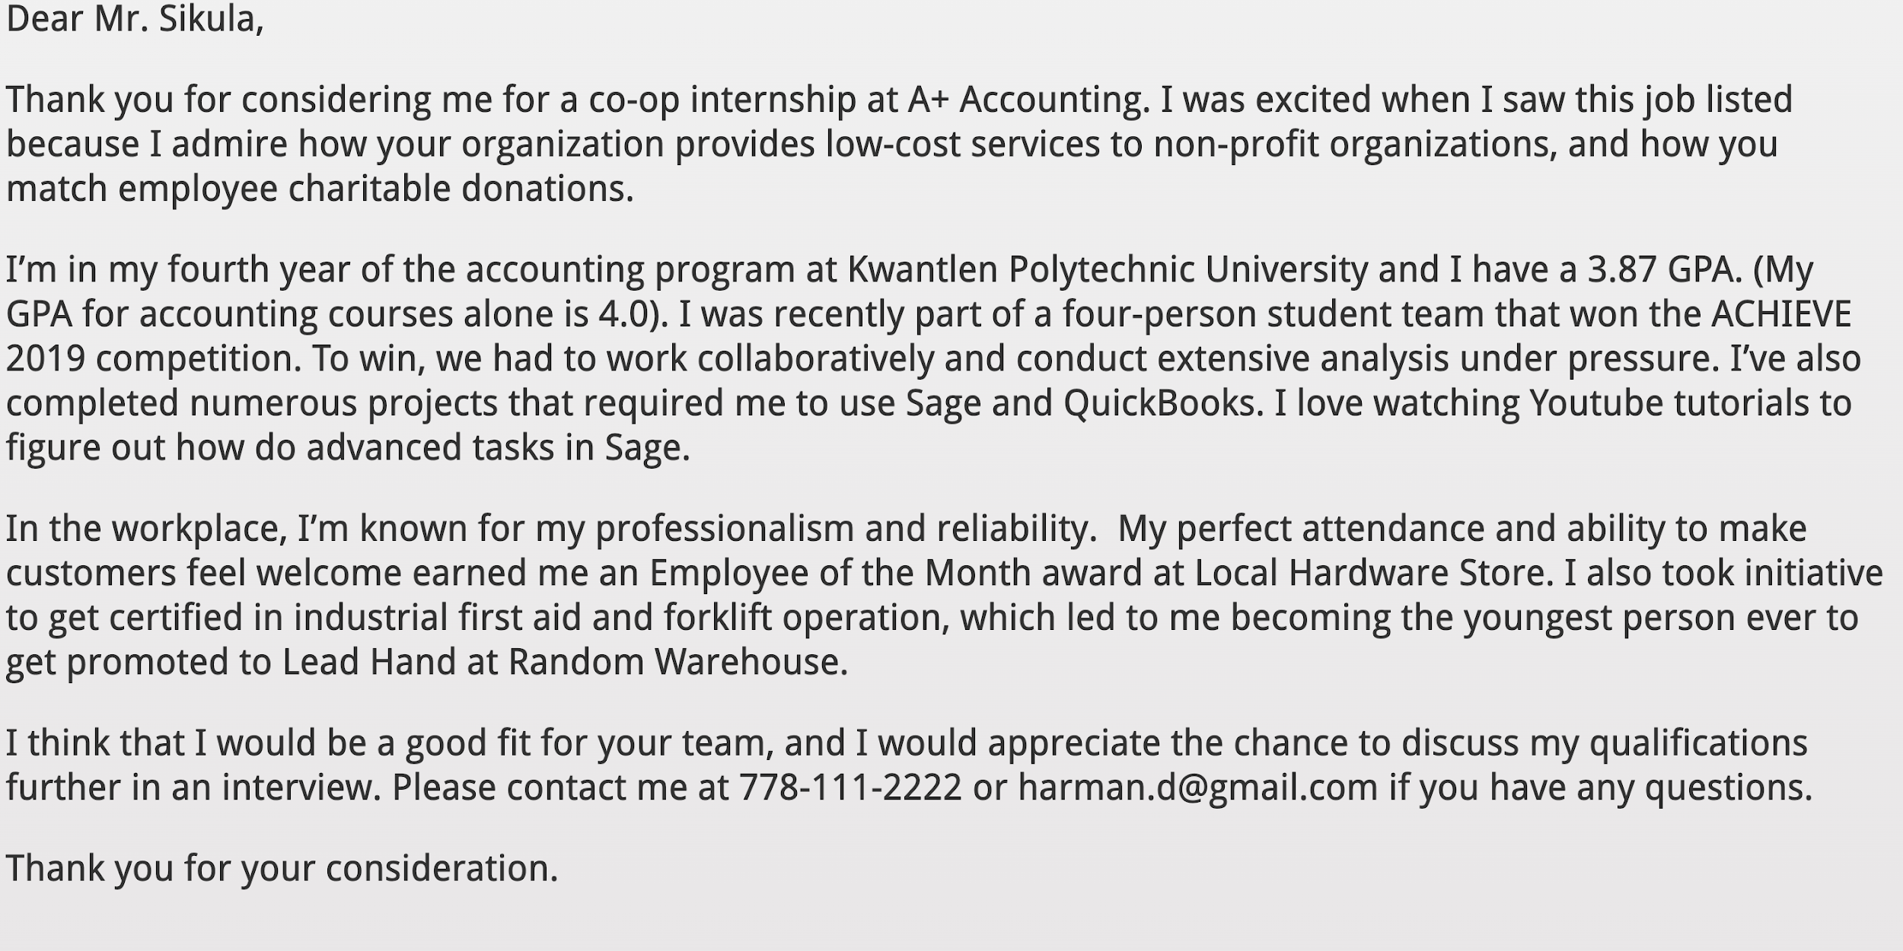

Slide 25
This student is doing a few things well:
They’ve explained why they want to work for this company.
They’ve focused on their accomplishments.
They’ve shown how they have subjective skills like reliability and punctuality.
Even though they don’t have a lot of experience in accounting, they’ve shown how their other work history makes them qualified.
They’ve edited their cover letter carefully.
They’ve focused on their most persuasive evidence (their school accomplishments first).

Slide 27
Wrapping It Up
In this lecture, you:
Analyzed an audience and used this information to develop a persuasive strategy.
Came up with evidence to persuade an audience, such as focusing on your job accomplishments not your job duties.
Learned how to use persuasion in cover letters and resumes.
The skills you learned here can be applied to other persuasive situations. If you want to learn more about writing cover letters and resumes, you can read the Communicating for Employment chapter in your textbook.

