Slide 1
CREATING
ARGUMENTS
This week, you will have two readings: how to give effective oral presentations, and how to make an argument. In this session, we’ll explore features of effective arguments in everything from reports to speeches.
Photo by Tony Zhen on Unsplash

Slide 2
Reviewing the Parts of an Argument
Let’s look at an example of an argument, which uses all of the parts. To review the parts, visit this section in your textbook.
Claim/Thesis: Encouraging more interaction between international and domestic students will benefit both groups.
Evidence: Our study found that 50% of international students had no domestic friends.
Reason: One article showed that students with diverse friend groups reported higher satisfaction in their education and were less likely to drop out.
Acknowledgement: Some may say that it’s not the university’s place to help students make friends.
Response: But we will argue that having more satisfied students will lead to greater student success and retention, which benefits the university.
Photo by Bruno Bučar on Unsplash

Slide 3
Audience Analysis (Again!)
The components of an argument are flexible. As we’ve seen, you could use them in a casual conversation, or in a formal report. It all depends on your audience. Your audience will influence:
What type of evidence you bring in.
How you use evidence.
What genre you use (memo, report, conversation, etc.)
Your tone.
The level of detail.
The objections you consider.
Photo by Miguel Henriques on Unsplash

Slide 4
What Is An Executive Summary?
To better understand arguments, let’s take a look at a genre where it’s important to present a clear argument: an executive summary.
An executive summary goes at the beginning of a report. It’s a short overview aimed at managers or decision makers, and it’s the most important part of the report.
It gives an overview of everything in the report -- your main argument -- in a way that’s persuasive.
Think of it as a report’s elevator pitch focused on the people who have the power to implement the changes proposed in your report.
Photo by Abhijith S Nair on Unsplash
`

Slide 5
ACTIVITY: Investigating Executive Summaries
To better understand how to create an argument, let’s take a look at the executive summaries of 3 different reports.
Read the executive summaries of these 3 reports:
Covid-19. Numbered Treaties and the Politics of Life (here, it’s called an Introduction, not an executive summary, but the function is similar).
Red Women Rising: Indigenous Survivors in Vancouver’s DTES
Land Back: A Yellowhead Institute Red Paper (Scroll down for the report overview, or read the executive summary on pg 8).
As you do, consider:
How do each of these reports use evidence?
How do they attempt to persuade their audience?
What is their argument? Can you find the parts of the argument for each one?

Slide 6
Reflection
You’ve probably noticed that all of these reports use evidence differently.
The Red Women Rising report uses images and a dialogue between two women. Why do you think the report authors chose to present evidence this way?
The Land Back report is more interactive. It has a lot of images and breaks up the parts of the report into different chunks. What impact does this have on the reader?
The report about Covid-19 begins with quotes from elders. Why do you think this evidence was introduced?
Understanding why these authors made the choices that they did will help you with your own ability to craft an argument. Your purpose and your audience will determine what evidence you use, and how you use it.
Photo by John Schnobrich on Unsplash

Slide 7
Making an Argument in Oral Presentations
Think back to the best oral presentation that you’ve ever heard: the one that has stayed with you.
You might not have thought initially that the speaker was making an argument, and that’s because it might have sounded like storytelling. That’s because oral presentations are a place where argument and storytelling collide.
Let’s take a look.
Photo by NeONBRAND on Unsplash

Slide 8
We remember stories.
People will forget what you said,
People will forget what you did,
But people will never forget how you made them feel
Maya Angelou
1928-2014

Slide 9
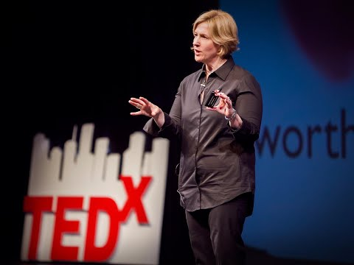
Brene Brown - The Power of Vulnerability
This TED Talk uses storytelling to make an argument.
Brene Brown calls herself a “researcher-storyteller.”
Watch this TED Talk, then flip to the next slide for the activity.

Slide 10
Activity
Obviously, Brene Brown is very persuasive. That TED Talk has been viewed 13 million times. Think back to what you watched, then write down the answers to the following questions?
What was Brene Brown’s claim?
How did she back it up with evidence?
What was the most memorable/interesting part of the TED Talk for you personally?
How did Brene Brown hook the viewer in?
Photo by Marcos Luiz Photograph on Unsplash

Slide 11
Wrapping It Up
As you can see, creating an argument is not just about how you arrange evidence. When it comes to oral presentations, it’s also about how you shape that evidence using stories, how you deliver it to your audience, how you use visuals, and how you connect.
So what can we take away here?
Have a clear message: Brene Brown had 1 main claim--that vulnerability is important--and she repeated it.
Show your audience the connections: In an oral presentation (especially a live one), if a viewer gets confused, it’s hard to go back. Make the connections clear by using signposting (“I told you___, now I’m going to ____” or “Remember when I said ______? Here’s why that’s important”) and repetition.
Use stories: You probably noticed that what hooked you into the TED Talk wasn’t the use of a Powerpoint. Using stories helps you to connect with your audience.
Use all of your tools: Brene Brown used her voice modulation, humour, images, and even her body language to convince you.

