Slide 1
Photo by Thought Catalog on Unsplash
In this lesson, we'll learn about storytelling. It may seem strange to learn about storytelling in a business communication class, but learning about storytelling will:
a) Help you be more persuasive.
b) Help you blog more effectively.
c) Help you organize information.

Slide 2
Storytelling
Business writing might be a new genre for you. (A genre is a type or category of writing.) When you enter a new genre, it's helpful to think about what existing skills can help you. Storytelling is one skill that can be really useful; most people tell stories every day.
Humans are hard-wired to learn through stories, and nearly every culture practices storytelling. Often, we like to think that we’re rational people who will change our minds when confronted with good evidence to the contrary. But if that was true, people would never believe fake news. Storytelling can help you be persuasive, which is a key part of business communication.
Research shows that:
Stories help us remember concepts/ideas/facts.
Donors who were presented with a story were twice as likely to donate as those who were presented with statistics.
Storytelling creates connections between the region of the brain where facts are stored and where emotions are stored.

Slide 3
Activity
Using either the blog that you're studying or a piece of your own work, see if you can find some of the principles we just discussed, such as:
Wordiness
Filler phrases
Vague language
Passive voice
Sentence fragments or run-on sentences
Jargon
Freewrite
To begin thinking about stories, let's take 5 minutes to write a story so that we have material to work with.
Write for 5 minutes about a time when you overcame something difficult. (Remember: no one else will be reading this.) It could be something minor or major.

Slide 4
Reflection
Take a moment to reflect on the following questions:
What makes a good story?
How do people tell stories in your family or culture?
What makes a good storyteller?
Photo by Pepe Reyes on Unsplash

Slide 5
So we know that stories are powerful and can be really persuasive. And we know that we'll need to be persuasive throughout our working lives. So, let's learn a bit about the parts of a story. Remember: this model is very Western. Many other cultures use a totally different model. For example, in many Indigenous cultures, stories aren't linear and the listener is expected to do more work in figuring out the lesson.
But this model can help us to craft stories in our own lives.
Most stories have:
A Character: The main character is called the protagonist.
Desire: What does the protagonist want?
Conflict: What’s keeping the character from getting what he or she wants?
Change: What has changed by the end of the story? The change should be driven by the character’s decisions.
"So What?”: Why does this matter?
Take a look on the next slide at the ad for Google and see if you can pick out the elements.

Slide 8
Probably, you got something along these lines:
Character: The granddaughter.
Desire: To reunite her grandpa with his childhood friend.
Conflict: But she doesn't know how to find him.
Change: Thanks to Google, she finds the friend and reunites them.
So What: You could have multiple answers. The most cynical would be "so Google is great" but you could also say that the "so what" is that technology can connect us with our past and help us reach out to people.
This is a simple story, but it has all of the pieces. We can also take a look at the classic narrative arc (which we'll cover next), which is again a very Western idea. But first, let's take a moment to reflect ...

Slide 9
Reflection
Look back at the story you wrote in your last freewrite.
Can you identify the elements of storytelling we just learned?
Photo by Pepe Reyes on Unsplash

Slide 10
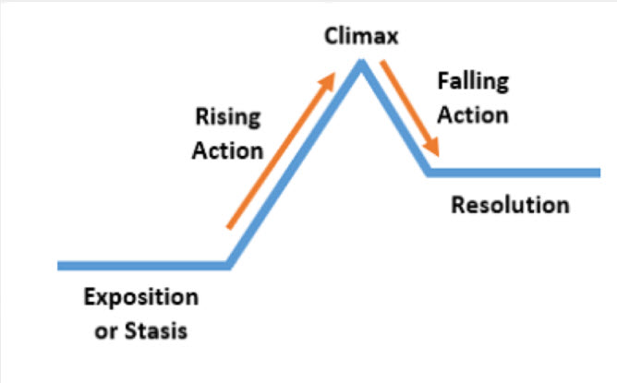
This shows the traditional narrative arc.
Nowadays, most stories focus on the rising action. For example, an action movie might start at the moment of crisis, rather than setting up the scene. With the rising action, you will often find:
The trigger: The event that sets the plot in motion.
The quest: How characters respond to the trigger.
The surprise: Any twist/turn/unexpected event.
The critical choice: The decisions of the main characters lead to the climax of the story.
Narrative arc

Slide 11
Let's Look At An Example of the Rising Action in the Narrative Arc
A movie released in 2013 starring Sandra Bullock and George Clooney as two astronauts stranded in space
TRIGGER: There is a debris shower as the astronauts are completing a space walk. They get detached from the space station and are floating in space.
QUEST: All the things they do to get back to the space station in the hopes of returning to Earth.
SURPRISE: They have just enough oxygen in reserve to steer their way back to the space station.
THE CRITICAL CHOICE: As they approach the space station, the astronauts have a collision and their safety tether (that was keeping them together) detaches. This causes George Clooney's character to start free floating again. Sandra Bullock's character risks losing her connection with the space station in order to save George Clooney's character. He decides to sacrifice himself by letting go of the tether so that Sandra Bullock's character can survive.
[Side note: If you've seen the movie, you'll know that this is only part of what happens. Once Sandra Bullock is back inside the space station, she still has to find a way to get back to Earth.]

Slide 12
Reflection
Go back to the freewrite. How many aspects of the narrative arc does the story you wrote in your freewrite have?
Photo by Pepe Reyes on Unsplash

Slide 13
Putting It All Together
Hopefully this lesson has given you some ideas for your blog. Storytelling will come up again this semester. When we return to the idea of persuasion, we will see how storytelling again helps us to persuade an audience. When we talk about oral presentations, we will again come back to telling stories.

