Slide 1
Listening To Give and Receive Feedback
Throughout your professional life, you will need to give and receive feedback about other people's writing. Your readings taught you about how to do a peer review. But in order to benefit from other people's feedback, and to give useful feedback, you'll also need to be a good listener.
In this session, we'll explore the role that listening plays and practice our listening skills.
Photo by Mimi Thian on Unsplash

Slide 2
Read this short excerpt, then think about how it might apply to the topic of listening:
A university professor went to visit a famous Zen master. While the master quietly served tea, the professor talked about Zen. The master poured the visitor’s cup to the brim, and then kept pouring. The professor watched the overflowing cup until he could no longer restrain himself.
“It’s full! No more will go in!” the professor blurted.
“This is you,” the master replied. “How can I show you Zen unless you first empty your cup?”
– Suler (2013)
Quoted in: Pulling Together: A Guide For Teachers and Instructors.

Slide 3
To practice listening, pick one of the following videos and watch it.
As you watch it, pay special attention to how you are listening.
Option #1: Want to Help Someone? Shut Up and Listen! This video is about how listening can benefit non-profits and entrepreneurs.
Option #2: Thich Nhat Hanh on Compassionate Listening. This video features a Buddhist monk talking about changing people's minds through listening.
Option #3: The Listening Stone: Dr. Susan Dion This video reflects on the importance of listening and hearing in her work.

Slide 4
Activity
Using either the blog that you're studying or a piece of your own work, see if you can find some of the principles we just discussed, such as:
Wordiness
Filler phrases
Vague language
Passive voice
Sentence fragments or run-on sentences
Jargon
Freewrite
Now, set a timer for 3 minutes and write about your experience with the TEDTalk. How did you listen? What barriers did you face to listening? (Distraction, composing an answer in your own mind, etc).

Slide 5
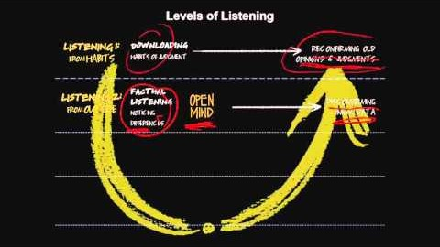
The Four Levels of Listening
Next, we're going to deepen our understanding of listening. Watch this short video clip by Otto Scharmer on the Four Levels of Listening.
https://www.youtube.com/watch?time_continue=3&v=eLfXpRkVZaI&feature=emb_logo

Slide 6
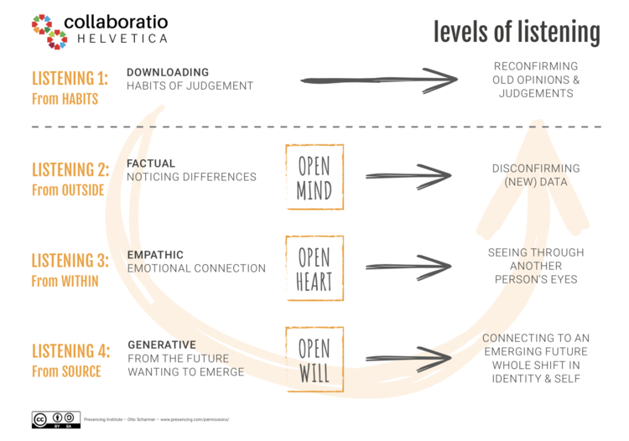
The Four Levels of Listening
This chart summarizes the four levels of listening you learned about in the video.
Source: https://www.collaboratiohelvetica.ch/blog/2020/1/15/4-levels-of-listening-theory-u-deep-listening-exercise

Slide 7
Let's Look at An Example
A teacher discovers that a student has copied and pasted material from the Internet into her assignment. She invites the student in to talk about it.
Let's start with the teacher's perspective:
Downloading: The teacher believes that students are all trying to cheat, and so listens for clues that confirms this belief. She leaves the conversation angry and doesn't believe the student's explanation.
Factual: The teacher expects to be angry, but hears the student express confusion about citation, which disrupts her idea that the student was intentionally cheating.
Empathic: The teacher listens as the student describes the situation. She can imagine how hard it must be to come to a new country and learn a new way of using sources.
Generative: Through listening to the student, the teacher can see that the student understands the subject matter and once she learns a few citation skills, she will be able to write excellent papers.

Slide 8
What about the student's perspective?
Downloading: The student believes that the teacher hates her, and interprets her expression as being hostile. She therefore becomes defensive and later tells her friends that the teacher singled her out for no reason.
Factual: The student notices that the teacher is giving her another chance to rework the assignment.
Empathic: The student can imagine that the teacher wants her to learn this important skill. Perhaps she can even imagine the amount of work it takes to grade a paper and meet with students.
Generative: The student listens to the teacher's explanation, and can imagine a time in the future where she learns citation. She can see that rewriting the assignment will give her time to practice citation to get it right.

Slide 9
Test Your Knowledge
Test your knowledge on the four levels of listening by completing this short quiz over the next three slides.
1. Downloading is…
When you listen to confirm what you already believe.
When you pretend to be someone else.
When you try to imagine someone else’s point of view.

Slide 10
2. When a coach listens to a player's struggle and can imagine how they will improve over the season, that's an example of:
Downloading
Generative listening
Empathetic listening

Slide 11
3. The difference between downloading and factual listening is that…
Downloading requires more empathy.
Factual listening is considered facts that you already know.
When you use factual listening, you are open to finding out information that doesn’t confirm what you already believe.

Slide 12
Check your answers
a
b
c

Slide 13
Activity
Using either the blog that you're studying or a piece of your own work, see if you can find some of the principles we just discussed, such as:
Wordiness
Filler phrases
Vague language
Passive voice
Sentence fragments or run-on sentences
Jargon
Activity
Now, try to apply what you've learned by listening to the first 2 minutes of the TEDTalk over again, using these skills.
Option #1: Want to Help Someone? Shut Up and Listen!
Option #2: Thich Nhat Hanh on Compassionate Listening
Option #3: The Listening Stone

Slide 14
Giving and Receiving Feedback
Now, let's think about what how we can apply what have learned about listening to the topic of giving and receiving feedback. Let's return to the idea of the master pouring tea into the cup. How can you make room for learning new things?
A useful peer review requires two things:
The person giving the review respects their partner. They're aware of their own position as a reader. They're not an expert trying to "fix" the piece, but just one reader offering their own perceptions. They're willing to learn something from the piece. A good reviewer also thinks about what the writer wants for the piece.
The person receiving the review is willing to listen. They're willing to move past defensiveness and consider their peer's opinion. If they disagree, they reflect on why they disagree.

Slide 15
Re-Vision
This brings us to the topic of revision. There is a common saying:The ear is a better editor than the eye.
Reading your work out loud is a great way to get new insight into your piece.
But revising also requires willingness to accept other people's points of view.
This requires emptying your metaphorical cup, and being willing to accept a new perspective on your work.
Photo by Aaron Burden from Pexels

Slide 16
Wrapping It Up
In this lecture, we've learned:
That listening is a valuable workplace skill.
That there are 4 levels of listening.
That practicing your listening skills can help you give and receive feedback more effectively.
That revision requires you to be open to a new way of thinking about a topic.
Photo by Christina Morillo from Pexels

