Slide 1

Risk Factors for
Dementia

Slide 2

What are risk factors?
Characteristics that increase your likelihood of getting a disease
  Lifestyle
  Environment
  Genetic
These do not cause the disease, but increase the chances of diagnosis.
Notes:
https://unsplash.com/photos/_af0_qAh4K4

Slide 3

Modifiable risk factors
Hearing loss
Hypertension
Obesity
Smoking
Poor sleep
Depression
Physical inactivity
Social isolation
Diabetes
Low education
Notes:
https://www.pexels.com/photo/upset-black-woman-touching-head-on-light-background-5699869/

Slide 4
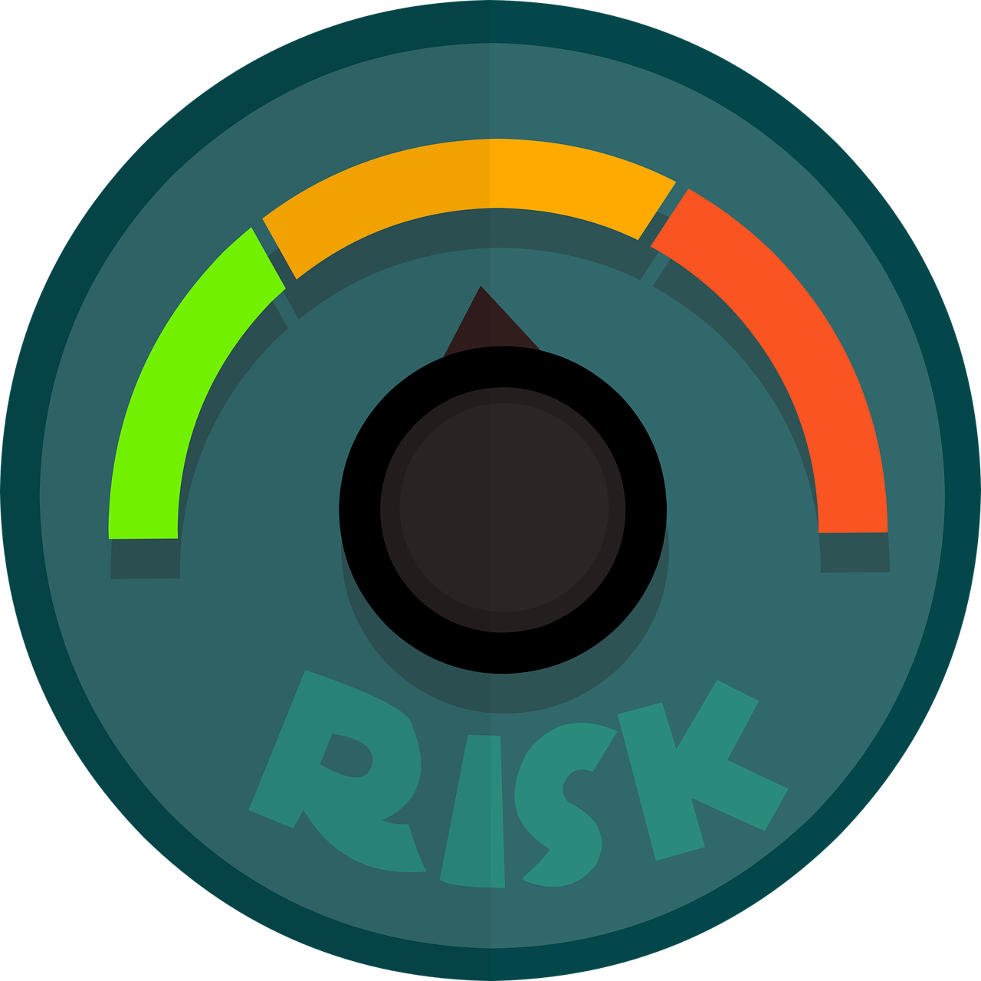
Modifiable risk factors
High Blood Pressure
  Effects the heart, arteries and circulation increasing the risks for vascular dementia
Poor Sleep
  Contributes to cognitive decline and dementia. (Spira et al., 2014)
Smoking
  Smokers have a 45% higher risk of developing dementia vs. non-smokers
Diabetes
  Doubles the likelihood of developing dementia
Notes:
https://pixabay.com/vectors/risk-risk-management-risk-assessment-3576044/

Slide 5
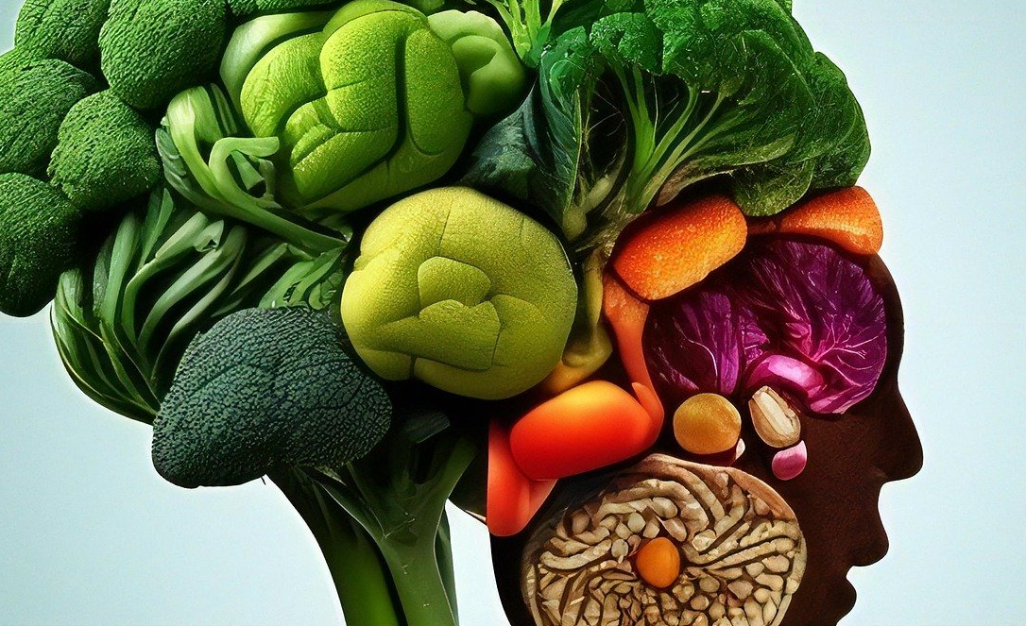
Modifiable risk factors
High Cholesterol
  Increased risk of developing hypertension, diabetes and dementia
  Drugs such as statins can lower the risk
Obesity and lack of physical activity
  Regular exercise can lower the risks
Poor diet
  Diets high in sugar, salt and saturated fats increase risk
Notes:
https://pixabay.com/photos/brain-salad-vegetables-dementia-7670395/

Slide 6
Other modifiable risk factors
Alcohol
  Drinking more than 21 drinks (for men) and 14 drinks (for women) increases risk
Low levels of formal education
  No high school education appears to increase risk
  Actively engaging one’s brain (as happens in higher education) creates a Cognitive Reserve that protects the brain
Depression
  Unclear whether this is a cause or a predictor of dementia

Slide 7

Other modifiable risk factors
Head injuries
  Severe or repeated head injuries can increase the risk
  Athletes in boxing, soccer, hockey, and football
Hearing loss
  Mild hearing loss can increase the risks of cognitive decline and dementia
Social isolation
Notes:
https://pixabay.com/photos/dementia-alzheimers-dependent-3051832/

Slide 8

Non-modifiable risk factors
Age
  Dementia is not a normal part of aging
  1 in 20 Canadians over age 65 has Alzheimer’s disease.
  Risk of developing Alzheimer’s disease doubles about every five years for people over 65
  25% of Canadians over 85 have Alzheimer’s disease.
Notes:
https://www.pexels.com/photo/man-in-black-jacket-wearing-black-headphones-3831645/

Slide 9


Non-modifiable risk factors
Gender
  Women are at higher risk than men
  Risks are not the same for all types of dementia
Genetics
  Over 20 genes appear to increase the chance of developing Alzheimer’s disease
  PS1, PS2, and APP seem to cause Alzheimer’s disease
Notes:
https://pixabay.com/vectors/frame-gender-girl-boy-emblem-2028075/
https://pixabay.com/vectors/dna-icon-gene-helix-double-helix-2316641/

Slide 10
Non-modifiable risk factors
Parkinson’s disease, multiple sclerosis, chronic kidney disease and HIV increase the risk of developing dementia
Disorders such as Down’s syndrome also increase the risk of early onset dementia

Slide 11
References
Alzheimer-Society-Canada. (2022). Navigating the path forward for dementia in Canada- Report 1. https://alzheimer.ca/sites/default/files/documents/Landmark-Study-Report-1-Path_Alzheimer-Society-Canada.pdf
Boscart, V., McCleary, L., Taucar, L. S., Touhy, T. A., Jett, K. F., & Touhy, T. A. (2023). Ebersole & Hess' Gerontological Nursing & Healthy Aging in Canada (3rd edition). Elsevier Canada.
Jacklin, K. M., Walker, J. D., & Shawande, M. (2013). The emergence of dementia as a health concern among First Nations populations in Alberta, Canada. Canadian Journal of Public Health, 104, e39-e44.
Sabia, S., Fayosse, A., Dumurgier, J., Dugravot, A., Akbaraly, T., Britton, A., ... & Singh-Manoux, A. (2018). Alcohol consumption and risk of dementia: 23 year follow-up of Whitehall II cohort study. bmj, 362.
Spira, A. P., Chen-Edinboro, L. P., Wu, M. N., & Yaffe, K. (2014). Impact of sleep on the risk of cognitive decline and dementia. Current opinion in psychiatry, 27(6), 478.
National Institute on Aging. (2016). Does poor sleep raise risk for Alzheimer's disease? https://www.nia.nih.gov/news/does-poor-sleep-raise-risk-alzheimers-disease

Slide 12

Thank You
Notes:
https://pixabay.com/illustrations/meeting-meet-together-collaboration-1015313/

