Slide 1
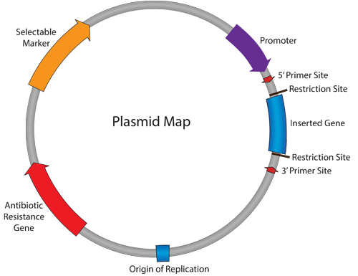
Chapter 6:Plasmids
Part 1: What are plasmids and what features are important?
http://www.addgene.org/mol-bio-reference/plasmid-background/

Slide 2
Vector (molecular biology, collective term)
Vehicle used to transfer genetic material to a target cell
Target cells typically propagate the vector
MANY identical copies of the vector and its inserted genetic material can be collected – this is the cloning part
The term “vector” can be applied to: plasmids, viruses, artificial chromosomes, and other means of introducing DNA into cells
We will focus on plasmids in our course

Slide 3
Terminology (capitals in some words is the syllable that is emphasized)
“INsert” (noun) means the piece of DNA you are cloning into the plasmid
“inSERT” (verb)
“vector” refers to the plasmid
”plasmid” small (compared to the bacterial chromosome) circles of DNA in a bacterial cell, that replicate autonomously and are non-essential for survival under non-selective conditions
“CONstruct” (noun) the insert plus vector combination you are trying to make
“ConSTRUCT” (verb) making something.
“WE are going to inSERT the INsert into our plasmid in order to conSTRUCT the CONstruct

Slide 4
Replication of plasmids
The replicon of a plasmid contains
origin of replication (ori), typically an A/T-rich region
at which replication starts
2. gene(s) encoding protein(s) that regulate replication
Genes on the bacterial chromosome may or may not
be required for replication.
Replication can occur by different mechanisms depending
on the plasmid (not important in this context)

Slide 5
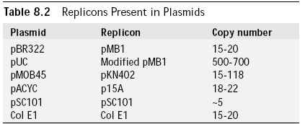
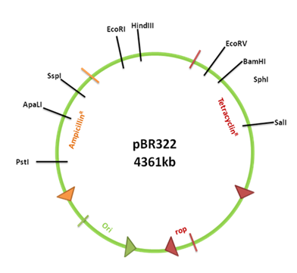
Replication of plasmids
The replicon has genes that encode proteins that regulate the number of plasmids/cell
Different replicons results in different numbers of plasmids/cell
Example: Loss-of-function mutation in the Rop gene of the pMB1 replicon results in a much larger number of plasmids/cell.
This results in a high-copy replicon, which is often used in gene cloning.

Slide 6
Copy number of plasmids/cell
Two categories
Low copy # plasmids
limited #, down to 1/cell
can have genes regulating replication
usually large plasmids (up to 200 kb)
single copy plasmids have replication
and segregation during cell division
regulated similarly to chromosomes
High copy # plasmids
up to many hundreds/cell
limited control of replication
usually small (2-20 kb)
deletion of gene(s) from low copy
plasmid can result in high copy
plasmid
used extensively in gene cloning

Slide 7
Host range of plasmids
Determined by the extent that replication depends on host components
and whether a host’s replication machinery is compatible with ori sequences
two categories
Broad host range plasmids
encode most to all proteins required for replication on the plasmid
ex. P-family plasmids can survive in hundreds of species
promiscuous or relaxed plasmids
some are responsible for multiple antibiotic resistance
useful for expression of genes in various species (“shuttle” vectors)
Narrow host range plasmids
can replicate in only one or few
related species
ex. ori from Col E1 replicate
only in some enteric bacteria
species
commonly used high-copy #
plasmids have narrow host
range

Slide 8
Plasmid naming
pBR322
number of particular construct
plasmid,
lower case
plasmid named after your own taste
In this case after people that made it; Bolivar and Rodriguez
Notes:
Versatile – implies they can be used for a variety of purposes such as subcloning, making probes, sequencing…

