Slide 1
Chapter 6:Plasmids
Part 1B: Common features and types of plasmids
http://www.addgene.org/mol-bio-reference/plasmid-background/

Slide 2
Common elements of simple cloning plasmids
Replicon , including ORIgin of replication (ORI)
Described before
Antibiotic Resistance Gene
Allows for selection of plasmid-containing bacteria.
Multiple Cloning Site (MCS) aka polylinker
Short segment of DNA which contains several restriction sites allowing for the easy insertion of DNA.
Insert
Gene, promoter or other DNA fragment cloned into the MCS for further study.
from: http://www.addgene.org/mol-bio-reference/plasmid-background/

Slide 3
Common elements of simple cloning plasmids
Promoter Region
Drives transcription of the target gene. Vital for expression vectors: determines which cell types the gene is expressed in and amount of recombinant protein obtained.
Selectable Marker (usually also antibiotic- resistance gene, to be used in different organisms)
The antibiotic resistance gene allows for selection in bacteria. However, many plasmids also have selectable markers for use in other cell types.
Primer Binding Site
Short sequence shared by many plasmids,
Primers matching these sequences are used for sequencing of DNA inserted into MCS
from: http://www.addgene.org/mol-bio-reference/plasmid-background/

Slide 4
Types of Plasmids
The combination of elements often determines the type of plasmid. Below are some common plasmid types
Cloning Plasmids - for cloning of DNA fragments. Tend to be very simple, often containing only a bacterial antibiotic resistance gene, ori and MCS. They are small and optimized to help in the initial cloning of a DNA fragment.
Expression Plasmids - Used for gene expression. Expression vectors must contain a promoter sequence as well as a transcription terminator sequence, and the inserted transcription unit/ORF.
Gene knock-down Plasmids - Used for reducing the expression of an endogenous gene. This is frequently accomplished through expression of an RNA targeting the mRNA of the gene of interest (RNA interference)

Slide 5
Types of Plasmids
The combination of elements often determines the type of plasmid. Below are some common plasmid types
Reporter Plasmids - for studying the function of genetic elements. These contain a reporter gene (for example, GFP) that offers a read-out of the activity of the genetic element. For instance, a promoter of interest could be inserted upstream of the GFP gene to visualize with green fluorescence where in an organism the gene normally harboring the promoter is expressed
Viral Plasmids - These use technology evolved by viruses to aid in delivery of genetic material into target cells . You can use these plasmids to create viral particles, such as lentiviral, retroviral, AAV, or adenoviral particles, that can infect your target cells at a high efficiency.
from http://www.addgene.org/mol-bio-reference/plasmid-background/

Slide 6
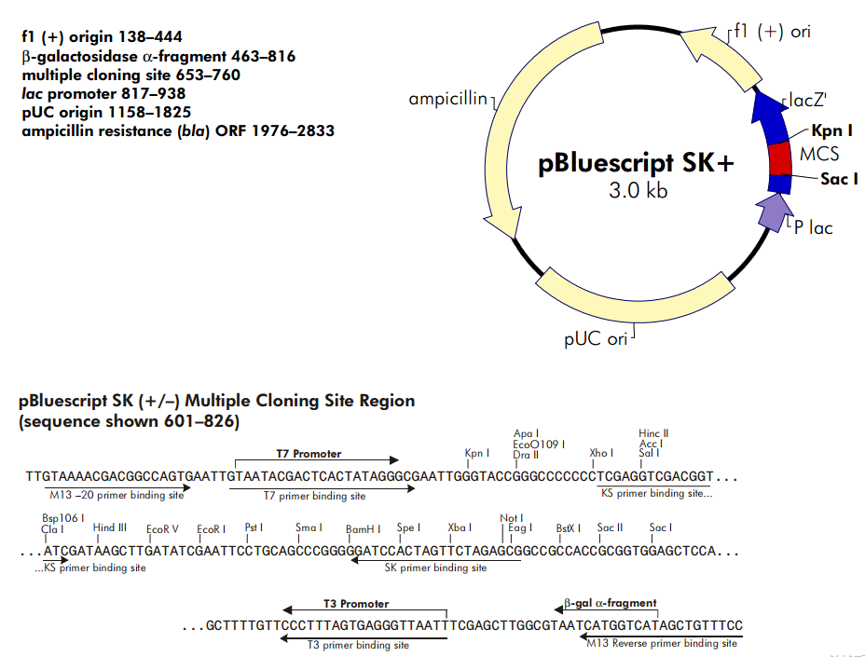
A plasmid derived from pUC
Full size 2961 bp

