Slide 1
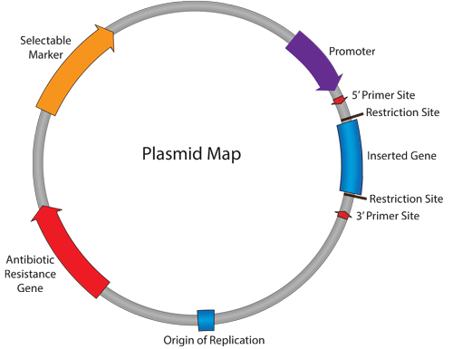
Chapter 6:Plasmids
Part 3: How do we select colonies that probably have inserts?
http://www.addgene.org/mol-bio-reference/plasmid-background/

Slide 2
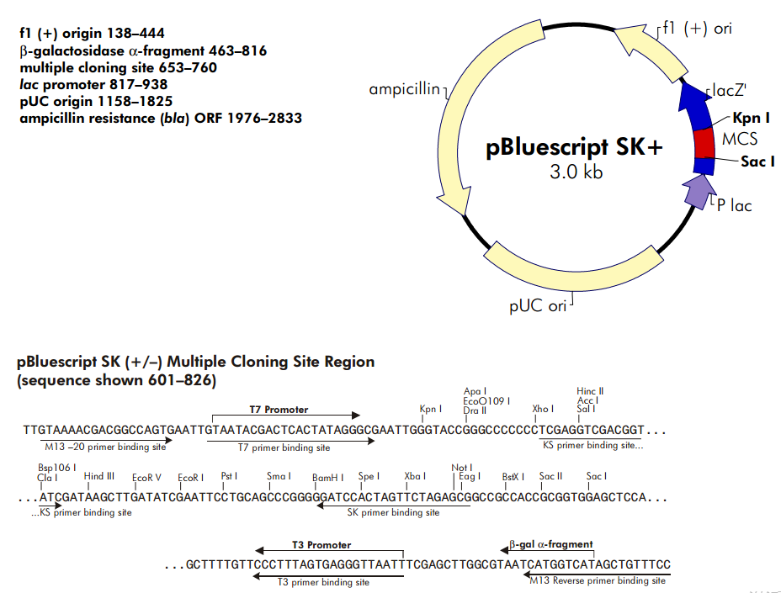
The plasmid that you will use next week
Full size 2961 bp

Slide 3
Terminology: Getting DNA into cells
Transformation
The uptake of DNA by bacterial cells
can be induced artificially
Need to have competent cells!
Transduction
Introduction of DNA by viruses
Transfection
The uptake of DNA by eukaryotic cells in tissue culture

Slide 4
Selection
Transformation is inefficient
Fewer than 0.01% of cells will take up plasmid (~1/10,000)
How can you identify colonies with plasmid?
antibiotic selection for resistant cells due to detoxifying enzyme produced by plasmid gene. Resistant cells divide and form colonies
untransformed cells (great majority of cells) cannot divide/die
How can you identify colonies with plasmids that have insert in the MCS?
We like to use blue-white screening based on α-complementation
Follow up with endonuclease digest of purified plasmid to
confirm presence of insert

Slide 5
Antibiotic resistance
(ampicillin resistance) through gene encoding the enzyme beta-lactamase)
MCS; Allows for blue /white screening for colonies with plasmids
Incubate overnight
at 37 C
Re-streak colonies on new plates to obtain pure culture
Or, pick well isolated white colonies (clones) to inoculate broth culture for plasmid purification
Spread transformed E. coli cells on LBA plates with ampicillin and X-gal
Notes:
Antibiotic resistance – resistance is provided by an enzyme Beta-lactamase (bla) which breaks down Beta-lactam ring structure of Beta-lactam antibiotics (Penicillin group of antibiotics)
lacZ: The polylinker in the MCS is in frame with the lac Z reading frame – it simply adds on a few extra amino acids to the amino terminal of the protein, but the beta-galactosidase is still functional
Insertional Inactivation
lacZ: can insert YFG (your favourite gene) into MCS – disrupts lac Z which allows for blue white selection with X-gal substrate
disrupted lac Z won’t produce blue substrate from X-gal and therefore appear white!
However! If YFG is relatively small and does not cause a frame disruption it is possible to have blue colonies with inserts
Also, A white colony is not a guarantee that you have what you want! Insertion of undesirable fragments or deletions in the plasmid can give false positives. Examples of undesirable fragments can include multiple inserts

Slide 6
Blue-white screening based on α-complementation
of a defective β-galactosidase protein
(encoded by the LacZ gene)
E. coli cell
of strain used
in lab
X
circular chromosome
with deletion of fragment
encoding amino acids 1-146
in the Lac Z gene
(lacZΔMI5 ). This generates a
β-gal peptide missing the
α- fragment.
Plasmids that have the gene for the α fragment of LacZ gene encoding
amino acids 1-146.
This generates the α- fragment
of the β-gal peptide.
The two parts of the β−gal protein come together to make
a functional enzyme complex

Slide 7
Blue White screening for plasmids with inserts in MCS based on α-complementation
IPTG, a lactose analog
is added to the media to
inactivate the lac repressor
→ Expression of the lac Z operon
α-fragment
of the Lac Z
protein
Proteins from genomic
fragment and α-fragment
complement each other,
forming a functional
enzyme.
If a gene is inserted in the
MCS, a defective α-fragment will be
produced (insertional inactivation)
unable to convert X-gal into blue product
white colony, indicating plasmid with insert in MCS
Figure is available from wikipedia by Dylan2106 (2007)
http://en.wikipedia.org/wiki/File:Blue_white_assay_Ecoli.jpg
Notes:
The strains of E. coli used for blue white selection has a deletion in the Lac Z operon which expresses the enzyme Beta galactosidase
This enzyme normally cleaves disaccharides, such as lactose into monosacharides
The deletion in the host cell chromosome prevents the enzymes from cleaving dissacharides
However, if the deleted portion, Lac Z’, is carried on plasmid vector a functional enzyme complex will form through a process called alpha complementation
When Lac Z’ is expressed from the plasmid, the peptide will complex with the inactive fragment of Beta-galactosidase to form a functional enzyme complex
The MCS on the plasmid is included in the Lac Z’; so if a gene is inserted in the MCS it will disrupt the LacZ’ fragment from forming properly
X-gal is a chromogenic substrate for Beta-galactosidase that will form a blue coloured product upon hydrolysis
So if the native plasmid transforms cells, they will appear blue b/c active enzyme complex will cleave the X-gal
Alternatively, if a plasmid with an insert in the MCS is in the cells, they will be less likely to produce a functional Beta-galactosidase complex and the colonies will appear white

Slide 8
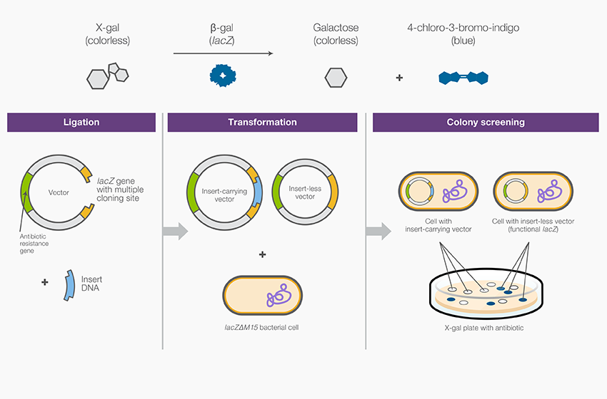
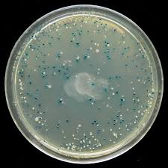
empty vector
Figure from Thermo Fisher Scientific

Slide 9
Transformation efficiency
Count the colonies
Figure out how much vector that plate represents (see chapter 6 for details of how to do this)
Divide the colony # by the amount of vector and convert to colonies per μg of vector
Then pick some white colonies to grow in liquid culture and isolate the plasmids next day

