Slide 1
Chapter 6
Restriction enzyme cloning
Gene
Restriction Endonuclease
Gene
Plasmid 1
Plasmid 1
Gene
+
Gene
Restriction Endonuclease
Plasmid 2
Ligation

Slide 2
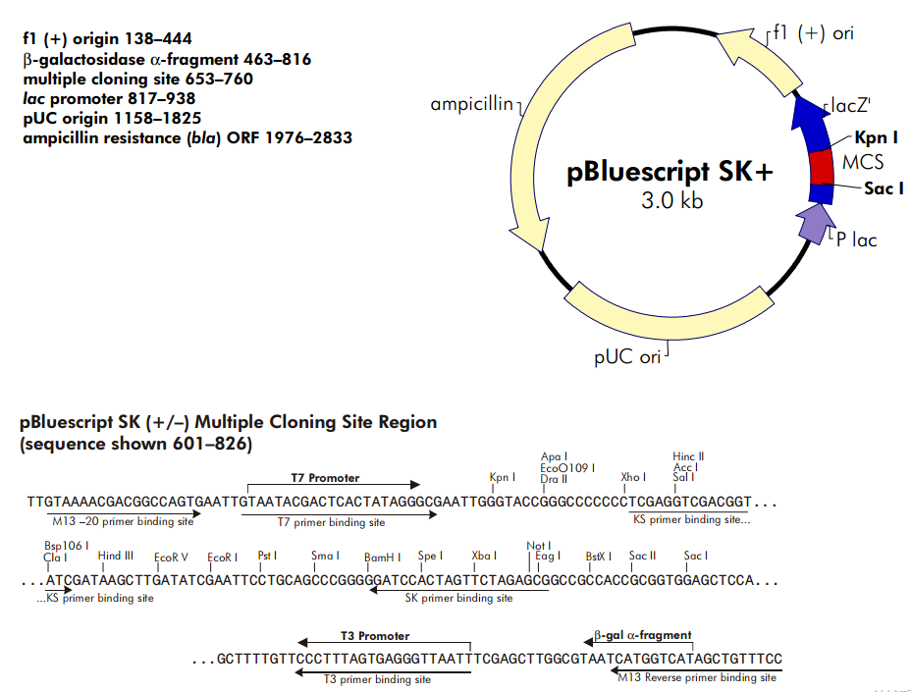
A plasmid used for blue-white selection
Full size 2961 bp

Slide 3
Cloning in plasmid vector
DNA fragments
or genes of interest
Endonuclease
Endonuclease
Plasmid
Chromosomal DNA
DNA Recombination
Ligase joins single fragments with compatible overhangs
Into individual plasmids
Transformation
Bacterial Cells
Each cell
contains only
one type of plasmid
Transformed
bacteria with
recombinant
plasmids
Animation modified from Juang RH (2004) http://juang.bst.ntu.edu.tw/BCbasics/Animation.htm
Notes:
Cloning animation modified from Juang RH (2004) Bcbasics ppt

Slide 4
Cloning!
Cells are diluted so individual cells are
isolated on solid media
1
Spread
Plating
Individual cells divide to form
Colonies
1 colony = clone = cell line
X100
Plasmid
Replicates
Independently in
bacteria
X100,000
Pick the colony
containing genes
or DNA of interest
Animation modified from Juang RH (2004) http://juang.bst.ntu.edu.tw/BCbasics/Animation.htm
Notes:
Cloning animation modified from Juang RH (2004) Bcbasics ppt

Slide 5
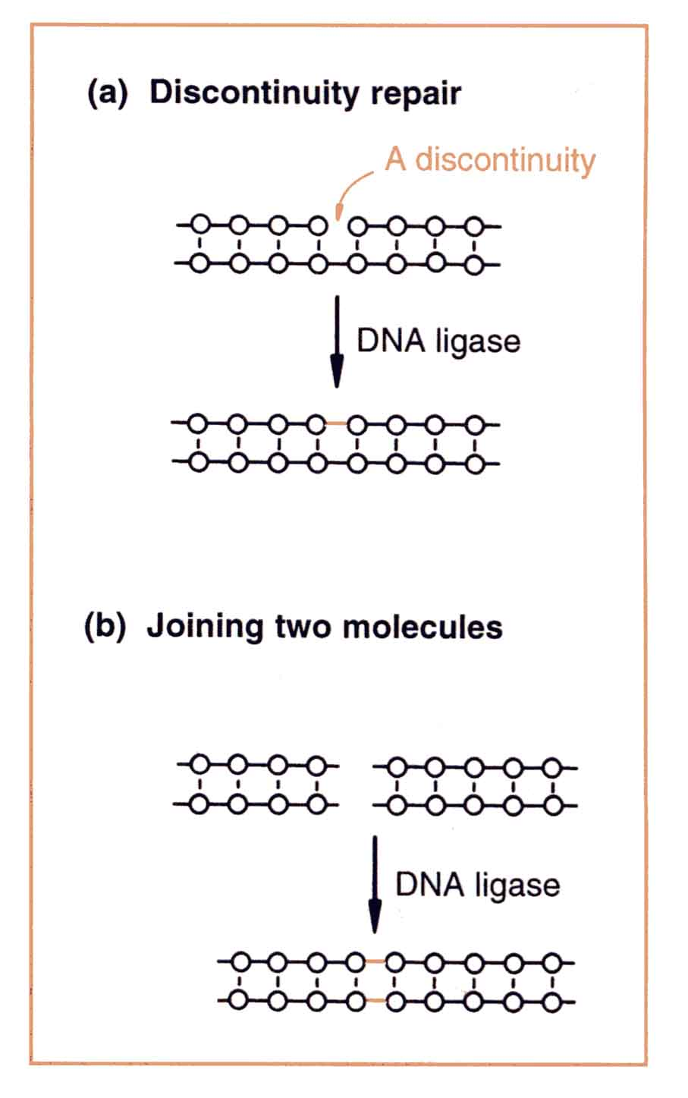
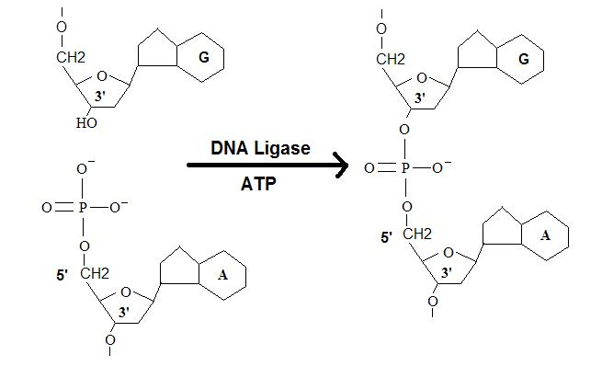
Ligases,
catalyze the joining of a 3’ hydroxyl of one nucleotide with the 5’ phosphate of another nucleotide resulting in covalent phosphodiester bond
join discontinuities (nicks) in single strands
join ends of two molecules

Slide 6
Common misconception:
Many people believe that ligase physically joins the two strands together.
This is wrong!
Ligase adds AMP to the 5’ phosphate, thereby activating it.
Upon contact, the ends join spontaneously and in the absence of ligase.

Slide 7
1. Adenylation of DNA ligase
A lysine in the ligase forms a bond with Adenosine triphosphate (ATP),
and then ATP releases two phosphate groups to become
an AMP-ligase complex (Kahn, 2003).

Slide 8
2. Activation of 5’ phosphate
The monophosphate of the AMP-ligase complex forms a bond
with the 5’ phosphate of the broken strand.
This bonding activates the 5’ phosphate group and releases ligase

Slide 9
3. Attack of 3’ OH on 5’ P connects the broken strand and releases AMP
Now that the 5’ phosphate has been activated by the AMP-ligase complex,
the 3’ hydroxyl group attacks the 5’ phosphate and forms a new bond,
releasing the AMP.

Slide 10
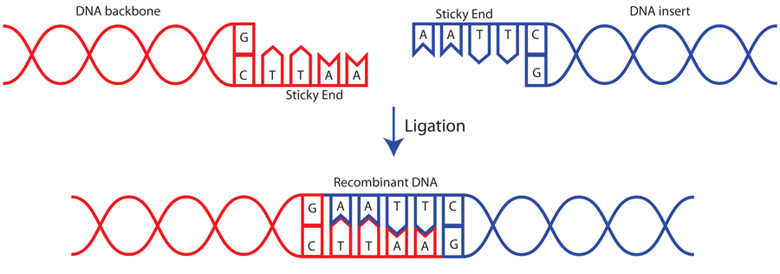
Sticky or Cohesive end ligation
- connect two cohesive ends together
- The hydrogen bonds between the complementary bases hold the
two ends together, increasing the chances of ligation
- base-pairing lasts longer at lower temp/ longer overlap/ high GC
content of overlaps → higher rate of ligation in a population of ends
hydrogen
bonds
AMP activated phosphate
(by ligase) results in covalent
phosphodiester bonds
in backbone
Figure from http://www.addgene.org/plasmid-protocols/dna-ligation/

Slide 11
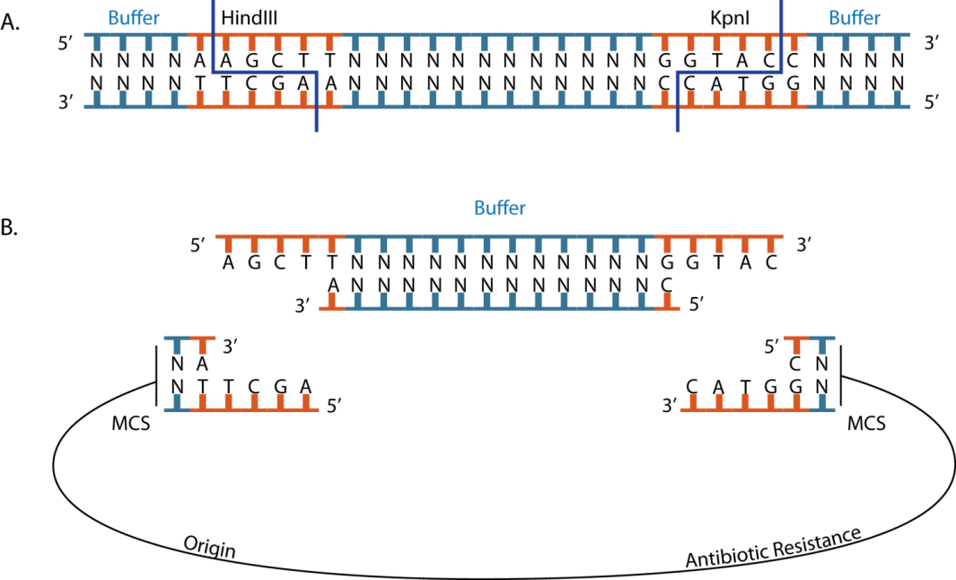
Fragments generated by cutting with two enzymes can be ligated into a plasmid
that also has been cut with the same enzymes
Many plasmids have multi-cloning sites (MCS) with recognition sequences for
commonly used restriction endonucleases, to be used for this purpose.
Advantages:
allows fragment to be ligated in one
direction only
prevents self-ligation of vector
(since sticky ends of
vector are incompatible)

