Slide 1
CHAPTER 9. DNA Sequencing I The Sanger method
https://www.illumina.com/techniques/sequencing/dna-sequencing.html
DNA sequencing is the primary method for gene and protein characterization
(protein sequence can be predicted from DNA sequence).

Slide 2
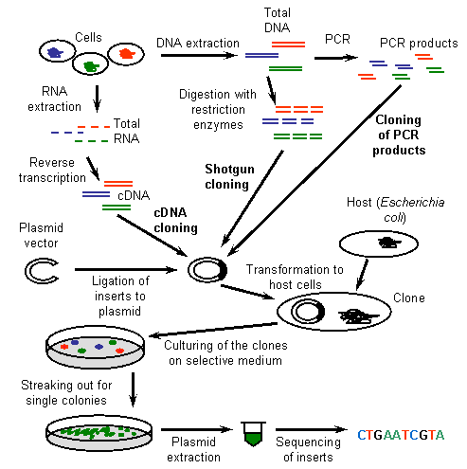
DNA sequencing is done either as an end product to see what sequences the samples
contain, or as a confirmatory step before proceeding to genetic engineering
http://wiki.biomine.skelleftea.se/biomine/molecular/index_10.htm

Slide 3
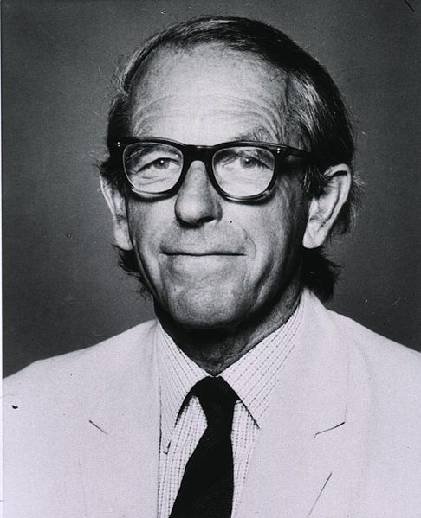
Frederick Sanger (1918- 2013)
British biochemist
Twice the recipient of the Nobel Prize for Chemistry.
1958 "for his work on the structure of proteins, especially that of insulin“
1980 Walter Gilbert and Sanger shared half of the chemistry prize "for their contributions concerning the determination of base sequences in nucleic acids.”
/Wikipedia
http://www.sanger.ac.uk/

Slide 4
Examples of genomes sequenced with Sanger technology
Human
Model organisms
- mouse
- yeast
- E. coli
- Drosophila melanogaster (fruit fly)
- Ceanorhaditis elegans (nematode)
- Arabidopsis thaliana (plant)
cDNA libraries, genomic clones of endless # organisms

Slide 5
DNA fragments are sequenced using primers that anneal to the plasmid at either side of the multi-cloning site. (some are commonly used and commercially available e.g. M13 forward and reverse, T3 and T7)
Sequencing from one direction will sequence one end of fragment and one strand of fragment
Sequencing from the other direction gives the sequence of the other strand
In general we prefer to do two sequences, one from each direction, to have confirmation of the sequence
Sequencing primer
Sites flank MCS

Slide 6
Common practice
Purify plasmid
Send two aliquots of same plasmid to company for sequencing ask them to sequence inserted fragment:
aliquot 1. using primer M13 forward (matching one strand on one end of MCS)
aliquot 2 using primer M13 reverse (matching other strand, on other end of MCS
Company will use these primers as starting points for sequencing, and return DNA sequence read (700-1000 bases) in a few days (for $5/sequence read)
DNA SEQUENCING IS STANDARD PROCEDURE. EMPLOYS MANY PEOPLE
HOW DOES IT WORK?

