Slide 1
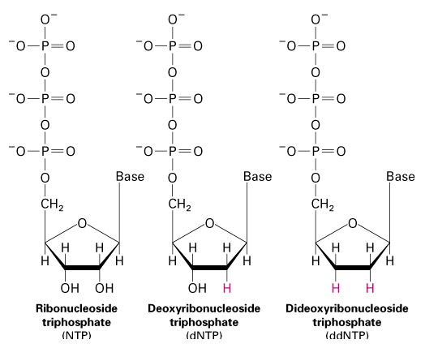
Sanger sequencing Method is based on DNA synthesis in the presence of low concentration of ddNTPs, terminating synthesis
Also called
Dideoxynucleotide sequencing
Chain termination sequencing
Nucleotide vs nucleoside
Nucleoside = Sugar + Base Nucleotide = Sugar + Base + Phosphate
3’ hydroxyl group is required for DNA synthesis
DNA synthesis will terminate with the incorporation of a dideoxynucleotide
(dideoxy = lacking two oxygens)

Slide 2
Principle of Sanger sequencing Sanger et al (mid 70s)
Technique based on DNA synthesis:
requires single-stranded template (to be sequenced), usually accomplished by denaturing plasmid into single-stranded DNA
requires a primer (why?)
requires a DNA polymerase (Klenow or Taq pol)
dependent on incorporation of dideoxynucleotides
dideoxynucletides do not have a 3’OH
Termination of DNA synthesis
Notes:
There is another method called Maxam-Gilbert sequencing which was historically important but is now obsolete
As this is not currently very important we will not cover it in the course
We will look at some new next generation sequencing developments that are not all covered in the text
These are particularly relevant to genome sequencing

Slide 3
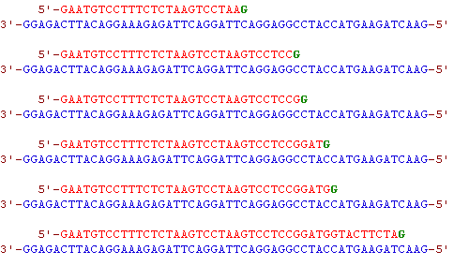
If a specific dideoxy nucleotide (in this case ddGTP) is present at low concentration, together with higher concentration of dNTPs, DNA synthesis will result in subpopulations of synthesis products, each terminating at the position of the dideoxy nucleotide.

Slide 4
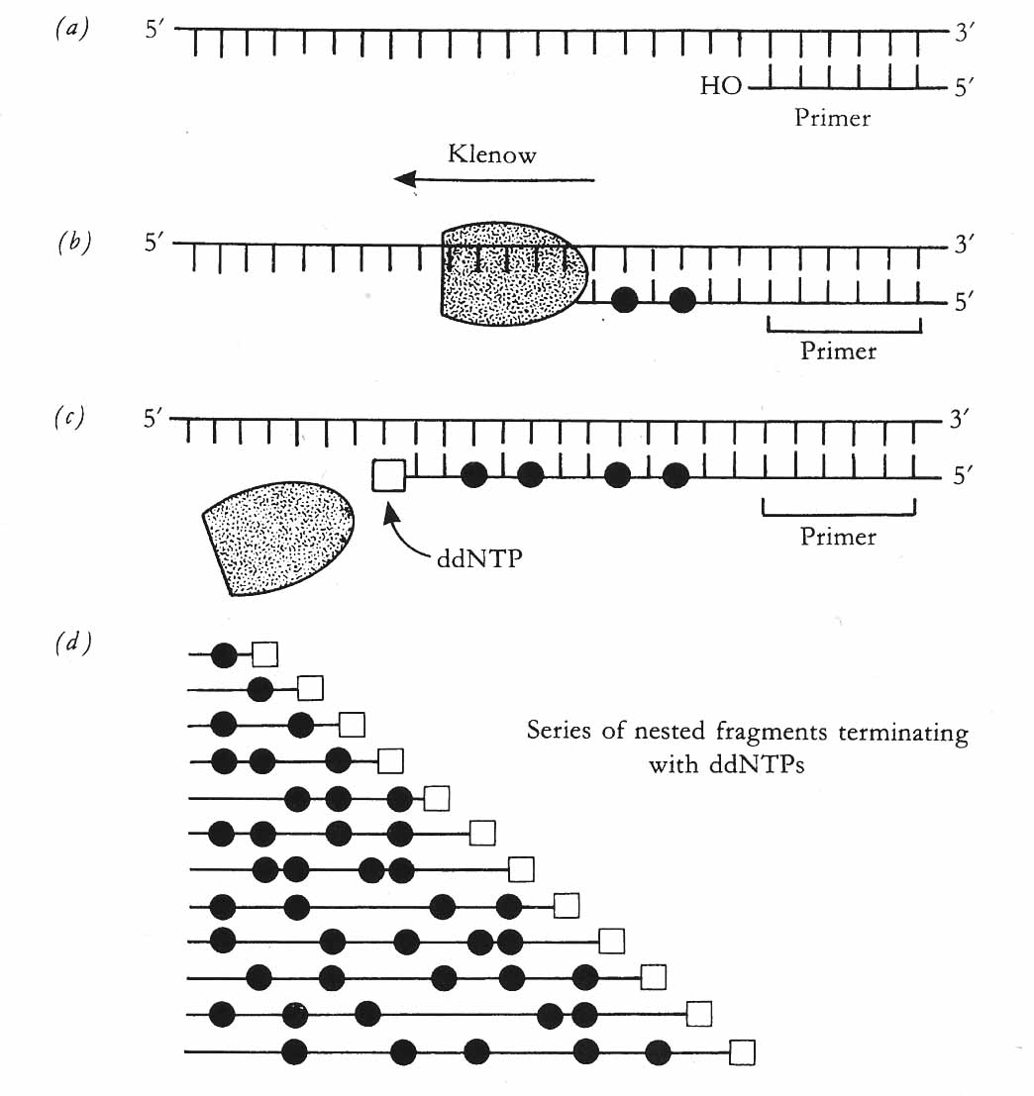
How it started: Sanger sequencing with isotope-labeled nucleotides
= isotope-labeled dCTP
= ddNTP (dideoxy NTP)
All four dNTPs are included
Four separate reactions are set up
Each has a different ddNTP at low conc.
ddATP
ddTTP
ddCTP
ddGTP
Klenow will incorporate dNTPs
until a ddNTP is incorprated,
terminating synthesis
DNA is denatured and the four samples
are loaded next to each other and DNA separated on PAGE gel

