Slide 1
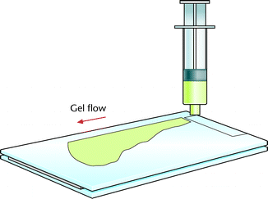
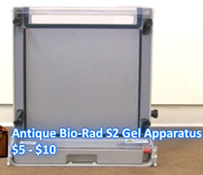
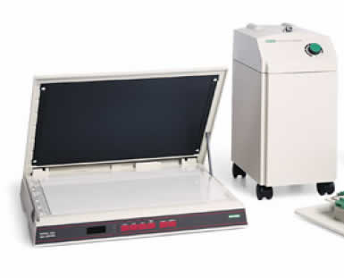
After synthesis, a polyacrylamide gel was cast
Acrylamide is neurotoxic until polymerized

Slide 2
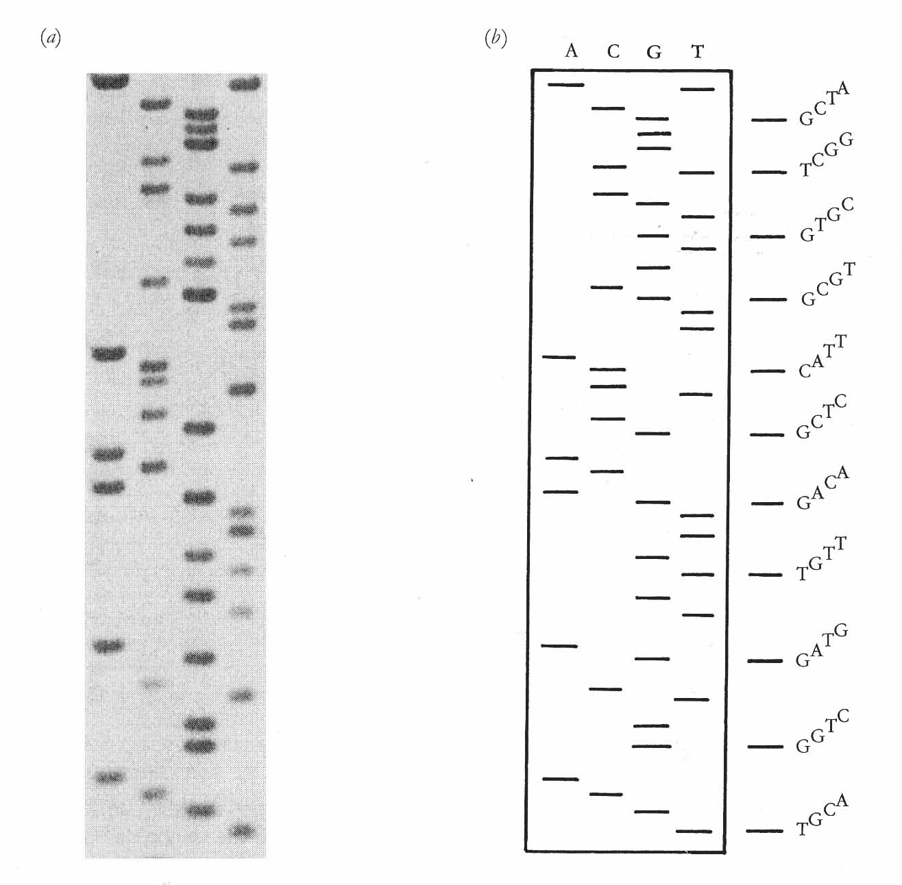
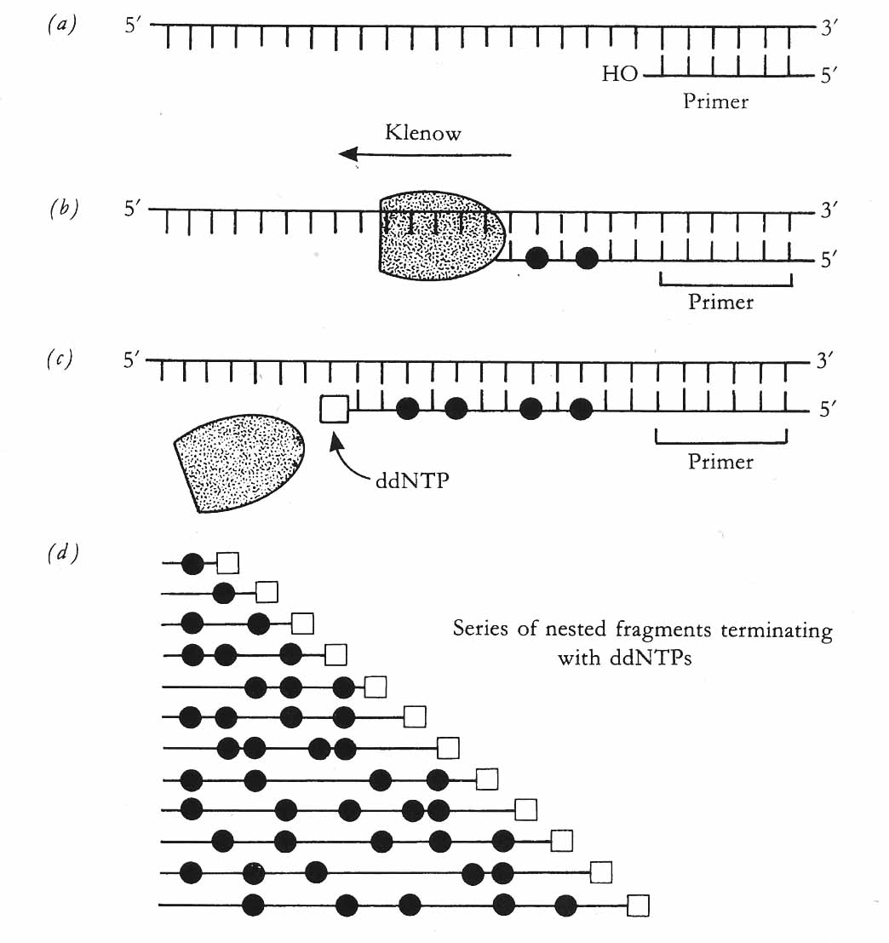
The terminated fragments are separated according to size on the gel.
After electrophoresis, the gel is dried and exposed to photographic film.
The decay of Isotope-labeled dCTP (filled circles) produces photons, that blacken the film.
PAGE allows us to distinguish DNA fragments that differ in size by only one base pair
large
small

Slide 3
A
C
G
T

Slide 4
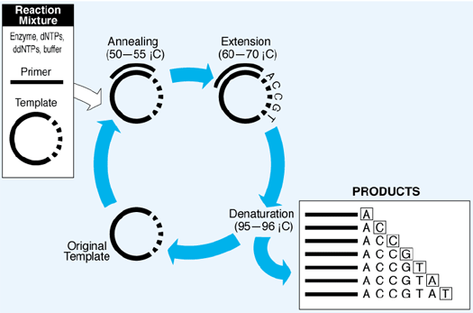
1980s: Linear PCR is used to generate more products from less template
Cycle sequencing is a simple method in which successive rounds of denaturation, annealing, and extension in a thermal cycler result in linear amplification of extension products.
From applied biosystems.com

