Slide 1
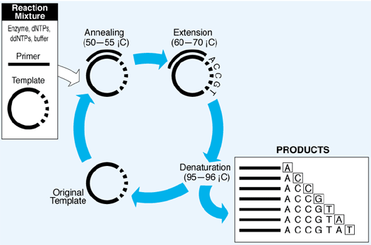
1980s: Linear PCR is used to generate more products from less template
Cycle sequencing is a simple method in which successive rounds of denaturation, annealing, and extension in a thermal cycler result in linear amplification of extension products.
From applied biosystems.com

Slide 2
Current Sanger sequencing use dideoxy terminators that have different fluorescent dyes attached
From Applied Biosystems
Dyes are attached to the ddNTPs
Only one reaction tube per sample, instead of four (isotope method)
Fluorescent fragments are generated by incorporation of dye-labeled ddNTPs.
Each different dideoxy nucleotide (ddATP, ddCTP, ddGTP, or ddTTP) carries a different colored dye.
All terminated fragments (those ending with a ddNTP) contain a dye at their 3’ end
Only one lane/sample on gel, instead of four (isotope method)

Slide 3
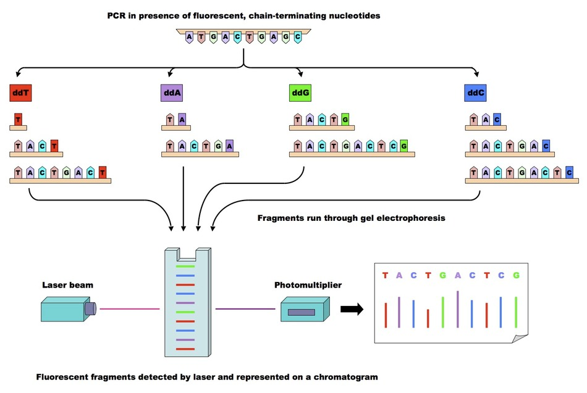
Overview of procedure
Tube contains all four fluorescently labelled dideoxynucleotides
Linear PCR is used to generate multiple rounds of terminated fragments
Sample is loaded in one capillary

Slide 4
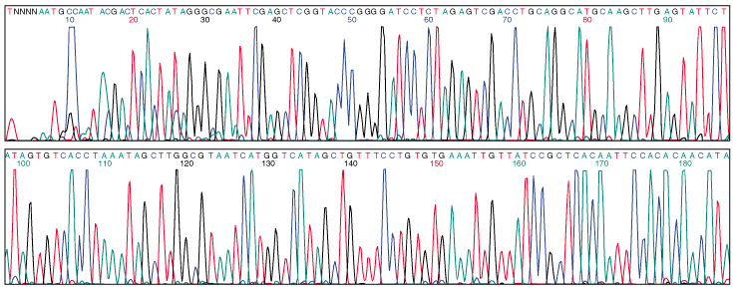
The output of the detector can be sent directly to a computer and the DNA sequence recorded (in real time) as the gel is being run…
Example of output:

