Slide 1
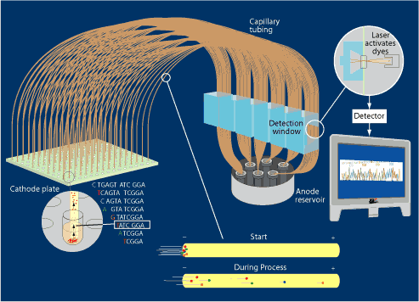
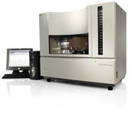
Automated capillary electrophoresis
Each sequencing machine can run 384 samples (lanes) through its 384 capillary tubes at one time.
Automated loading
and recording.
http://www.jgi.doe.gov/sequencing/education/how/how_10.html
Notes:
The sequencing systems have been automated
The electrophoresis is often done through capillary gels
Faster and provides better resolution between different sized bands than conventional slab gels
As the fragments move through the gel they pass a laser which excites the fluorophore
The wave length (colour) of the fluorescence is then determined by a detector which reads the base

