Slide 1
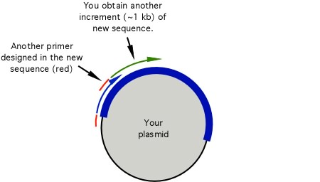
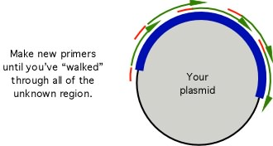
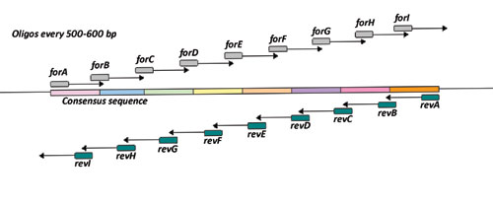
Primer walking to sequence inserts longer than 1 kb
The length of sequence from a single run is limited
The sequence becomes progressively less reliable with increasing fragment size
Sequences > 1kb are too big for single sequence read!
Primer walking can be used to extend sequence
Involves additional primers designed from first sequence obtained
Disadvantage:
Takes time
Need to keep designing primers
Used for 1-10 kb fragment of importance
Notes:
Sequence becomes progressively less reliable with size of sequence
Larger fragments are not resolved well on gels
The amount of product in each fragment is reduced making the signal weaker
The probability that synthesis will stop due to ddNTP incorporation becomes greater with increased fragment size!
The likelyhood that synthesis stops due to secondary structure also increases
Primer walking can be used to extend sequences
This involves designing additional primers based on the sequence already obtained
This techniques is attractive for sequences up to about 7 kb but gets tedious if working with larger sequences

Slide 2
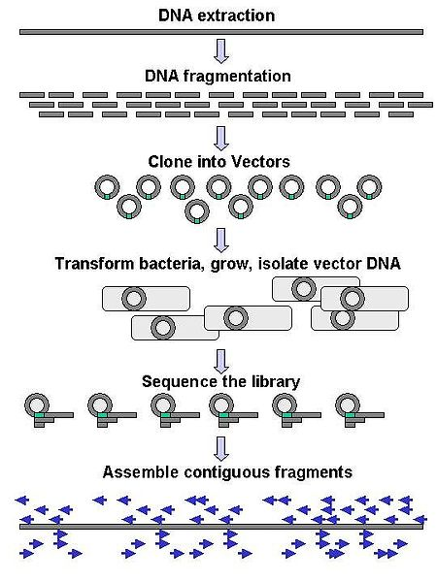
Shotgun Sequencing Longer Fragments
Can break up large pieces of DNA into sizes suitable for sequencing
Essential to have overlapping fragments
Shotgun sequencing
At the start you don’t have any idea where each bit of sequence comes from
Contiguous sequence assembly
Computer algorithms compare sequences from clones and assemble sequence based on overlaps
Figure is available from wikipedia by Abizar (2007)
http://en.wikipedia.org/wiki/File:DNA_Sequencing_gDNA_libraries.jpg
Notes:
DNA is broken up into random overlapping fragments and cloned into suitable vector
Essentially like making a genomic library
Clones are then sequenced in what is often termed shot-gun sequencing
The term is derived from the fact that a shot-gun’s shot scatters in the hope of hitting the target
In this case the clones are randomly sequenced in the hope of assembling a contiguous sequence
Where there is an overlap, those fragments will be joined together to form a “contig”
There are diminishing returns when it comes to sequencing; the first 90% of the sequence can take as long to assemble as the last 9% and the last 0.9% can take as long again
Some sequences may be under-represented in the library
Some contig’s may be challenging to assemble if there are long stretches of repeats

