Slide 1
In vitro transcription to produce probe
(a)
(b)
(c)
(d)
(e)
(f)
(h)
(i)
(j)
(k)
Vector such as pBluescript
in which fragment of interest
has been cloned
T7 or T3 RNA polymerase
NTPs
gene of interest
T7 or T3 promoter
multiple antisense
transcripts
Produce multiple ssRNA copies
(transcripts) of the non-coding strand
Usually done in presence of a nucleotide
labeled with DIG or ³³P or ³²P
DIG is detected by antibody linked to alkaline phosphatase,
alkaline phosphatase can convert substrate into blue/purple product
³³P or ³²P are isotopes detected by covering slides with liquid photographic emulsion
followed by incubation in darkness and development (like X ray film)
Textbook:
In vitro transcription, page 508; isotope labeling, pages 500-502; DIG on page 505
(l)
(m)
(n)
(o)
(p)
(q)
(r)

Slide 2
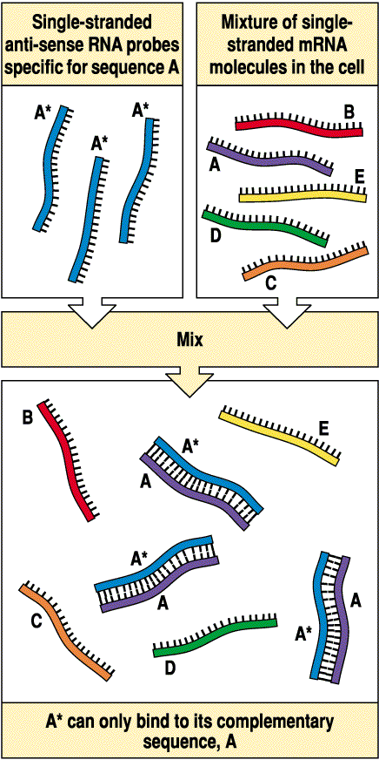
Principle: hybridization with labeled probe (either DNA or RNA) which is complementary to cellular RNA to detect internal expression

Slide 3
EXAMPLE:
http://people.biology.ucsd.edu/davek/intro.html

Slide 4
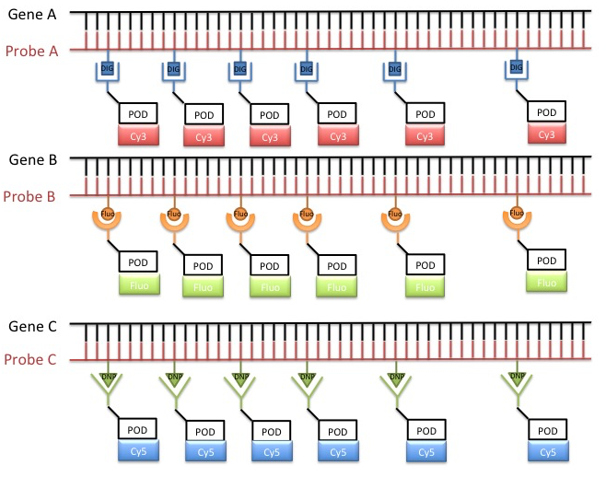
Can do more complicated ones using different labels and varied fluorophores:
DIG label
Fluor label
DNP label
Antibodies to each label, conjugated with unique fluorophore
https://insitutech.wordpress.com/2015/12/17/in-situ-hybridization/
Notes:
POD is horseradish peroxidase
Dinitrophenol

Slide 5
The type of image that can be generated
The labels each fluoresce at different wavelengths to produce distinct colours
And the regions of overlap show additional easily distinguished colours:
Blue + Red = violet
Green + Red = yellow

Slide 6
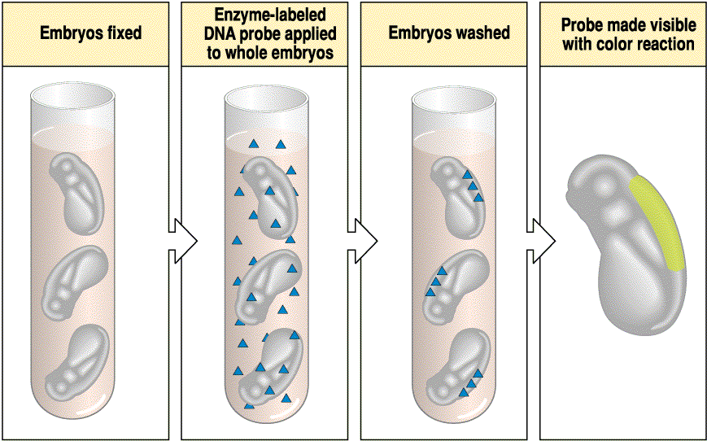
major approach 1: whole-mount in situ hybridization
Whole or intact structures are hybridized with probe and thereafter
mounted on microscope slides for assessment
advantages: gives an immediate overview of expression
relatively fast and simple
disadvantage: low sensitivity and resolution (penetration of tissues)
Notes:
It is much more work than shown here. Many protease treatments, followed by fixation, staining, washing, tons of washes, dehydration through alcohol series, mounting, microscopy

Slide 7
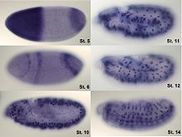
whole-mount in situ hybridization, example from Drosophila embryos
In situ hybridization of wild type Drosophila embryos at different developmental stages for the RNA from a gene called hunchback.
From Wikipedia

Slide 8
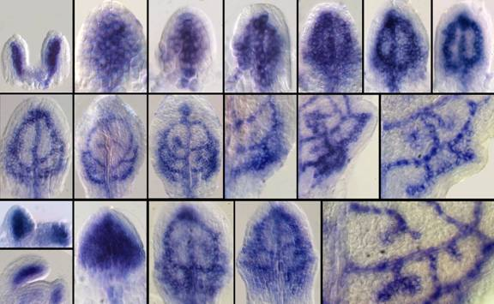
Example: expression of a transcription factor detected by whole-mount expression in leaf primordia
(a)
(b)
(c)
(d)
(e)
(f)
(g)
(h)
(i)
(j)
(k)
(l)
(m)
(n)
(p)
(q)
(r)
(s)
(o)
*
Wenzel et al., Plant Journal 2007 49: 387-

