Slide 1
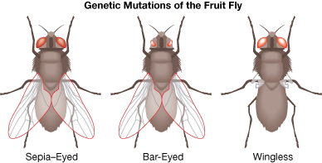
Chapter 8: Assessing gene function 2:
Knock-down or knock-out of gene function
http://moodle2.rockyview.ab.ca/mod/book/tool/print/index.php?id=51991&chapterid=25407

Slide 2
Rationale of knock-out, knock-down
Used for eliminating or reducing the expression of a gene in an organism, resulting in a loss-of-function of the gene
The resulting phenotype change will inform the scientist about the function of the gene
Example:
A knock-out of a specific gene results in fruit flies with altered wings: in the case below, each of the genes knocked out affects development of the wings

Slide 3
Terminology to know:
Amorph- a genetic mutation that completely lacks gene function
Hypomorph – a genetic mutation with reduced (but not zero) function
It can be difficult to demonstrate that a particular mutation is really an amorph
These are LOSS OF FUNCTION mutations- i.e. the function is either reduced or eliminated

Slide 4
Terminology to know:
Hypermorph- a genetic mutation that leads to overproduction or excessive activity of the product
Regulatory sequences change to promote more transcription
Inability to inactivate or down regulate the function
Neomorph – a genetic mutation with a new function, not seen in wild type
Expressed in tissues/times not normally expressed
Localized to a place in the cell not normally found
Interacts with other proteins or cell components not seen in wild type
These are GAIN OF FUNCTION mutations- i.e. overexpression or novel functions

Slide 5
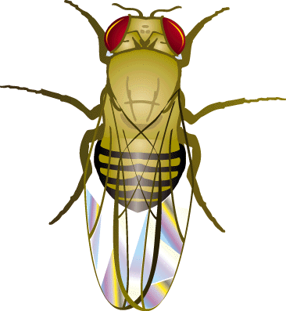
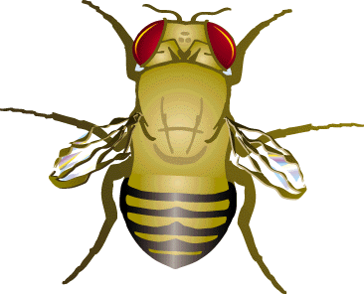
Traditional approach to gene function
Mutagenize a population (chemical, radiation)
Screen F2/F3 generation for mutants, 10,000-100,000 lines
Most mutants are homozygous for recessive mutant allele
(3:1 segregation ratio)
Phenotype gives overall gene function:
“Since mutant allele results in defective wing development,
the corresponding wild type allele is required for normal wing development”
But, it is a long process
to identify the altered
gene based on single-nucleotide
Mutation
Called “forward” genetics
wild type mutant

Slide 6
Alternative forward genetic approaches
Large scale induction of mutations using insertional elements genetics
Called insertional activation
Introduce insertional element, insertion is random
Isolate mutations, based on phenotype and then identify the gene the element inserted into
Use knowledge of the element sequence to find the sequence next to it (the inactivated or mutated gene)

