Slide 1
Reverse genetic approaches
Reverse genetics: Identify a gene of interest and mutate it to see the phenotypic effect. Work backwards to figure out what the wild type gene normally does
Use of recombination to replace wild type gene with mutated version (which we’ve designed)
CRISPR (gene editing borrowed from bacteria)
RNAi
The first two generally eliminate gene function, while the second may only reduce gene function

Slide 2
Gene knock-out plasmids (eliminate function)
Insertional mutagenesis
DNA-mediated homologous recombination with target gene
CRISPR/CAS for RNA-mediated disruption
of target gene (not only used for gene knock-out)
Gene knock-down plasmids (RNA silencing) – (reduce function)
4. Expression of double-stranded RNA to generate
RNA interference

Slide 3
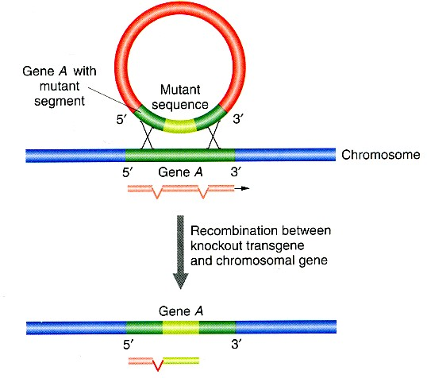
2. Knock- out by homologous recombination
Plasmid harboring
a mutated version of target gene, usually by insertion of antibiotic resistance gene
or reporter gene
Introduction of large
number of plasmids into
cells result in recombination
with target locus in a few cells/nuclei.
Those cells are selected for
by addition of antibiotic, killing
cells that don’t have resistance
gene in their genome
Works in many prokaryotes, yeast, mouse, flies, but not in plants, human cells
Notes:
Neomycin resistance is often used here as well
WORks well in mouse embryos because early stage embryo cells are really sticky (that means lots of cell adhesion molecules on the surface) so you can manipulate in vitro and then put the cells together with normal embryonic cells to form a functional embryo
Well talk details when we talk about introducing DNA into animal cells

Slide 4
Antibiotic resistance or marker gene
Target gene
Target gene
Antibiotic resistance or marker gene

Slide 5
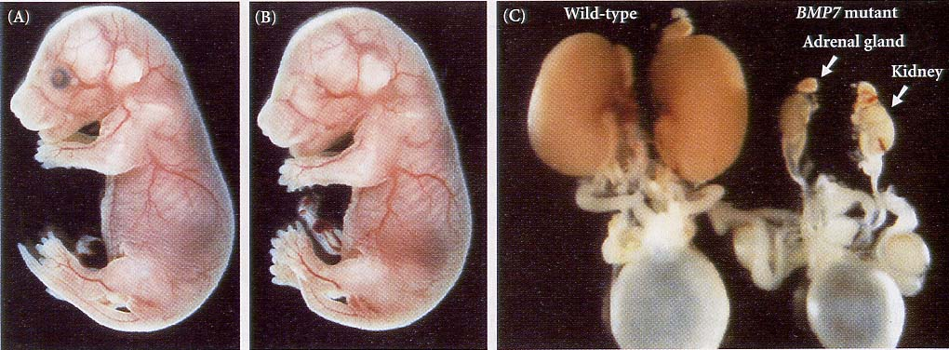
Example: knockout line of the gene encoding the bone-morphogenetic protein 7 (BMP7) in mouse
wild type knock-out wild type knock-out
from Gilberts, Developmental Biology

Slide 6
Homologous recombination has generated mice mutants and phenotypes that provided insights into genetics of MANY human diseases
Examples:
Cancer
Obesity
Heart disease
Diabetes
Arthritis
Ageing
Substance abuse
Anxiety
Parkinson’s disease
Many others

