Slide 1
4. Gene knock-down Plasmids
RNA interference/RNA silencing
Based on introducing a construct (into cells or an entire organism) that reduces the amount of mRNA and protein produced from a specific gene
introduced DNA
Chromosome 1
target gene
Chromosome 2
-
Notes:
This picture is about the principle- just conceptual

Slide 2
RNA interference (RNAi) is an integral part of gene regulation in many organisms
Simplified model for how it works
Double-stranded RNA is recognized by dicer.
2. Dicer digests dsRNA into short interfering
RNAs (siRNAs, 21-24 bp long).
3. An endonuclease complex,
RNAi silencing complex (RISC),
is guided by antisense strand of the siRNA
to bind and cleave specific mRNA
or inhibit translation.
4. Post-transcriptional inactivation of
target gene function
http://www.nature.com/focus/rnai/animations/index.html

Slide 3
RNA interference
Natural mechanism to regulate gene expression
Cells produce micro RNAs and small interfering RNAs to inhibit activity of native and foreign genes
(i.e. RNA viruses).
Mechanism can be used to reduce (or maybe eliminate) the gene product of a selected gene by production of double-stranded RNA of gene of interest

Slide 4
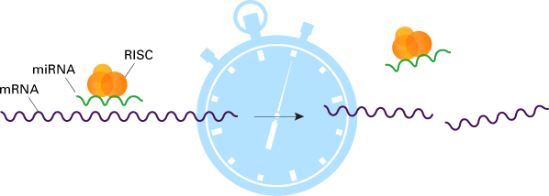
RNA interference can be used for transient down-regulation
of target gene and scoring of phenotype
delivery of synthetic dsRNA
RNA is broken down hours to a day
2. Delivery of plasmid that does not replicate or integrate
in chromosomal DNA. Plasmid transcribes dsRNA
but is broken down in hours to a day

Slide 5
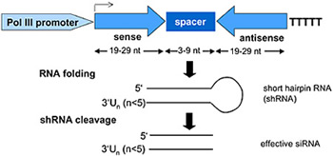
To generate a plasmid for RNAi, part of the transcribed region
of target gene is cloned twice and in opposite directions
Transcription of this region results in an RNA
that folds into double-stranded hairpin RNA
Part of plasmid
The cloned regions can be short, enough to produce a single siRNA,
Alternatively, part or complete cDNAs can be cloned, resulting
in dsRNAs that are cut into many siRNAs

Slide 6
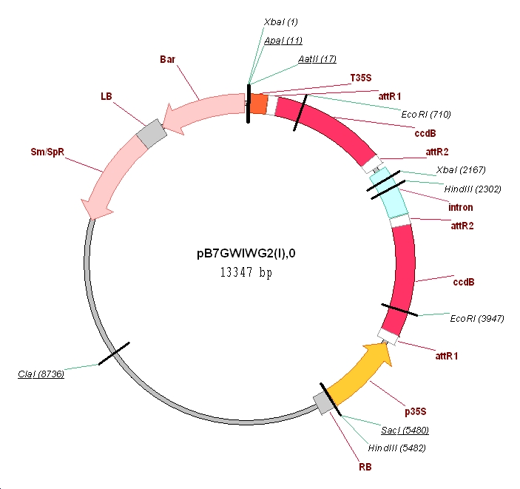
Some plasmids are designed for stable integration into chromosomal DNA resulting in permanent and inheritable RNAi
This plasmid is used for Agrobacterium-based
transformation of plant cells. The DNA between
left border (LB) and right border (RB)
is integrated into chromosomal DNA
Terminator
Double recombination sites
in opposite directions for insertion of cDNA
in opposite directions
(will talk about recombination-based
cloning in later class)
Viral promoter that provides
Strong, constitutive expression
http://gateway.psb.ugent.be/
Notes:
Also, P elements in flies. This doesn’t work for all organisms, it depends on what sorts of transposons are present in the orgnaims.

Slide 7
Another approach
One insert, a promoter to each side, so that transcription occurs in both directions at once
promoter
One insert
promoter

Slide 8
Examples RNA interference/silencing phenotypes
From developmental biology
One has two tails and the other has two heads

