Slide 1
How we have modified this system
Only two components are introduced into eukaryotic cells for disruption of target gene:
A single guiding RNA (sgRNA; a fusion of tracrRNA and crRNA) binds CAS9 protein at one end, the other end guides CAS9 to target DNA sequence based on complementarity
Gene for the CAS9 protein, encodes endonuclease, cuts both strands of the target sequence
The bacterial CRISPR repeats are not needed for disruption of target genes. But, the term “CRISPR” is easy to remember/catchy.

Slide 2
Protospacer adjacent motif
IMAGE FROM INTEGRATED DNA TECHNOLOGIES: https://www.idtdna.com/pages/support/faqs/what-is-a-pam-sequence-and-where-is-it-located
This not in the sg RNA, but in the target sequence

Slide 3
The two components are typically delivered into cells as:
Cas9 protein and sgRNA
OR
Plasmids or viruses containing Cas9 and sgRNA producing genes
- Some of the plasmids enter the nucleus
- Transcription is initiated from eukaryotic promoters
- Cas9 RNAs and sgRNAs are produced
- Cas9 mRNA is translated outside the nucleus
- Nuclear localization signals (NLS) in the CAS protein results in its import to
the nucleus
- sgRNA/Cas9 complex finds the targeted gene, Cas9 cuts it.
(methods for delivery into cells will be discussed in a later lecture)
part of plasmid

Slide 4
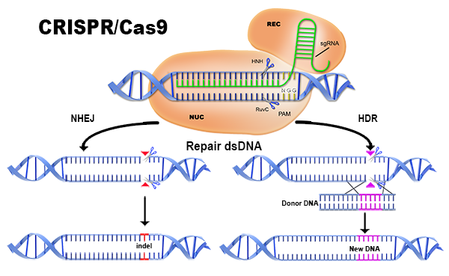
When Cas 9 and guiding RNA are introduced into eukaryotic cells and cause cleavage of targeted DNA sequence, repair systems are activated
The NHEJ (non-homologous end-joining) system joins strands, but in the process can cause either an insertion of extra DNA or deletion of DNA (insertion/deletion or indel). In either case, the gene may lose some or all of its function
If fragments of DNA matching the cut site region are also provided (donor DNA), the cut is repaired by the NHJR or HDR (homology-directed repair, a.k.a. homologous recombination, HR) system, resulting in an integration of the donor DNA sequence

