Slide 1
Two methods that are more expensive:
Column chromatography
We generally use it to purify PCR products and plasmids
“Solid phase” method using magnetic beads
Can use different beads for different isolations: DNA, mRNA, total RNA, protein

Slide 2
Alternative method to DNA precipitation:
Adsorption Chromatography Method
We use this method for plasmid and PCR product purification.
DNA within a crude lysate is bound to a silica surface
The silica surface is washed with a solution that keeps DNA bound, but washes out all other substances
The silica surface is washed with a solution unfavorable to DNA binding. The solution containing purified DNA is recovered.

Slide 3
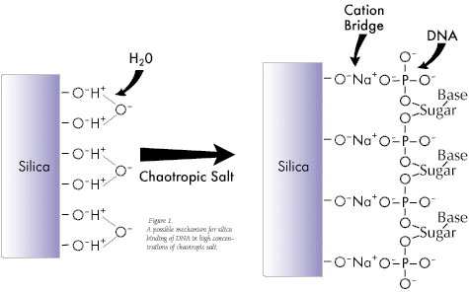
Adsorption Chromatography Method
Step 1: Prepare crude lysate
Step 2: Adsorb to silica surface
Apply to column
Centrifuge
Nucleic acids
Flow through
(discard)
Silica-gel membrane
Extraction Buffer composition favors DNA and RNA adsorption to silica:
• Low pH
• High ionic strength
• Chaotropic salt (guanidinium)
Nucleic acids bind to the membrane, while contaminants pass through the column.
Surface silanol groups are weakly acidic, and will repel nucleic acids at near neutral or high pH due to their negative charge
Chaotropic salt= salt that disrupts
hydrogen bonds
Also disrupts hydration shell around DNA,
allowing cation bridge-binding between
silica and negatively charged DNA

Slide 4
Adsorption Chromatography Method
Step 3: Wash away residual contamination
using solution that favors DNA binding to silica matrix
Step 4: Elute DNA
Elution Buffer composition is unfavorable to surface binding:
- High pH
- Low ionic strength

Slide 5
Solid phase method:
Makes use of tiny beads of iron oxide, 20 – 30 nm in diameter
Only magnetic when an external magnetic field is applied
Various companies make different types of these for isolation of protein, DNA or RNA, or nucleic acids etc. from a cell lysate
Different surface coating and buffers will provide the specificity
Some of the simulations in the lab use the magnetic beads – we can afford it because it is just a simulation

Slide 6
DNA binds to beads
Cell lysate
Add beads
Apply magnetic force
Remove solution
Wash several times
Elute in TE or other suitable solution

