Slide 1
Assessing the quality and yield of nucleic acids PART 2: gel electrophoresis
The spectrophotometer cannot tell you if your DNA or RNA are intact, undamaged
Vigorous shaking, pipetting up and down, and vortexing, can damage DNA, breaking it into smaller pieces
To be sure it is not damaged, you can run a small amount, 100-200 ng, on a gel

Slide 2
Agarose gel electrophoresis for DNA:
Gel electrophoresis separates DNA fragments (and RNA too) according to their size.
DNA samples are loaded into wells (indentations) at one end of a gel, and an electric current is applied to pull them through the gel.
DNA fragments are negatively charged, so they move towards the positive electrode (which is red in most systems).
https://www.sciencedirect.com/topics/biochemistry-genetics-and-molecular-biology/agarose-gel-electrophoresis

Slide 3
Agarose gel electrophoresis for DNA:
DNA fragments move different distances through a gel based on size
When we speak of the “size” of a DNA fragment, we mean the length in base pairs
Agarose is like a mesh with pores- smaller fragments can move through the pores more easily while longer fragments take longer
A ladder is used to determine the sizes of the DNA fragments in each lane
https://www.sciencedirect.com/topics/biochemistry-genetics-and-molecular-biology/agarose-gel-electrophoresis

Slide 4
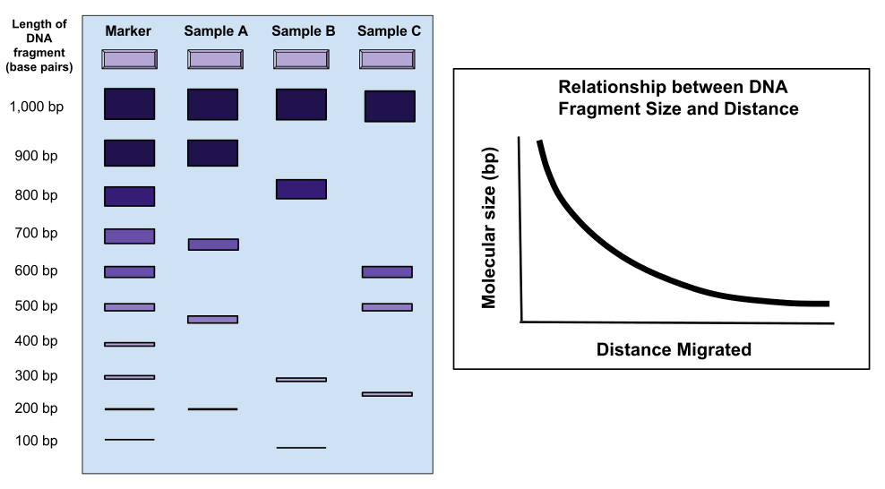
DNA runs through a gel in linear pieces proportionately to length
RNA must be made linear to maintain the relationship between length and distance migrated
When a gel is stained with a DNA-binding dye, the DNA fragments show up as bands, each representing a group of same-sized DNA fragments (same for RNA)
https://commons.wikimedia.org/w/index.php?title=File_talk:Gel_Electrophoresis.svg&action=edit&redlink=1

Slide 5
Dyes used to visualize DNA and RNA in gels (just a few common ones- there are others)
Ethidium bromide: (UV)
Fluoresces when bound to DNA with low background
High sensitivity
A known mutagen
Gel red: (UV)
A safer form of ethidium, modified so that it cannot penetrate cell membranes, therefore should not be toxic (according to manufacturer)
As sensitive as ethidium bromide (some claim it is more sensitive)
More expensive than ethidium bromide
SYBR safe: (blue light or UV)
Safest of all these, because not toxic and UV is not needed
Less sensitive than Gel red
Not as pricey as Gel red

Slide 6
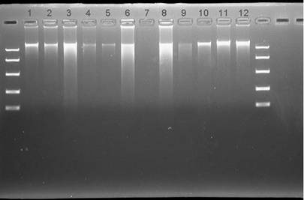
Intact vs degraded DNA
We use a gel of 0.7- 1.5% for examining the length of DNA fragments and extent of DNA degradation.
Good quality DNA should migrate as a high molecular weight band, 20-40 kilobase pairs, kb), with little or no evidence of smearing.
“ladder” of DNA fragments
with known lengths provide
references to estimate the
length of your DNA fragments
smears of partially degraded
DNA

Slide 7
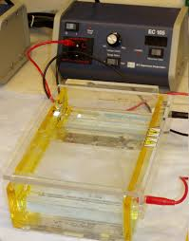
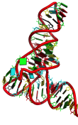
Separation of RNA according to size by denaturing formaldehyde agarose gel electrophoresis
Method:
Incubate RNA in the presence of formaldehyde and formamide
at 55-65ºC for a few minutes. (it is bad for you, use the fume hood)
RNA denatures/ secondary structures are removed
Carry out electrophoresis in agarose gel containing formaldehyde
RNA remains denatured during electrophoresis
RNases are denatured, inhibiting RNA degradation
RNA molecules will migrate according to their molecular weight
rather than ability to form secondary and tertiary structures
*Nucleic acids must be LINEAR in order to migrate by size in a gel
Caution:
1. formaldehyde is a strong fixative/irritant
2. buffer warms up during electrophoresis – fumes can fix your corneas!
< <

Slide 8
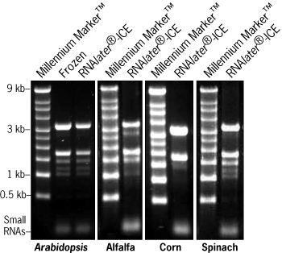
The integrity of ribosomal RNA can be used as an indicator of mRNA quality
Ribosomal RNA (rRNA) makes up more than 80% of total RNA samples.
Total RNA preps should display two prominent rRNA bands after gel electrophoresis.
These correspond to the 25S and 18S rRNAs, in plants, 28S and 18s rRNAs in animals
25S
18S
Good quality RNA will have:
- No/little evidence of smearing
- 25S/18S or 28S/18S ratio ~ 2
mRNA is present but in very small amounts, but will typically be intact if ribosomal RNAs are intact

Slide 9
Ribosomal RNA Sizes vary with organism
Don’t memorize – you would need to know what sizes you are expecting to see for your research organism
Svedberg (S) units
Species | rRNA | Size (kb)
Human | 18S | 1.9
 | 28S | 5.0
Mouse | 18S | 1.9
 | 28S | 4.7
Drosophila | 18S | 2.0
 | 28S | 4.1
Tobacco Leaf | 16S | 1.5
 | 18S | 1.9
 | 23S | 2.9
 | 25S | 3.7
Yeast | 18S | 2.0
 | 26S | 3.8
E. coli | 16S | 1.5
 | 23S | 2.9
What are the 16S and 23S rRNAs in plant cells? Where do they come from?

