Slide 1
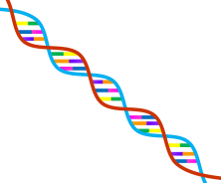
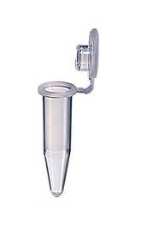
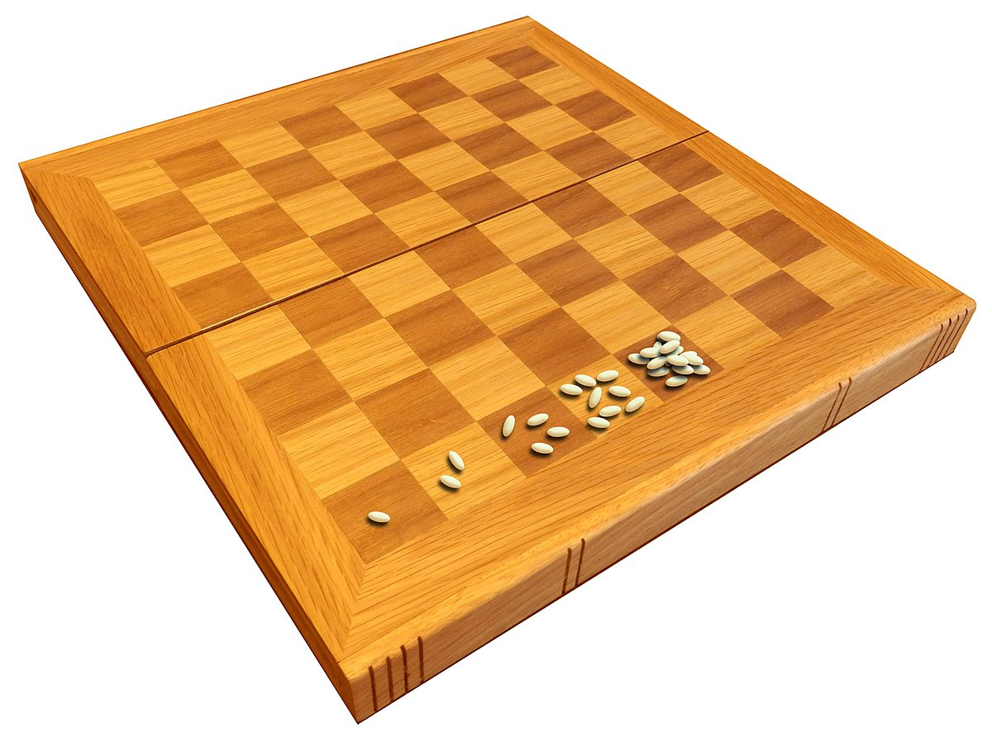
5. PCR polymerase chain reaction
If a piece of DNA could be doubled over
and again, 35 cycles would generate
2³⁵ = 34,359,738,368 = 34 billion
Kary B. Mullis developed it in 1985
→ Nobel Prize in Chemistry 1993
2⁶⁴ = 18,446,744,073,709,551,616
https://www.youtube.com/watch?v=byk3pA1GPgU

Slide 2
What is PCR?
A method to select a particular (known) sequence and amplify millions or billions of copies of that sequence in order to work with it further

Slide 3
What is PCR used for?
Amplifying a gene so we can clone it (making the insert)
Identifying individuals in a population by amplifying key genes that differ between individuals
Ranges from studies of wildlife populations to forensics- finding the killer or the long lost heir
Making probes, sequencing DNA for many purposes such as identifying variants or mutations in DNA, assessing level of expression of particular genes
Introducing mutations into a gene of interest to study its function

Slide 4
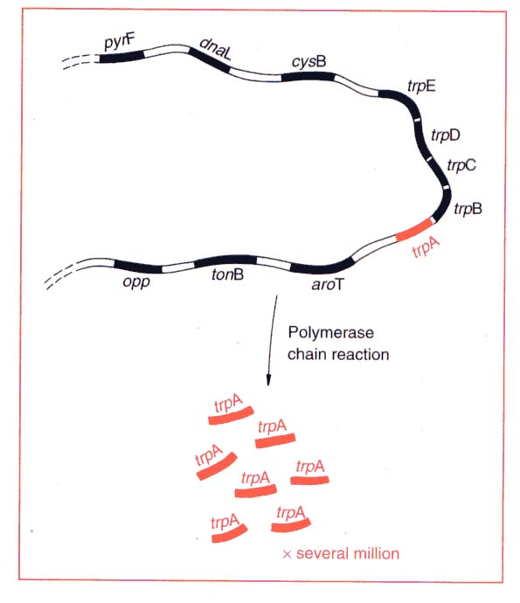
Commonly PCR can be used to amplify specific gene/fragment from complex genomes
PCR products
or
amplicons

Slide 5
Principle:
You use short primers (around 18-24 nt long) to TARGET specific DNA sequences
This means you have to have some knowledge of the gene you want to amplify
You can then amplify HUGE amounts of that selected sequence (millions or billions of copies of it), to levels where you have enough to:
Visualize on a gel
Clone
Sequence (etc.)

Slide 6
What does PCR involve?
DNA template (genomic, cDNA, plasmid etc)
Nucleotides (dNTPs)
Reaction buffer with correct salts, pH, Mg⁺⁺
Primers specific for the gene of interest (forward and reverse)
Taq polymerase, or other thermo-tolerant DNA polymerase
This polymerase can undergo many rounds of heating and cooling to amplify the DNA of interest

Slide 7
How we do PCR
Cycles:
denaturing: high temperature (95C) to denature the DNA, pull the strands apart (also called “melting”)
annealing: temperature lowered to allow the primers to bind specifically to the DNA target
extension: temperature raised to 68 or 72 to allow the strands to be completed by the polymerase
Repeat as needed, usually 20-35 cycles
Notes:
need template, primers, buffer, nucleotides, magnesium, enzyme

Slide 8
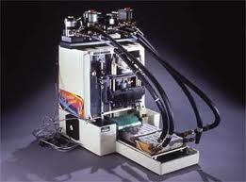
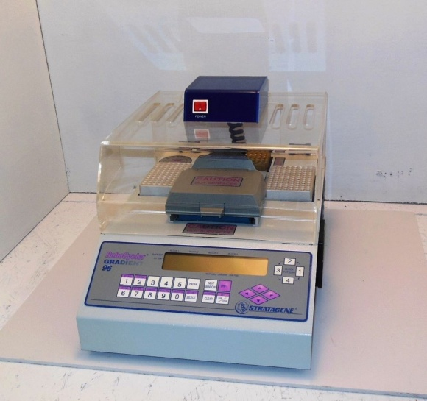
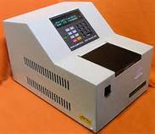
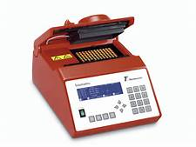
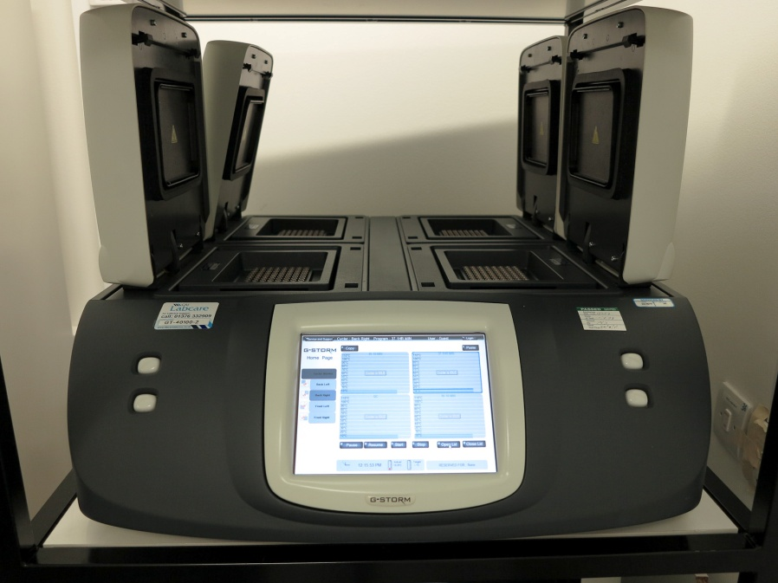
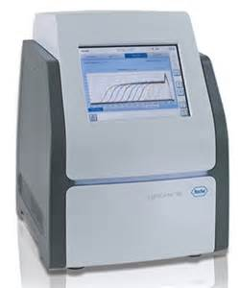
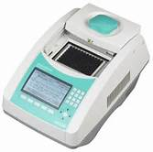
Polymerase Chain Reaction (PCR) is carried out in thermocyclers

Slide 9
Polymerase Chain Reaction (PCR) performed in a thermocycler
94ºC for 30 s
Extension time varies depending on your product size and the enzyme. Must have a long enough extension time to make the correct product
e.g. Taq is 60 seconds per kb, but some enzymes claim 1 kb in 10 seconds
3. 72ºC for variable time
2. 55ºC, for 30 s
one cycle
Usually 30-40 cycles total

Slide 10
Then, the known DNA polymerases were heat sensitive → Needed to add more enzyme after each denaturation cycle → Expensive and used up a lot of a grad student’s time → So not used much until a breakthrough occurred- not practical
The breakthrough: heat tolerant polymerases
Isolated from organisms living in the hot spots of the world

Slide 11
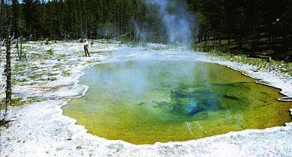
https://instruction.bact.wisc.edu/themicrobialworld/LAHT/b27.html
BY Thomas D. Brock

