Slide 1
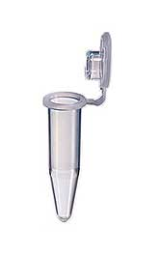
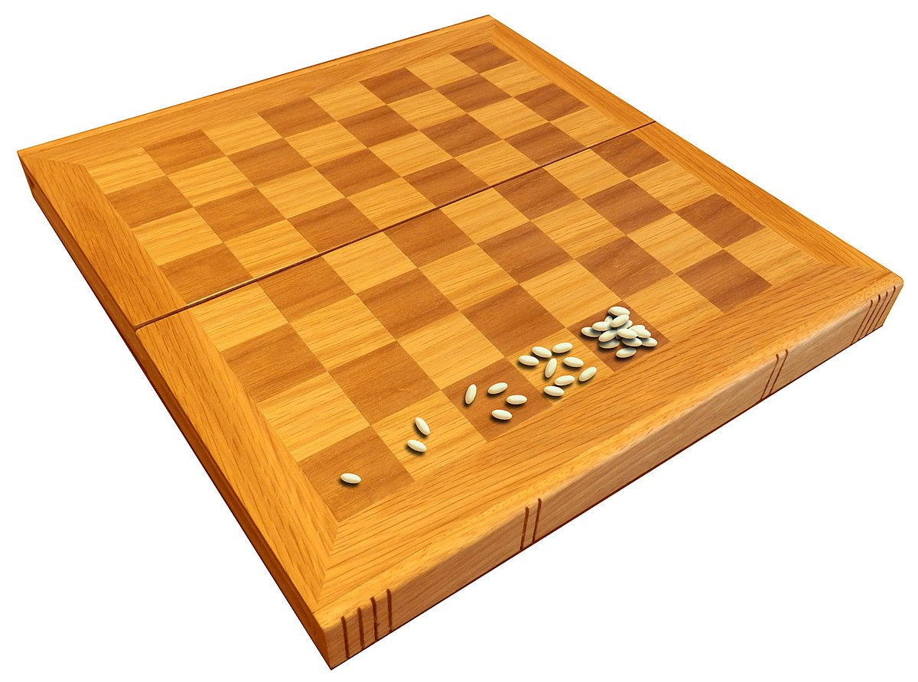
5. PCR polymerase chain reaction
Part 2: About primers
2⁶⁴ = 18,446,744,073,709,551,616
https://www.youtube.com/watch?v=byk3pA1GPgU

Slide 2
Primers:
Usually short, around 18-24 nt long
Complementary to sequences to either side of the intended amplicon
Unique - must recognize only one target in the genome
The pair of primers should have the same melting temperature (see next slide)
The primers should not have any self-complementarity or base pair with each other, forming primer dimers

Slide 3
Melting temperature:
The temperature at which half of the primers bind their target sequence and half do not
We want this sequence to be similar for both primers so that they both bind to the target DNA in the same way
There are programs that accurately determine the Tm of your primers
But a quick calculation is 4(# Gs + Cs) + 2(#As + Ts)
from researchgate
Notes:
enzyme will die eventually but generally will last through 35 cycles

Slide 4
Self complementarity:
5’-GGCATTGACATTCAGACCGG-3’
5’-GGCATTGACATTCAGACCGG-3’
5’-GGCATTGACATTCAGACCGG-3’
5’-GGCCATTGACATTCAGACCG-3’
5’-GGCCATTGACATTCAGACCG-3’
5’-GGCCATTGACATTCAGACCG-3’

Slide 5
Primers:
genomic DNA- in data files, only one strand shown, 5’ to 3’
1 5’ ataacgacagggtcgtacatcatcatgtcagctaactatgaacgatttcagcgttcatag
5’acgacagggtcgtac➔
61 ataattggacgggggggtttcggagaagtatatggatgccgaaaagctgacactggaaaa
121 atgtatgctatgaaatgcttggacaaaaaacggattaaaatgaaacaaggagaaatgcta
181 gctcttaatgaaagaaatatgctgcaagcagtcagtactggaattgattgtccgttcata
181 gtgtgtatgacgtatgcctttcatacgccggataagctatgttttatattagatctaatg
241 aatggtggtgatctacattaccatttatctcaacatggtattttcagtgaggatgaaatg
301 aaattttatgcagcggaggtgattttgggattggaacacatgcataaacgttgcattgtg
361 taccgagacttaaaacccgccaacatactgctcgatgaaaacggacacatacgaatttct-3’
⬅ cgagctacttttgcctg-5’
“forward” primer: same sequence as the DNA sequence given
“reverse” primer: reverse complement of the DNA sequence given
Make sure you can see the relationship between primer sequence and gene sequence

Slide 7
Denaturing

Slide 8
Annealing
AAGGTCTA- 5’
Reverse primer
Forward primer
5’-ATGGTACC

Slide 9
Extension
3’ - TACCATGG
AAGGTCTA- 5’
Reverse primer
Forward primer
5’-ATGGTACC
TTCCAGAT- 3’
Now two double stranded molecules of identical sequence

Slide 10
Outcome:many millions of PCR products (amplicons) that can easily be detected by DNA staining and agarose gel electrophoresis
This is an example of genotyping different strains – different sized bands indicate differences in the target DNA in each strain

Slide 11
The all or none nature of PCR If your PCR reaction is sub-optimal, it may look like it didn’t work at all. Many times, however, you just need to tweak the conditions to obtain a detectable amount of product
All
“it worked!!”
detectable levels of product
None
“ I hate PCR!”
Suboptimal PCR may result
in product, but not enough
for detection,
PCR products
optimal
suboptimal
detection level
approx. 20 ng
30-40
# cycles

Slide 12
Undetectable PCR product can be due to many factors:
pipetting errors – leaving out a vital component (less likely if you use master mix)
primer design issues
inefficient annealing of primers – annealing temperature too high
overestimate of DNA template concentration (RNA contamination)
impurities in DNA preparation that inhibit amplification
ex. those that bind magnesium, including EDTA
phenol or guanidinium – inhibit Taq polymerase activitiy
RNA – competes for primer binding

