Slide 1
Genome Trek: The next generation DNA sequencing technology
traveling at warp speed
through genomes!

Slide 2
Next Generation Sequencing (NGS) technologies:
Emerged in 2005
Have revolutionized the study of:
- genomes/genomics
- evolution
- anthropology
- microbe communities
- medical genetics
- biotechnology

Slide 3
Material sources:
Michael L. Metzker “Sequencing technologies: the next generation” Nature Reviews Genetics 11, 31-46 (January 2010)
websites of technology providers
cyberspace – lots of reviews, infographics etc.
E.g. https://www.nature.com/collections/jmgqdxpvsk

Slide 4
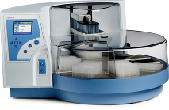
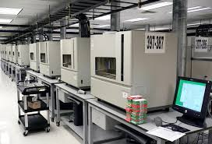
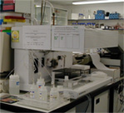
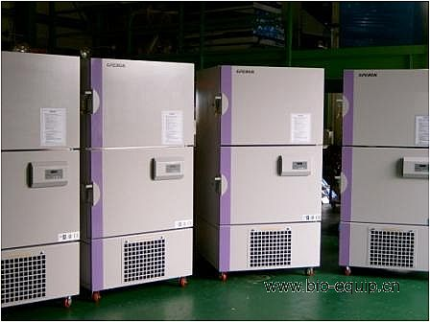
Sanger DNA sequencing is a costly procedure involving many steps, people, and much administration and time when done on a large scale
Notes:
Point out large number of people, machines, robots etc. Each sanger sequence of 800-1200 nt can be done for 5$ per reaction, but still, would be hugely expensive on the scale of an entire genome

Slide 5
Sanger sequencing is great but
Each reaction, covering about 800 bases, is 5$
We need multiple runs (coverage) of each sequence to have confidence in it
E.g. human genome is around 3Gb
Consider the cost of just one sequence of this genome (around 19.8 million$)
We need something with fewer steps, that uses fewer resources and will be less expensive
Notes:
* Or less, ours was about 3$ per reaction

Slide 6
What’s the basis of NGS technologies?
Remove cloning into plasmid
Sequence without
retaining samples
Simpler preparation of samples and many many samples analyzed at once
Develop massive
parallel processing

Slide 7
Massive parallel processing
Going from 384 to 6 billion samples/run of machine
 | Sanger | Illumina HiSeq
samples/run | 384 | ~ 6 billion
read length | 800 bp | 100 bp
total | 0.3 Mbp | 600 Gbp
human genome | 0.0001 | 200
equivalents
Haploid human genome ~ 3 Giga base pairs (Gbp)
Observe: Illumina sequences 100 bp from each end = 200bp

Slide 8
Instead of 1 fragment =1 plasmid =1DNA purification =1 sequencing reaction
Process billions of DNA fragments at once
Textbook, page 590 – 592
High-throughput sequencing, Sequencing by synthesis
“By synthesis” means you synthesize a DNA strand and identify each nucleotide as it is added

