Slide 1
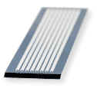
Step 2: Generate clusters of identical fragments/clones on glass surface by solid-phase PCR amplification (as done by Illumina technology)
The sequencing machine uses two flow cells at a time (about the size of a microscope slide)
There are 8 lanes per cell – that fluid with DNA segments (and the reagents used for the sequencing) can be put into
100-200 million clusters are made in each lane
Therefore about 1.6 to 3.2 billion clusters for each run of sequencing
What are clusters?

Slide 2
Step 2: Generate clusters of identical fragments/clones on glass surface by solid-phase PCR amplification (as done by Illumina technology)
Forward and reverse primers are covalently attached to the slide at high-density- in no particular pattern
These match the adaptors at the ends of the DNA segments that have been produced
DNA is added to the slides and allowed to anneal to the immobilized primers – diluted to keep the sites well separated –so when we amplify to form the clusters, each one is far from the others

Slide 3
What if we add polymerase and nucleotides (and the right buffers, etc.)?
So now we have this:
C
C
F
R
F
R

Slide 4
Now what if we increase the temperature?
C
F
R
F
R
Template is released and washed away

Slide 5
Step 2: Generate clusters of identical fragments/clones on glass surface by solid-phase PCR amplification (as done by Illumina technology)
****Clusters are distinct, separated in space (no overlap)
Bridge-break PCR amplification generates local clusters from single template molecules. So you start with just one molecule bound, over a series of amplification cycles, you get clusters of forward and reverse strands of the same sequence
How are the clusters made?

Slide 6
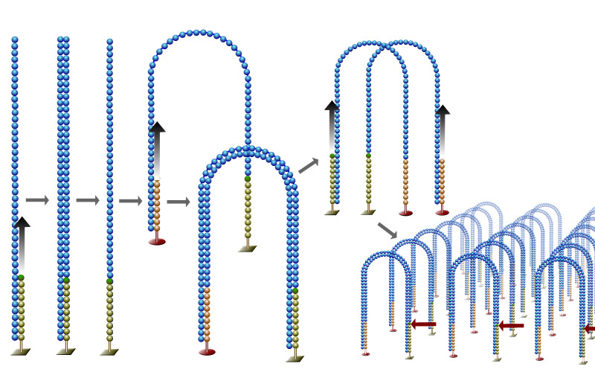
Next Steps: Bridge amplification- generate the clusters of the same sequence

Slide 7
Annealing
60C
R
F
F
R
R
F
F
R
MANY CYCLES
Like this
72C
Denaturing
95C
R
F
F
R
R
F
F
R

Slide 8
So, where are we so far?
We have in each lane 100 – 200 million spots or clusters, each of which represents one small fragment of DNA
The fragments are 100-200 nucleotides in length
Now we want to sequence the fragments

