Slide 1
How does real-time PCR work?
To best understand what real-time PCR is, let’s review how regular PCR works...

Slide 2
The Polymerase Chain Reaction How does PCR work??
3’
5’
5’
3’
3’
5’
5’
3’
d.NTPs
3’
Primers
5’
3’
5’
Thermal Stable
DNA Polymerase
5’
3’
3’
5’
3’
5’
5’
3’
Add to Reaction Tube
3’
5’
5’
3’
3’
5’
3’
5’
Denaturation
5’
3’
5’
3’
Annealing

Slide 3
3’
5’
5’
3’
5’
3’
5’
3’
Extension
3’
Taq
5’
5’
5’
5’
Taq
3’
Extension Continued
Taq
3’
5’
5’
Taq
5’
3’
Repeat

Slide 4
3’
5’
3’
5’
Cycle 2
4 Copies
3’
5’
5’
3’
3’
5’
5’
3’
3’
5’
5’
3’
3’
5’
3’
5’
3’
5’
5’
3’
3’
5’
Cycle 3
8 Copies
5’
3’
3’
5’
5’
3’
3’
5’
5’
3’
3’
5’
5’
3’
3’
5’
5’
3’
5’
3’
5’
3’

Slide 5
How does Real-Time PCR work?
…So that’s how traditional PCR is usually presented.
In order to understand real-time PCR, let’s use a “thought experiment”, and save all of the calculations and formulas until later…
Most importantly, we’ll start by imagining the PCR itself, and only then will we draw graphs to illustrate what’s Going on.

Slide 6
Imagining Real-Time PCR
To understand real-time PCR, let’s imagine ourselves in a PCR reaction tube at cycle number 25…

Slide 7
Imagining Real-Time PCR
What’s in our tube, at cycle number 25?
A soup of nucleotides, primers, template, amplicons, enzyme, etc.
LET’S ASSUME 1,000,000 copies of the amplicon right now.

Slide 8
Imagining Real-Time PCR How did we get here?
What was it like last cycle, 24?
Almost exactly the same, except there were only 500,000 copies of the amplicon.
And the cycle before that, 23?
Almost the same, but only 250,000 copies of the amplicon.
And what about cycle 22?
125,000 copies of the amplicon.

Slide 9
Imagining Real-Time PCR How did we get here?
If we were to graph the amount of DNA in our tube, from the start until right now, at cycle 25, the graph would look like this:

Slide 10
Imagining Real-Time PCR How did we get here?
So, right now we’re at cycle 25 in a soup with 1,000,000 copies of the target.
What’s it going to be like after the next cycle, in cycle 26?
?

Slide 11
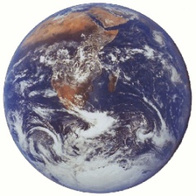
Imagining Real-Time PCR So where are we going?
What’s it going to be like after the next cycle, in cycle 26?
Probably there will be 2,000,000 amplicons.
And cycle 27?
Maybe 4,000,000 amplicons.
And at cycle 200?
In theory, there would be 1,000,000,000,000,000,000,000,000,000,000,000,000,000,000,000,000,000,000,000 amplicons…
Or 10^35 tonnes of DNA…
To put this in perspective, that would be equivalent to the weight of ten billion planets the size of Earth!!!!

Slide 12
Imagining Real-Time PCR So where are we going?
A clump of DNA the size of ten billion planets won’t quite fit in our PCR tube anymore.
Realistically, at the chain reaction progresses, it gets exponentially harder to find primers, and nucleotides. And the polymerase is wearing out.
So exponential growth does not go on forever!

Slide 13
Imagining Real-Time PCR So where are we going?
If we plot the amount of DNA in our tube going forward from cycle 25, we see that it actually looks like this:

Slide 14
Imagining Real-Time PCR Measuring Quantities
How can all this be used to measure DNA quantities??

Slide 15
Imagining Real-Time PCR Measuring Quantities
Let’s imagine that you start with four times as much DNA as I do…picture our two tubes at cycle 25 and work backwards a few cycles.
Cycle 25
Cycle | Me | You
23 | 250,000 | 1,000,000
24 | 500,000 | 2,000,000
25 | 1,000,000 | 4,000,000

Slide 16
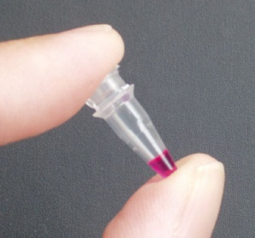
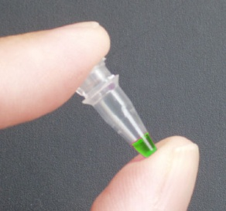
Imagining Real-Time PCR Measuring Quantities
So, if YOU started with FOUR times as much DNA template as I did…
…Then you’d reach 1,000,000 copies exactly TWO cycles earlier than I would!

Slide 17
Imagining Real-Time PCR Measuring Quantities
What if YOU started with EIGHT times LESS DNA template than I did?
Cycle 25
Cycle | Me | You
25 | 1,000,000 | 125,000
26 | 2,000,000 | 250,000
27 | 4,000,000 | 500,000
28 | 8,000,000 | 1,000,000

Slide 18
Imagining Real-Time PCR Measuring Quantities
What if YOU started with EIGHT times LESS DNA template than I did?
You’d only have 125,000 copies right now at cycle 25…
And you’d reach 1,000,000 copies exactly THREE cycles later than I would!

