Slide 1
What Type of Instruments are used with Real-Time PCR?
Real-time PCR instruments consist of THREE main components:
Thermal Cycler (PCR machine)
Optical Module (to detect fluorescence in the tubes during the run)
Computer (to translate the fluorescence data into meaningful results)

Slide 2
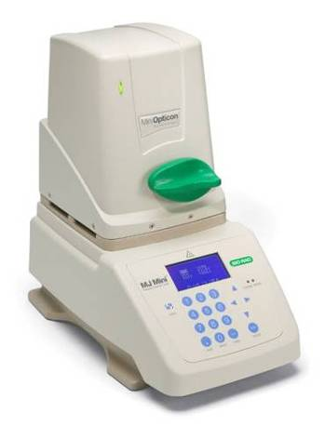
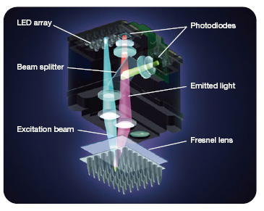
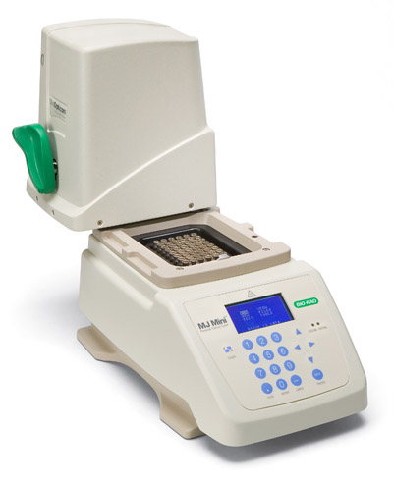
What Type of Instruments are used with Real-Time PCR?
example: MiniOpticon real-time instrument.

Slide 3
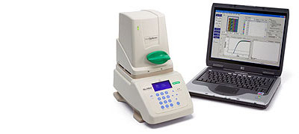
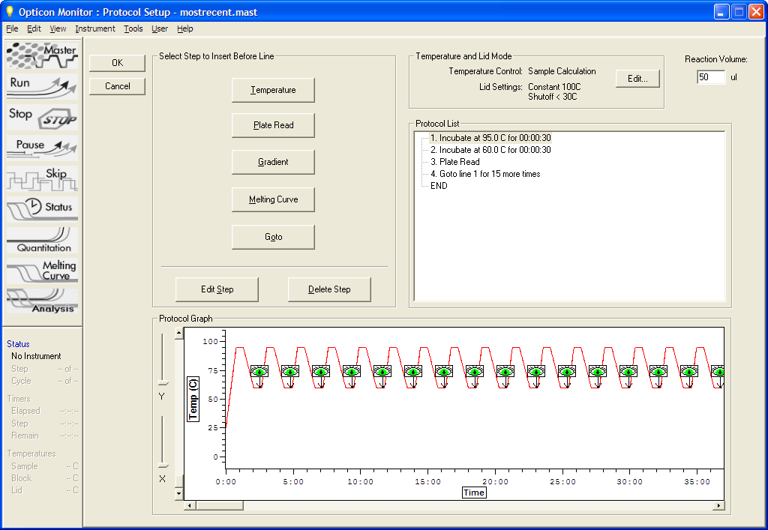
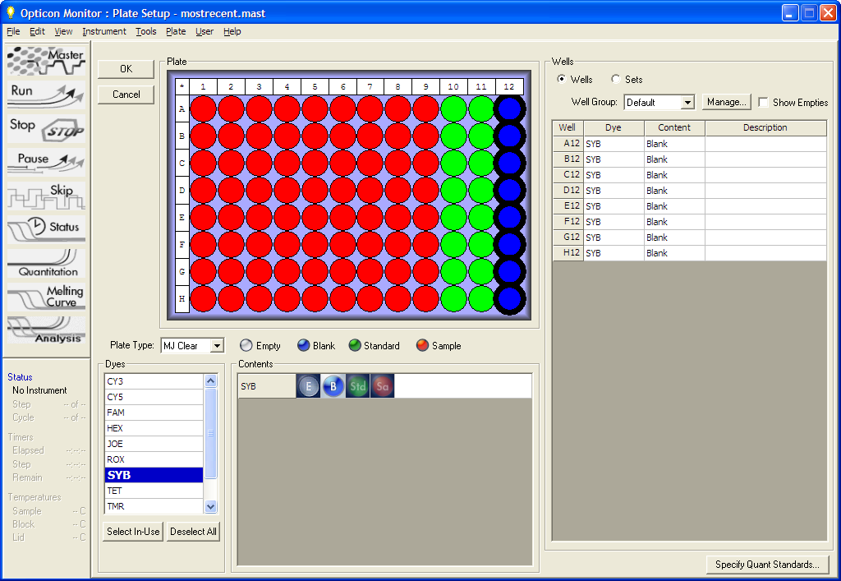
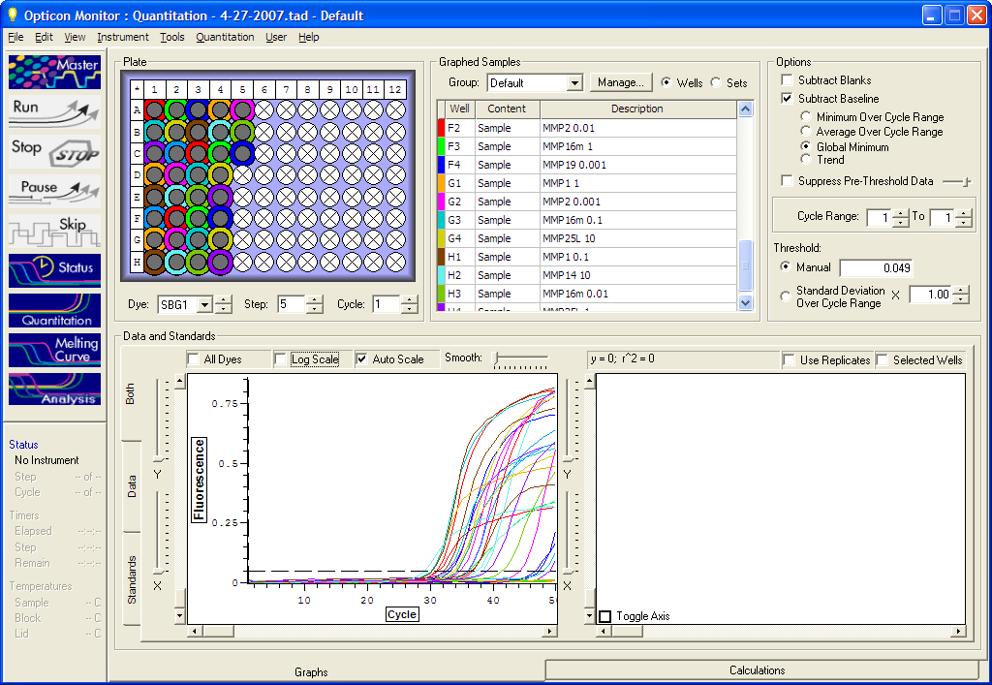
What Type of Software is used with Real-Time PCR?
The real-time software converts the fluorescent signals in each well to meaningful data.
Set up PCR protocol.
Set up plate layout.
Collect data.
Analyze data.
1
2
3,4

Slide 4
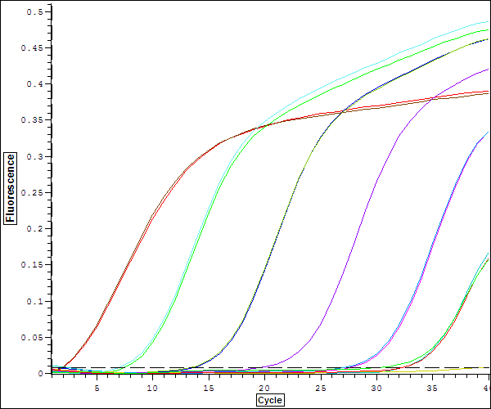
Part 4:
What does real-time data look like?

Slide 5
Real-Time PCR Actual Data
This is some actual data from a recent real-time PCR run.
Data like this can easily be generated by preparing a dilution series of DNA.
c366939

Slide 6
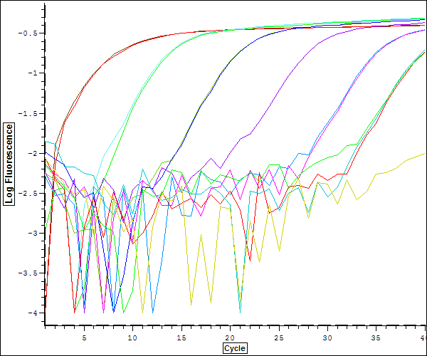
Real-Time PCR Actual Data
The same data set in log view

Slide 7
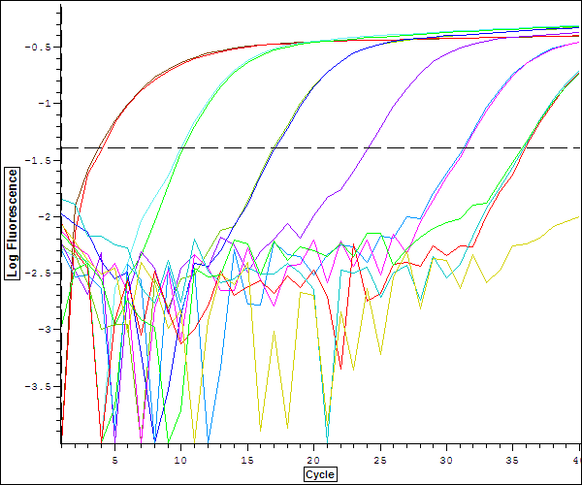
Real-Time PCR Setting Thresholds
Once threshold is set, Ct values can be calculated automatically by software.
Ct values can then be used to calculate quantities of template DNA.

