Slide 1
There’s a DIRECT relationship between the starting amount of DNA, and the cycle number WHERE THE THRESHOLD IS PASSED. a standard curve is generated from a serial dilution of known DNA target such as a plasmid The Ct value of An unkNown sample is then plotted on the line to obtain a corresponding copy number of target DNA in the unknown DNA sample. (JM)

Slide 2
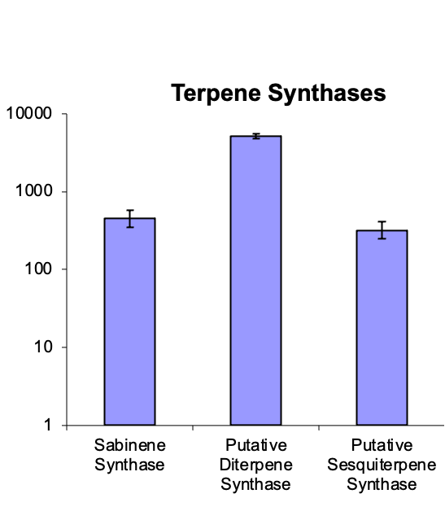
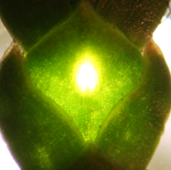
A common alternative, Relative quantification
Compares expression in a sample relative to other samples.
Example: The mRNA (after conversion to cDNA) is ~ 700-fold more abundant in sample a relative to sample b
samples
a b
relative expression a/b
Wildtype Natural mutant
leaf scales Western redcedar

Slide 3
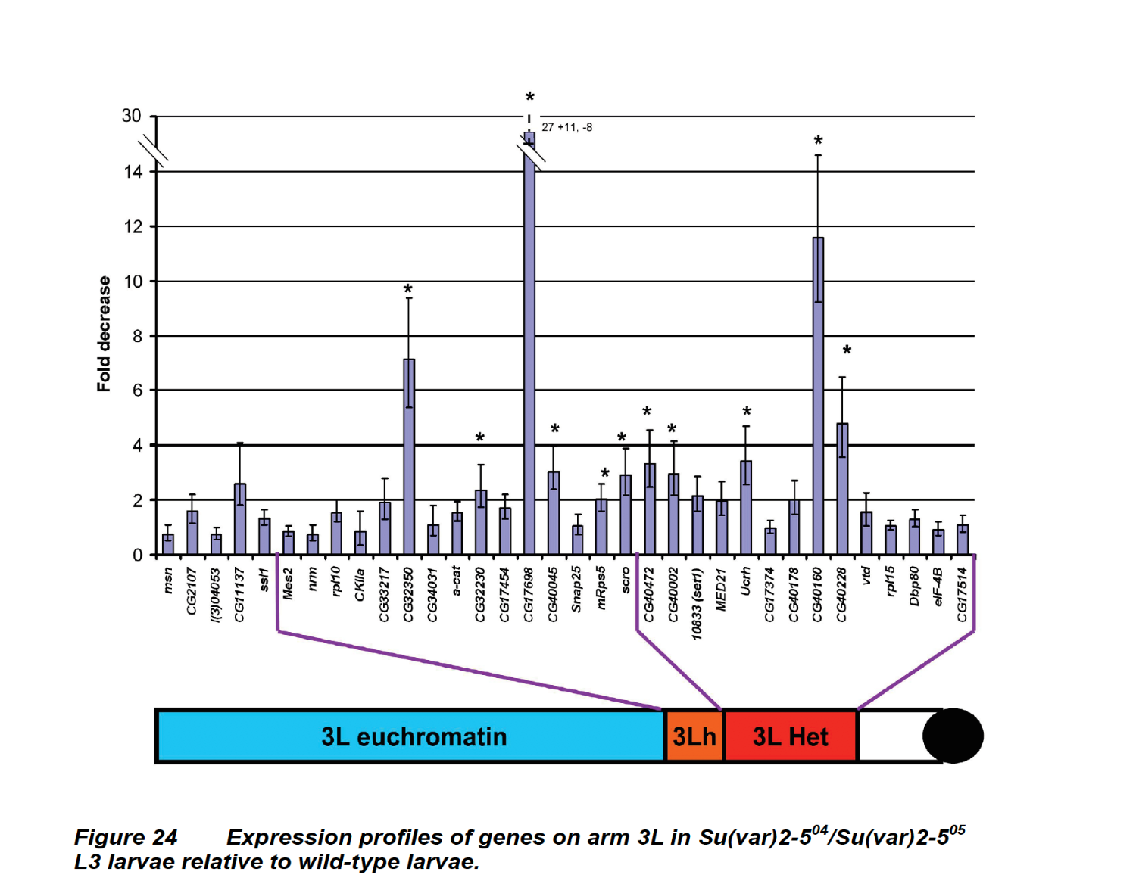
ANOTHER EXAMPLE, compares expression of a set of genes in a mutant background relative to wild type
PhD thesis, G. Hallson

