Slide 1
Chapter 12: Cloning by recombination
General background to site-specific recombination
The lambda recombination system (more stealing from other organisms!)
Potential advantages of using recombination for cloning
Adaptation of the lambda recombination system for efficient cloning – GATEWAY technology

Slide 2
Site-Specific Recombination
short specific sequences are required for recombination and are the only sites at which recombination occurs.
require specialized proteins to recognize these sites and to catalyze the recombination reaction at these sites.

Slide 3
Site-specific recombination involves two specific sites
two types of site-specific recombination reaction
1. Inverted repeats
If the two sites at which recombination will take place are oriented oppositely to one another in the same DNA molecule then the following illustrates the sequence of events that will take place:
recombination at inverted repeats causes an inversion.
2. Direct repeats
If the two sites at which recombination will take place are oriented in the same direction in the same DNA molecule then the following illustrates the sequence of events:
recombination at direct repeats causes a deletion (or integration in the reverse direction)

Slide 4
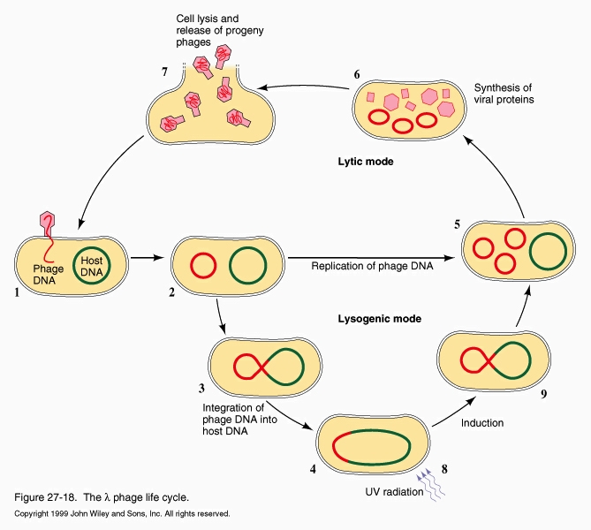
Integration of bacteriophage lambda
bacteriophage lambda is a temperate phage
the phage will either follow a lytic growth pathway
or a lysogenic growth pathway
In the lytic growth pathway
the phage replicates itself and lyses the host cell
In the lysogenic growth pathway
phage DNA is integrated into the host chromosome
the phage essentially shuts itself down and enters a dormant state known as a prophage
It can replicate & lyse the host at a later time
The integration of phage DNA and the induction from lysogenic to lytic phase involves site specific recombination!

