Slide 1
Site-specific recombination of λ into E. coli
λ integrates at one specific site in the E. coli chromosome
The site is,
located between the gal and bio operons
called the attachment site
designated attB (attachment Bacterial).
30 bp long
contains a conserved central 15 bp for recombination.
usually represented as BOB',
where B and B' represent the bacterial DNA on either side of the conserved central element.

Slide 2
The bacteriophage recombination site - attP
more complex contains the identical central 15 bp region as attB. overall structure can be represented as POP'.
Notes:
ATT P is more complex: is longer sequence

Slide 3
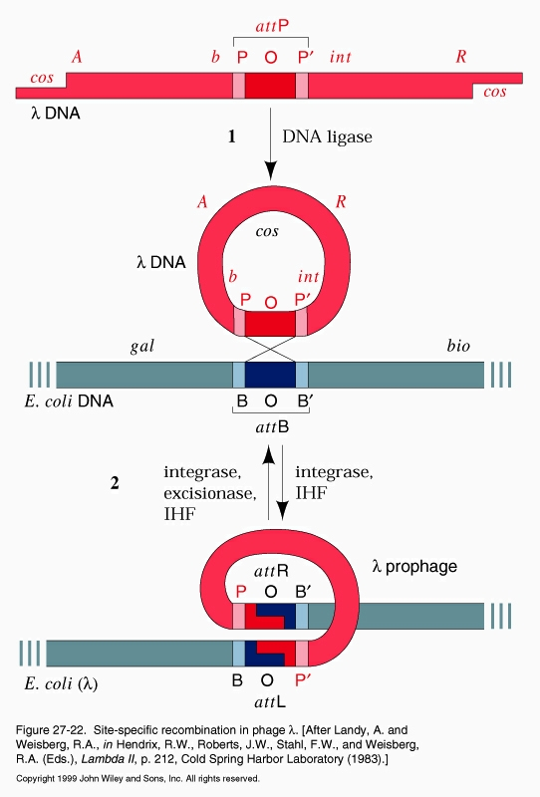
The result of recombination
integrated prophage is flanked by two slightly different attachment sites
attR has the structure POB‘
attL has the structure BOP'

Slide 4
Potential advantages with site-directed recombination cloning
higher efficiency and accuracy than ligation-based cloning
→ shorter training time of personnel
→ can process multiple samples in parallel
→ less need for confirmation after cloning
does not require restriction endonuclease digest of vector or insert before insertion of fragment
→ no need for “curing” vector or insert of restriction sites
→ can clone in large vectors, or with large inserts

