Slide 1
Adaptation of the λ system for cloning
A. The attB and attP sequences have been altered and are used as two distinct sequences in direct repeats
attB1
attB2
attP1
attP2
B. attB1 will recombine with attP1 only
attB2 will recombine with attP2 only
C. The net result is a strand exchange between recombination sites
Example of differences in attB1/attB2
attB1: GGGGACAAGTTTGTACAAAAAAGCAGGCT
attB2: GGGGACCACTTTGTACAAGAAAGCTGGGT

Slide 2
Summary of recombinations
exchange of fragment between sites 1 and 2
BP clonase mix
vector A
vector A
LR clonase mix
vector B
vector B
GATEWAY system (sold by Invitrogen)
when attB1 recombines with attP1, new sequences are created in each molecule at each site! attR1 and attL1 sequences are generated (see colours in fig above)
Similarly if attB2 recombines with attP2, attR2 and attL2 sequences are generated
attB is recombined with attP with BP clonase mix
attR is recombined with attL with LR clonase mix

Slide 3
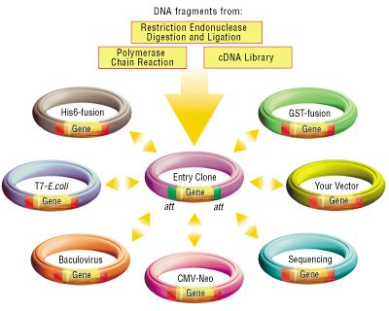
The gateway system for site-directed recombination cloning
The Gateway reactions are in vitro versions of the lambda bacteriophage recombination system
Allows efficient shuffling of fragments between vectors
saves time!
Exclusive rights by Invitrogen
reagents are expensive!
How to Enter the Gateway System
Traditional restriction endonuclease/ligation cloning
topoisomerase cloning
3. Add attB sites on PCR product followed by BP recombination
video clip
http://www.invitrogen.com/content.cfm?pageid=10541#

Slide 4
To start:
Start with an insert and an entry vector
pDONR is the name of one that is used a lot
Prepare your insert:
PCR amplify with restriction sites on the primers
Use Topoisomerase to clone into the vector (also cut at a restriction site)
PCR amplify with the compatible att sites in the primers

Slide 5
PCR amplify with restriction sites on the primers
Ligate into a vector cut with compatible REs
The construct will have att L sites to either side of the restriction site
Now you have your entry vector with att L sites, can introduce into many other vectors for multiple applications
att L1
att L2

Slide 6
Topoisomerase cloning:
Can be used for ligation in cloning experiments
Advantage over ligases is a higher efficiency of ligation.
Disadvantage is the HIGH cost of purchasing vectors with attached topoisomerase.

Slide 7
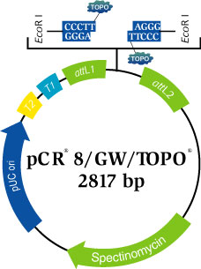
Topoisomerase cloning:
TOPO T-vector
Vectors compatible with the gateway system are available
Note the attL1 and attL2 in the example shown

