Slide 1
The Retroviral Genome
LTR Ψ LTR
gag pol env
Long Terminal Repeat (LTR): Necessary for integration into host genome
ψ (Psi): packaging signal
gag: Coat protein, for packaging viral genome into viral particles
pol: viral polymerase necessary for viral replication
env: viral envelope proteins, necessary for entry into host cells, dictate host range

Slide 2
Design of Replication Incompetent Vectors
The viral vector is reduced to a transfer vector without gag, pol, env, but has instead the gene(s) of interest
Removed functions are provided by other complementing vectors.
∆
gene of interest, selectable marker
∆
LTR Ψ LTR
gag pol env
Transfer Vector
with genes of
interest (GOI)
Packaging
Vector
Envelope
Vector

Slide 3
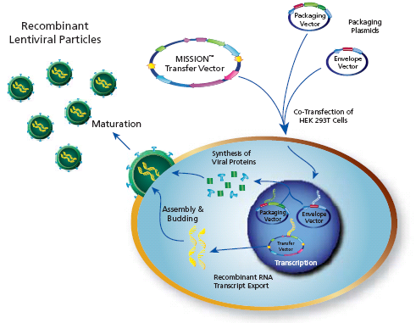
Transfection of cells with the three plasmids results
in production of viral particles with GOI RNA
The three plasmids containing the viral genome components are transfected into the packaging line to create the infectious viral particles.
Multiple plasmids are used to prevent reconstitution of a replication competent virus.
www.sigma.com/RNAI

Slide 4
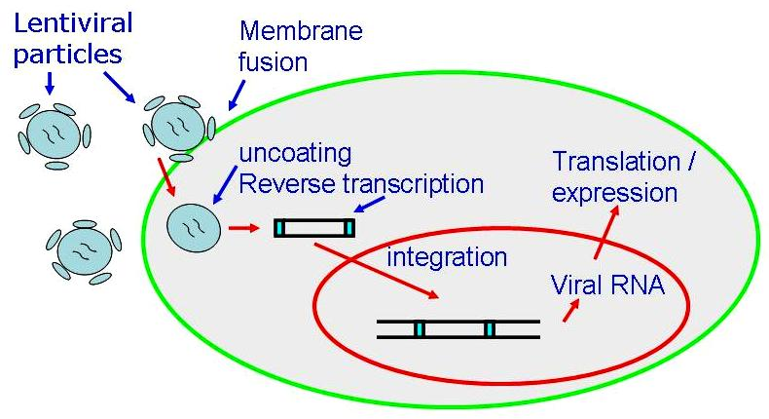
The viral particles with GOI RNA can be harvested and used to
transfect cells under study
RNA is reverse transcribed into DNA, DNA integrated into chromosome
Genes of interest expressed, and the effect of protein recorded
Record effect/
phenotype

