Slide 1
Agrobacterium tumefaciens-mediated genetic transformation of plant cells The only known inter-kingdom transfer of DNA

Slide 2
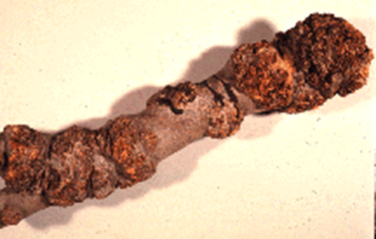
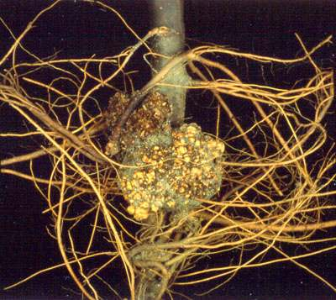
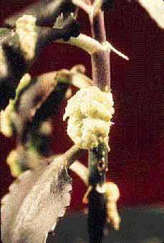
Crown gall disease is caused by Agrobacterium tumefaciens, a bacterium that transfers its own genes to plant cells for parasitic purposes
“Crown gall is a plant disease caused by a soil-inhabiting bacterium, Agrobacterium tumefaciens, which has worldwide distribution. As the name suggests, crown gall bacteria cause rounded, rough tumours of variable number and size, mainly on the stem of susceptible plants near the soil line.”
From: PEST DIAGNOSTIC CLINIC Laboratory Services Division, University of Guelph
Crown gall on apple
Photo courtesy Agriculture
& Agri-Food Canada

Slide 3
Agrobacterium’s tumor-inducing (Ti) plasmid and how it enables parasitism
Single-stranded Transfer DNA
(T-DNA) is transferred to
adjacent plant cell and integrated
into a chromosome
T-DNA encodes genes/proteins
for synthesis of,
hormones
opines
The hormones (auxin and cytokinin)
result in uncontrolled plant cell divisions
and formation of crown gall tumors
Opines are specialized amino acids that only the bacteria can metabolize, providing both
carbon and nitrogen.
Notes:
PP5e-Fig-02-17-0.jpg

Slide 4
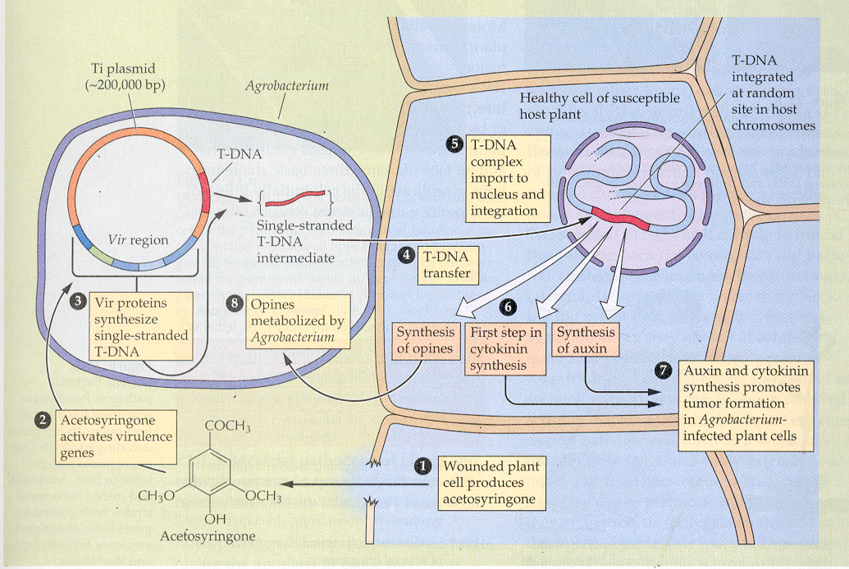
Overview of the Infection Process
Steps 1-5
are important

Slide 5
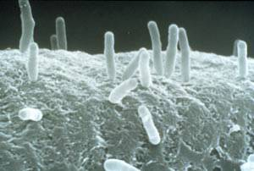
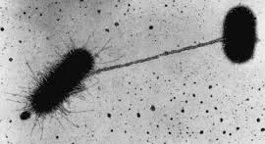
A. tumefaciens also has virulence genes that enable attachment to plant cells and formation of pilus for transfer of DNA

Slide 6
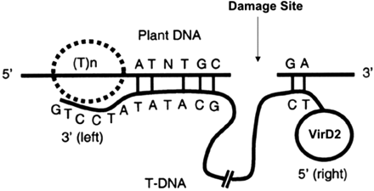
T-DNA integration into plant DNA is not well understood
There is evidence for micro-homology base-pairing (just a few bases) followed
by integration

Slide 7
T-DNA transfer does NOT require any of the genes within the T-DNA,
just the left and right border repeats.
→ T-DNA genes can be replaced with gene(s) of interest, including
an antibiotic resistance gene, allowing selection of transformed cells

Slide 8
Problem:
The Ti Plasmid is difficult to engineer:
very large – restriction endonucleases cut multiple
times, preventing insertion of DNA
low (single) copy/cell –
impossible to collect enough
copies for cloning experiments
T-DNA →

Slide 9
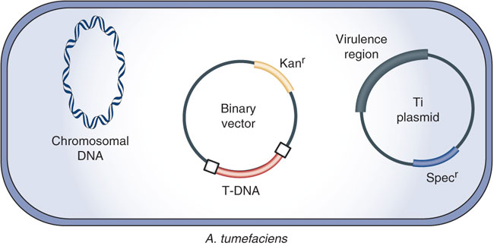
The solution: a binary system with T-DNA on a smaller plasmid, and virulence genes on a “disarmed” (no T-DNA) Ti plasmid
small (10-25 kb) large (150-200 kb)
The Agrobacterium strain used for transformation carries two plasmids. A non-oncogenic disarmed tumor-inducing plasmid (Ti plasmid) containing the virulence (vir) genes, but lacking the T-DNA region. The T-DNA region is present on a second plasmid, the binary plasmid.
Nature Protocols 3, 1671 - 1678 (2008)

Slide 10
A typical Agrobacterium binary plasmid transformation vector
Two origins of replication, one for E. coli, one for A. tumefaciens
High copy number→ easy to purify enough plasmid for cloning experiments
Small, with several unique restriction endonuclease recognition sites for cloning of GOI
Has left and right border repeats, recognized by Vir proteins for excision and transfer
into plant chromosome
Has selectable marker gene for
selection of bacterial cells with plasmid
Has selectable marker gene for
selection of plant cells with T-DNA

