Slide 1
Chapter 17. Introduction of DNA into eukaryotic cells - chemical and physical methods

Slide 2
Two different end goals of DNA introduction
Transient expression assays
Plasmid DNA is introduced into cell and nucleus
Gene(s) on plasmid transcribed in nucleus
Expression and effect (phenotype) is recorded
Plasmid DNA is degraded
Stable introduction of DNA into chromosome
The rare event of plasmid DNA integration into chromosome is selected or screened for, and cells with the construct collected
Cells are maintained either as cell culture or used to regenerate transgenic organism

Slide 3
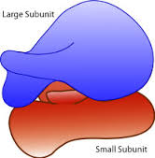
Selection for transformed cells (kill the ones that don’t have the construct)
1. Plasmid carries gene that produces protein that detoxify chemical in the medium
2. After transformation, cells are grown in medium that kills non-transformed cells
3. Transformed cells are identified by their ability to continue to divide
Example:
The Hygromycin PhosphoTransferase (HPT) -encoding gene
(from E. coli) can detoxify hygromycin, a chemical that inhibits translation by ribosomes.
HPT and hygromycin is often used to select for transformed animal and plant cells.

Slide 4
Screening for transformed cells (identify transformed cells among non-transformed)
1. Plasmid carries gene that produces protein that can be visualized, either directly or by an assay that marks the cell (without killing it)
2. After transformation, cells are screened for marked cells.
3. Transformed cells are
collected and grown.
Example:
The Green Fluorescent Protein
(GFP)-encoding gene
phase contrast
imaging shows
all cells
Excitation with
blue light results
in green light emission
from GFP-transformed
cells.

Slide 5
Examples of methods
Chemical methods
Cation/heat shock method (also bacteria)
Liposome method
Physical methods
Injection
Electroporation(Also bacteria)
Micro-projectile bombardment

Slide 6
REMINDER: Terminology
Transformation (introduction of DNA to bacterial cells)
Transfection (introduction of DNA to eukaryotic cells
Transduction (introduction of DNA to prokaryotes or eukaryote cell culture through a viral vector)

Slide 7
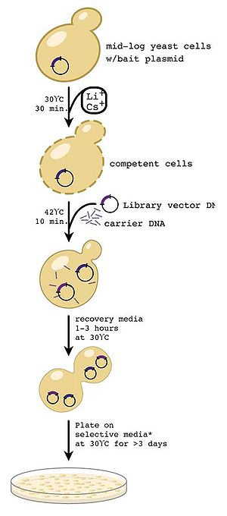
Cation/heat shock method to transform yeast cells
Method is almost identical to what you
have used for transformation of E. coli cells
Yeast is the by far most studied eukaryotic
organism when it comes to basal cellular mechanisms and metabolism.
This analysis is deeply dependent on the ability to generate various gene constructs and introduce them into cells for analysis of effects.

