Slide 1
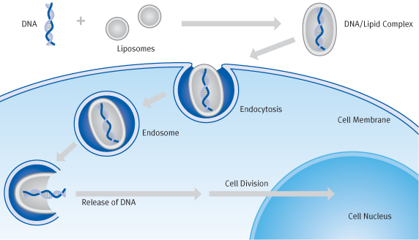
Introduction of DNA by liposomes- lipofection used extensively for transformation of animal cell cultures
1. Transfection-active lipoplexes spontaneously form from cationic lipids and
negatively charged DNA
Lipoplexes are taken up by endocytosis
The DNA is released by destruction of the endosome membrane
4. The DNA enters the cell nucleus during mitosis
(lipoplex)
Text and image from
http://www.biontex.com

Slide 2
https://www.slideshare.net/DanishKurien/liposomes-9644602

Slide 3
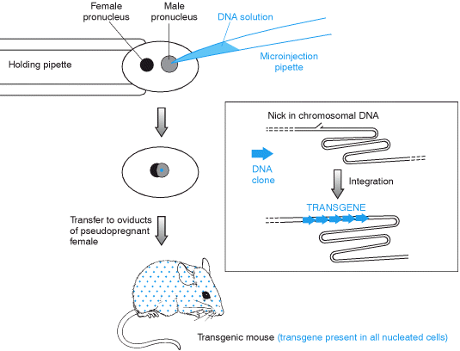
Microinjection of DNA into fertilized mouse egg cell
Notes:
Injection can be done in other organisms too. Stage is important. You cannot be sure of getting it into the nucleus so prior to nuclear fusion is good. Some DNA is only integrated during cell division when the nuclear envelope dissolves.

