Slide 1
Common reporter/marker genes for study of gene expression in transgenic organisms
Gene Gene product Assay kills? use
lacZ β-galactosidase histochemical test yes animal
GUS β-glucuronidase histochemical test yes plant
GFP Green Fluorescent Protein fluorescence no animal/plant
GFP variants fluorescence no animal/plant
What is the benefit of using reporters that don’t require fixing and staining of tissues?

Slide 2
GUS (uidA) gene
encoding a β-glucuronidase enzyme
Histochemical assay (assay in tissue)
β-glucuronidase
X-Gluc
Blue precipitate that does not
diffuse out of cells
5-bromo-4-chloro-3-indolyl
-β-D-glucuronic acid

Slide 3
Lac Z gene
Encodes a β-galactosidase enzyme
Histochemical assay (assay in tissue)
β-galactosidase
X-gal
Blue precipitate that does not
diffuse out of cells
5-bromo-4-chloro-3-indolyl
-β-D-galactopyranoside

Slide 4
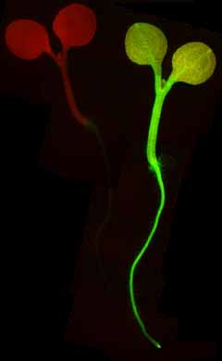
GFP (green fluorescent protein)-encoding gene from
the jellyfish Aequorea victoria
Fluoresces green light on irradiation with blue light
observed by fluorescence microscopy
A. thaliana wild type (left)
35S-gfp transformed (right)
jellyfish Aequorea victoria

Slide 5
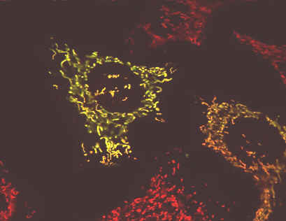
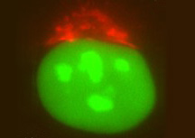
Green Fluorescent Protein (GFP)
Many spectral variants have been produced by mutagenesis:
Yellow (YFP)
Excitation Emission
Green (GFP)
Yellow (YFP)
Cyan (CFP)
Red (RFP)
red (RFP)

Slide 6
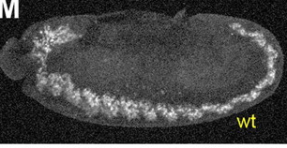
1-5000
ORF
T
Constructs:
Nucleotides 1-5000 upstream
GFP
T
Nucleotides 2000-5000 upstream
GFP
T
Nucleotides 1-3000 upstream
GFP
T
Nucleotides 1-2000
GFP
T
Nucleotides 3000 - 5000
GFP
T
Write down the part of the upstream sequence responsible for the expression pattern

Slide 7
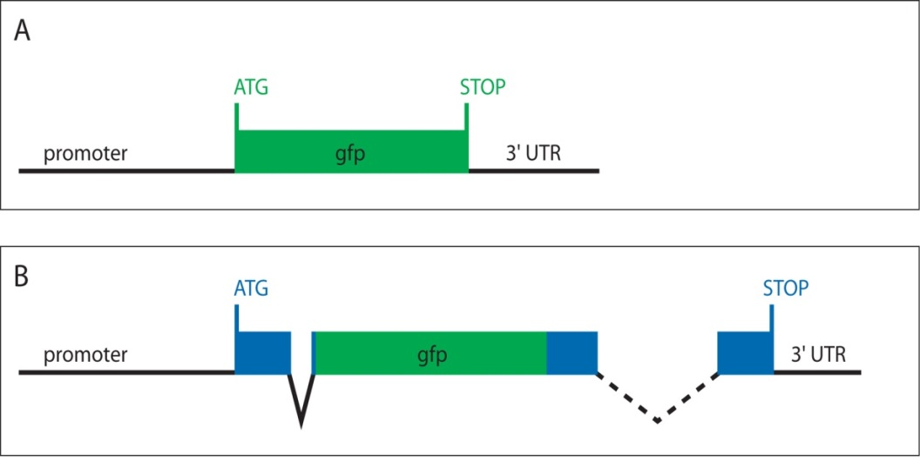
Transcriptional versus translational fusion to marker gene
Transcriptional marker gene fusion:
A promoter fragment is fused directly to the marker gene, which is what will be transcribed (A).
Translational marker gene fusion:
A promoter fragment and the whole or part of the genes open-reading-frame (protein-encoding region) is fused with
the marker gene open-reading-frame
so that a continuous translational fusion of protein is produced (B).
http://www.wormbook.org/chapters/www_reportergenefusions/reportergenefusions.html

Slide 8
Translational fusion can be in the middle or 3’ end of the gene as well as the 5’ end (previous slide)
fusion in frame with gene of interest:
stop codon is removed, and the ORF
continues into the reporter gene such that a
fusion protein will be made.
ORF will stop at stop codon in reporter gene.
3’
PROMOTER
exon 1
intron
exon 2
REPORTER GENE
We must pay attention to the reading frame of reporter gene and gene of interest. If they are different, one or both proteins won’t be made correctly
What additional information can we get about the gene function if we make a translational fusion? We are essentially labeling the protein.

Slide 9
Fusion type | Contains 5’ regulatory elements | Contains cis elements that may reside in introns or 3’ end | Fusion protein provides sub-cellular localization of native proteins
transcriptional | √
translational | √ | √* | √**
Transcriptional fusions are easier to make and tend to provide most of the relevant
info on which cells express the gene of interest based on 5’ regulatory elements.
Translational fusions are harder to make, but provide ALL cis elements AND
can also show in which subcellular localization the protein of interest localizes.

Slide 10
How can we be sure a fusion protein localizes correctly?
It is possible that the GFP amino acids prevent proper folding and/or localization of the tagged protein
Possible approaches:
1. make several constructs with the label in different positions of the protein- if all go to the same location in the cell, can be somewhat more confident that this is the correct location
2. If we have a genetic mutation that has a detectable phenotype, incorporate your fusion construct into the genome of individuals without a functional gene. If the phenotype returns to normal then the tagged protein is moving to the correct location and performing its normal function

Slide 11
Vectors with all three possible open reading frames for construction of vectors that result in fusion proteins: ONE OF THEM WILL BE THE CORRECT ONE
Main point - it costs a lot of money but makes life easier
part or whole ORF
of gene of interest
promoter
vector 1
MCS
GFP
vector 2
MCS + N
GFP
vector 3
MCS + NN
GFP

Slide 12
The next slide shows a beautiful example of GUS staining and a transcriptional fusion. It shows gene expression in the vascular tissue of the developing plant

Slide 13
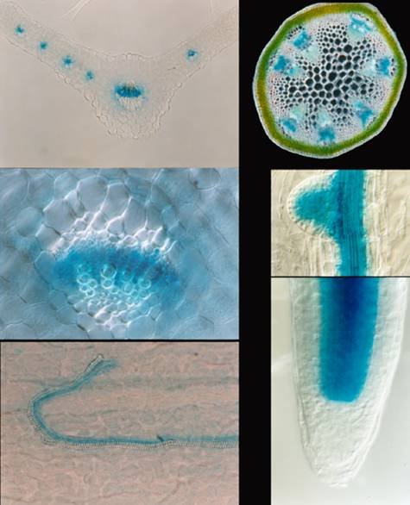
Example from the
Mattsson lab:
A fusion between a fragment
of the Arabidopsis AtHB-20
gene encoding a homeodomain
leucine zipper protein and the
gene encoding the GUS
enzyme revealed vascular expression
in various organs.
The construct included the presumed
promoter, and part of the AtHB-20
ORF arranged so that the ORFs of AtHB-20
and GUS are continuous, generating
a fusion protein.
gene construct
fusion protein
promoter
homeobox
GUS gene
homedomain
GUS enzyme
Mattsson et al., Plant Physiol. 2003 131:1327-39.
Notes:
I have identified En1 insertion alleles in two of these genes
Athb20,
No phenotype possibly due to redundant gene function, known for other members of this gene family. I’m working on making double mutants related genes to uncover function,
I’ve done translational fusion with marker gene, aerial organs expressed in
Provascular cells, referred to as xylary procambium

Slide 14
The final slide shows a GFP fusion in a gene that is responsible for transport of auxin, a plant hormone, from one cell to another. The protein localizes to the membrane just at one end of the cell because the hormone is transported in one direction only. A really beautiful example of the sort of info you can get from a translational fusion

Slide 15
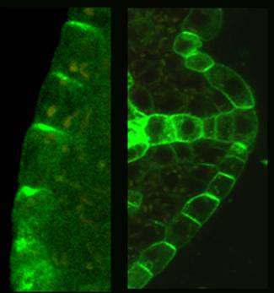
Insertion of marker gene into genomic clone allows production of fusion protein
with intact 5’, internal, and 3’ cis regulatory sequences.
Also allows functional protein to be produced
(a)
(b)
(c)
(d)
(e)
GFP gene
exon intron exon intron exon intron exon
(f)
In this case the GFP gene has been
inserted into an exon of the PIN1 gene
functional (PIN1 protein)
translational fusion
allow subcellular localization of
PIN1 protein via GFP
(g)
(h)
(i)
(j)
(k)
(l)
(m)
Wenzel et al., Plant Journal 2007 49: 387-

