Slide 1
Evaluating Decision-Making and Relationship Competence when Reporting Suspected Child Abuse and Neglect
Rater Training
Date

Slide 2
Agenda
Welcome and Introductions
Maltreatment Scenarios
Measurement Instruments
Completing the Rating Scales
LUNCH
OSCE Logistics
Practice Rating
Giving Feedback to Participants

Slide 3
Welcome and THANK YOU!

Slide 4
Introductions

Slide 5
Team

Slide 6
Rater Introductions
Name and affiliation
Experience with simulation and/or OSCE
Confidentiality, consent, and honorarium agreements

Slide 7
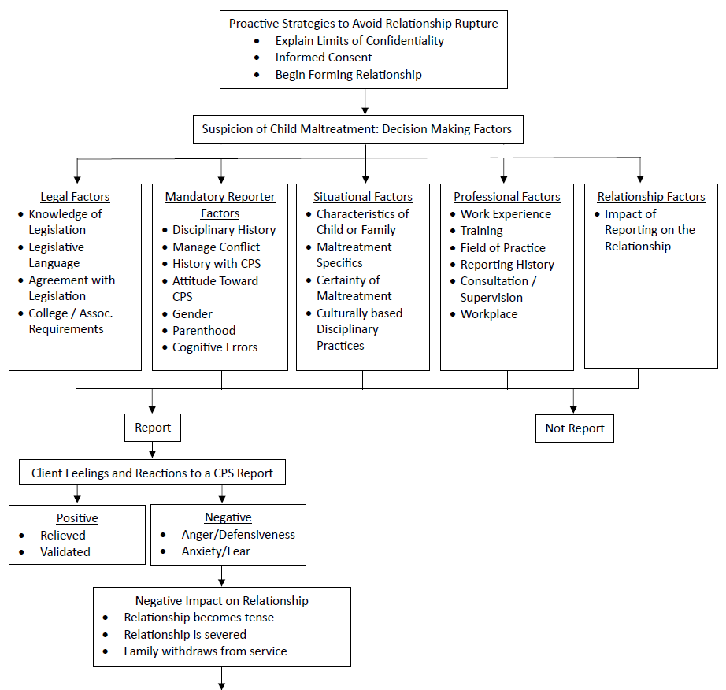

Slide 8
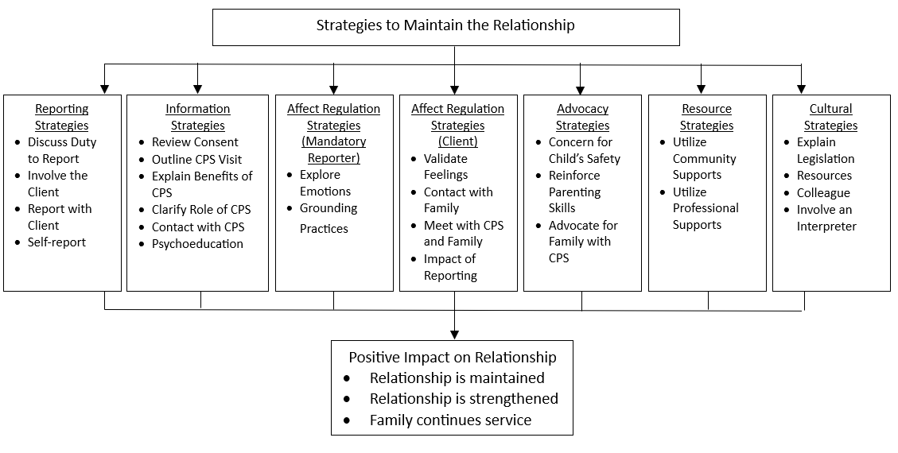
Framework Continued:

Slide 9
Maltreatment Scenarios

Slide 10
Physical Abuse
Mother - Tala (age 30)
Child - Benjie (age 4)
Father - Paul (age 32)

Slide 11
Neglect
Father - John (age 37)
Daughter - Flora (age 9)
Daughter - Sally (age 6)

Slide 12
Sexual Abuse
Boyfriend - James (age 40)
Girlfriend - Michelle (age 40)
Girlfriend’s daughter - Melissa (age 13)

Slide 13
Emotional Abuse
Mother - Sonia (age 24)
Daughter - Jaspreet (age 6)

Slide 14
Exposure to Intimate Partner Violence
Father - David (age 33)
Mother - Elena (age 33)
Son - Floyd (age 12)
Daughter - Juliana (age 10)

Slide 15
Measurement Instruments

Slide 16
Measurement Instruments
Demographic Form
Standardized Client Feedback Form
Participant Workshop Feedback
Performance Rating Scale*
Post-Performance Reflection Questions
Post-Performance Reflection Rating Scale*

Slide 17
Performance Rating Scale
9 Questions:
How do participants approach the child maltreatment issue?
How do participants discuss the child maltreatment issue with the client?
How do participants discuss the duty to report?
What factors do participants include in an eco-systemic assessment of child maltreatment issue?
How do participants maintain balance of content and process in the interview?
How do participants use strategies to maintain the relationship?
How do participants manage client affect (i.e., tears, anger, fear, protest)?
How do participants include culture, gender, race, age, or ability?
Based on your impression of the participant’s performance, this participant demonstrated competence at the level of...

Slide 18
Post-Performance Reflection Questions
11 questions:
What do you think of your performance in the interview?
What was the type of maltreatment and what evidence raised your suspicion?
What information did you gather about the child maltreatment situation?
What contributed to the decision-making process of whether to report to Child Protection Services?
Do you believe the situation is reportable to Child Protection Services? If yes, how did you approach the client about reporting to Child Protection Services?
In the interview, how did you feel and how did you use these feelings?
Was there a relationship rupture in the interview? If yes, what did this look like?
How did you attempt to repair / maintain the relationship between yourself and the client?
What would be your next steps(s), (if any), in continuing to repair / maintain the therapeutic relationship?
What do you feel you learned from this interview?
How might this learning experience influence your approach to a future suspicion of child maltreatment?

Slide 19
Post-Performance Reflection Rating Scale
11 Questions:
To what extent is the participant's reflection accurate to the behaviours observed?
How was the participant able to identify the type of maltreatment and what was the evidence?
How does information gathered in session inform participants’ thinking of the child maltreatment issue?
How do participants engage in a decision-making process?
How do participants approach the client with regards to reporting child maltreatment?
How do participants manage their emotions to the child maltreatment issue?
How do participants recognize relationship rupture?
How do participants conceptualize relationship repair strategies?
How do participants utilize relationship repair strategies in continued work with the client?
What do participants focus on and talk about regarding their performance in the OSCE?
What do participants say about how they would integrate this experience into their practice?

Slide 20
Completing the Rating Scales on Qualtrics

Slide 21
LUNCH

Slide 22
OSCE Logistics

Slide 23
OSCE
Room # – Registration
Room # – Computer Lab
Room # – Standardized Actors
OSCE Stations:
Room # – Emotional Abuse
Room # – Sexual Abuse
Room # – Exposure to IPV
Room # – Physical Abuse
Room # – Neglect

Slide 24
OSCE Schedule
Rater Training (9:00 am – 5:00 pm)
Mandatory Reporting Workshop (9:30 am – 12:30 pm)
OSCE Day 1 (9:00 am – 5:30 pm)
OSCE Day 2 (9:00 am – 5:30 pm)
OSCE Day 3 (9:00 am – 5:30 pm)
OSCE Day 4 (9:00 am – 5:30 pm)
OSCE Day 5 (9:00 am – 5:30 pm)

Slide 25
OSCE Daily Schedule – Raters
Assign a Room/Maltreatment Type for the OSCE
Participants arrive at 30-minute Intervals
Rate a total of X participants per day
Lunch
Complete Post-OSCE Reflection Rating Scale independently

Slide 26
OSCE Schedule – Participants
OSCE
5 mins to review case vignette
15 mins OSCE session
5 mins feedback from rater and actor
30 mins reflection in computer lab
Repeat x5

Slide 27
Participant Support
Community resource list

Slide 28
Practice Rating

Slide 29
Physical Abuse

Slide 30
Neglect

Slide 31
Giving Feedback to Participants
Order of feedback (participant, actor, rater)
Need for brevity
Positive and constructive feedback
Feedback must relate to discussing the duty to report and relationship repair strategies

Slide 32
Examples of Poor and Good Feedback
“you did great” or “good job”
“you didn’t do this, this, this, etc.”
“why did you lead with that question”
“don’t say that it makes you look (insert word)”
“I would not encourage you to become a clinical social worker”
Other examples?
“I liked how you addressed the client’s concern regarding her children; it was effective in calming the client. Remember to maintain eye contact”
“you did a good job paraphrasing the client’s situation”
“I would encourage you to pursue that line of questioning a bit more. Here are some suggestions …”
Other examples?

Slide 33
Thank You!

