Slide 1

Cross-cultural Research Methodology
This Photo by Unknown Author is licensed under CC BY-SA
Slides created by
Dr. Gira Bhatt
Kwantlen Polytechnic University
CC BY NC-SA 4.0

Slide 2

Cross-cultural Research: Methodology Challenges
Equivalence
Sampling Adequacy:
Non-cultural Demographic equivalence
Language & Translation issue
Operational definition of Variables
Reliability & Validity of the measure
Research Setting & Procedure
Cultural Response set
Interpretation
This Photo by Unknown Author is licensed under CC BY

Slide 3
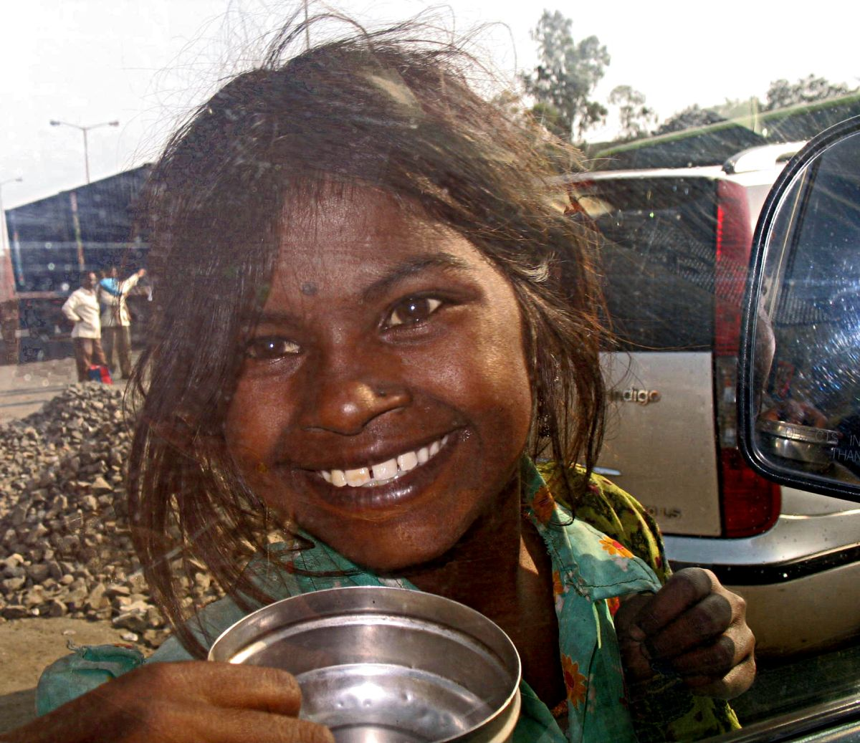

Equivalence
Similarity in conceptual meaning
Example:
Happiness
Similarity in empirical method
Example:
Survey: Self-report, Oral
Rating Scale: Numeric rating scale
This Photo by Unknown Author is licensed under CC BY
This Photo by Unknown Author is licensed under CC BY-NC-ND

Slide 4
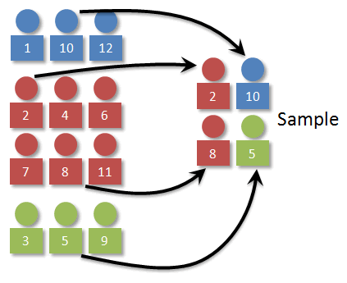
Sampling
“Good” representation of a culture
Example:
Comparing India and Canada on religiosity
Or
Comparing Canada and the US on political attitude
Getting a representative sample is critical
This Photo by Unknown Author is licensed under CC BY-SA-NC

Slide 5
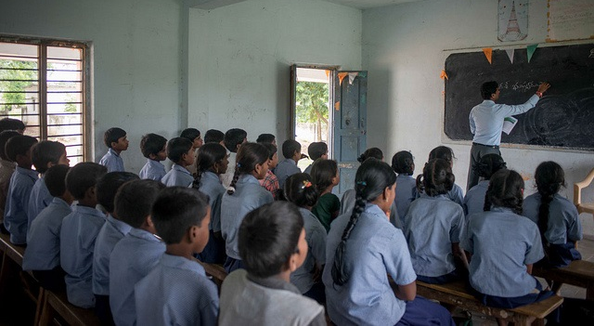
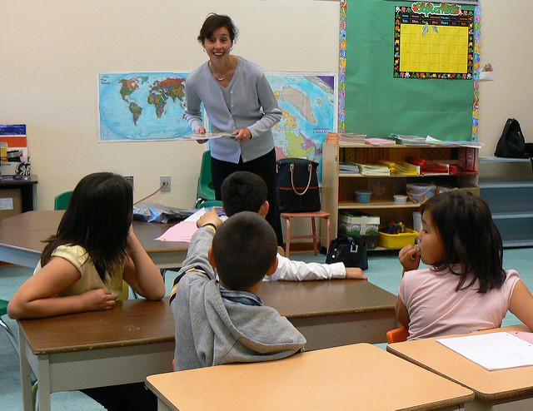
Non-cultural Demographic Equivalence
Other Demographic variables
may have different meaning
Example: Education
High School
- may have different timeline for completion in different countries
OR
Socio-economic status
Upper- Middle-Lower
This Photo by Unknown Author is licensed under CC BY-SA
This Photo by Unknown Author is licensed under CC BY

Slide 6

Language and Translation
* Certain terms may have different
interpretation when translated
Example: Anonymity
* Some terms may be absent in other
languages
Example: Self-Identity
* Importance of Back Translation
This Photo by Unknown Author is licensed under CC BY-SA

Slide 7

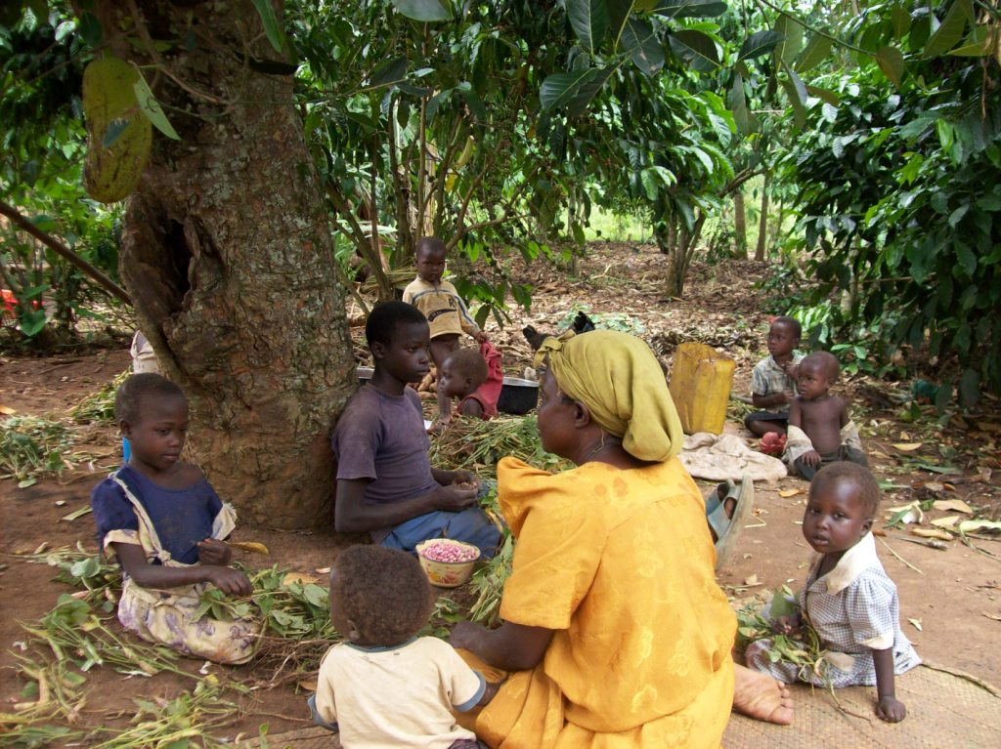
Operational Definition
Behavioural, observable part of the operational definition of a psychological construct may differ from culture to culture
Example: Mid-day Meal
This Photo by Unknown Author is licensed under CC BY-ND
This Photo by Unknown Author is licensed under CC BY-SA-NC

Slide 8
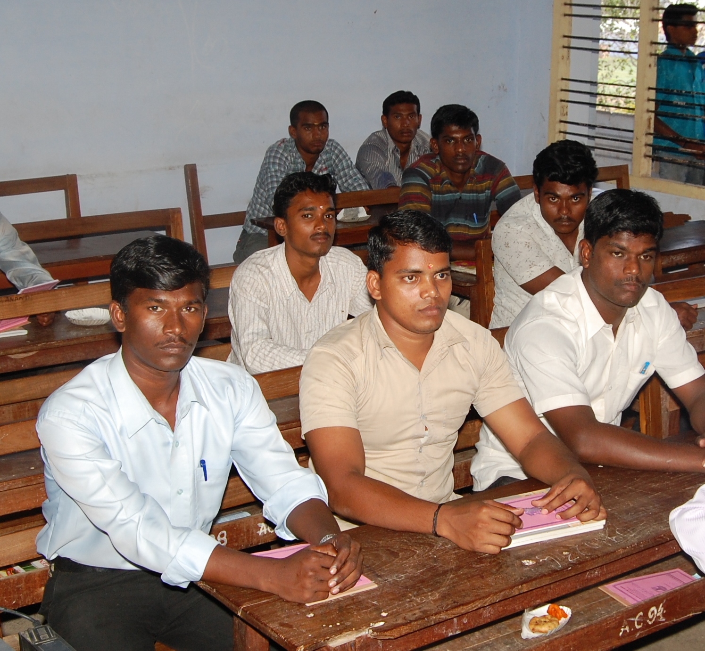
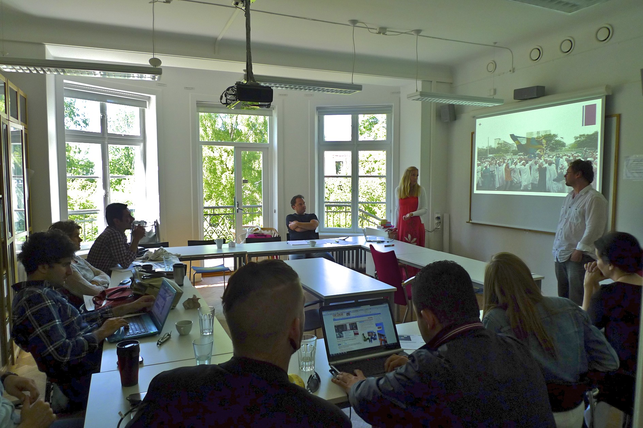
Research Setting and Procedure
Geographical, Physical setting may vary across cultures
Example: Classroom
This Photo by Unknown Author is licensed under CC BY-SA
This Photo by Unknown Author is licensed under CC BY-SA

Slide 9
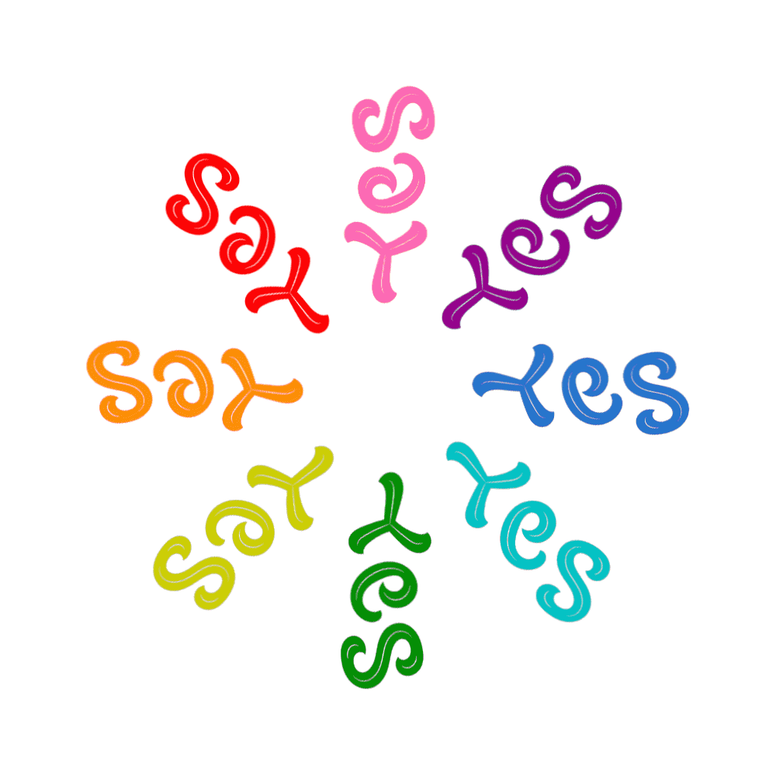
Cultural Response Set
Some cultures are “Yea sayers”
Agree to any statement
Cultural norm to be agreeable
This Photo by Unknown Author is licensed under CC BY-SA

Slide 10

Adapting a Psychological Measures
Some measures need to be adapted to the culture without losing its validity
e.g., Attribution Style (Weiner, 1985)
Item:
You go out on a date and it goes badly
Relational item, Negative valence
Some cultures do not have “dating” practice
Change to
Your engagement breaks off
This Photo by Unknown Author is licensed under CC BY

Slide 11
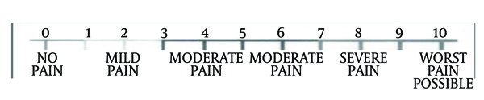
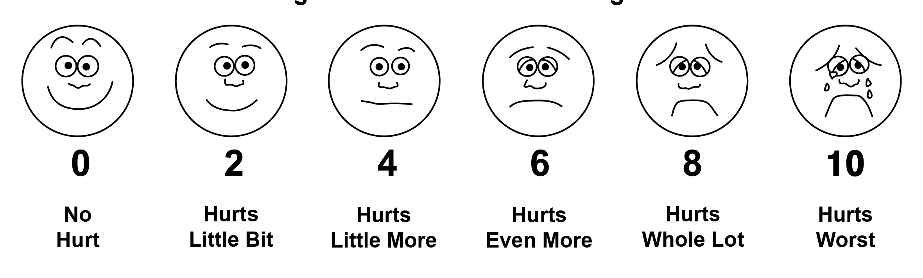
Test and Measurement Format
Commonly used rating scale may not be understood in some cultures
This Photo by Unknown Author is licensed under CC BY-NC
It may be adapted as diagrams
This Photo by Unknown Author is licensed under CC BY
Notes:
The top diagram shows a rating scale a straight vertical line with ratings from 0 to 10, with 0= no pain and 10 = worst possible pain.
The lower diagram shows the same rating scale using faces with the face at ) showing a smile, and the face at 19 showing sade face with tears – Hurts the Worst.

Slide 12
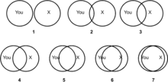
Rating scale for Measuring Self-Other Closeness e.g., How close are you to your neighbor ?
This Photo by Unknown Author is licensed under CC BY-SA
Notes:
This diagram shows the rating scale of closeness where two circles are used. 1 shows two circles next to each other, but not touching, indicating that the two are not close. These circles increasingly merge indicating the level of closeness with the 7 showing the circles almost totally merged indicating total closeness.

Slide 13
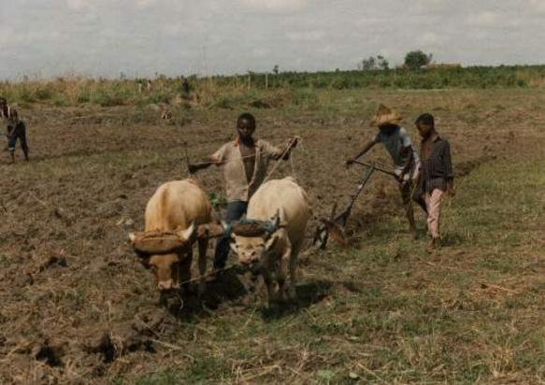
Interpretation
Research findings may lead to different interpretations from different cultural perspectives
Example:
Child labor or Helping parents?
This Photo by Unknown Author is licensed under CC BY
This Photo by Unknown Author is licensed under CC BY-SA

