Slide 1

Acculturation
Slides created by
Dr. Gira Bhatt
Kwantlen Polytechnic University
CC BY NC-SA 4.0
This Photo by Unknown Author is licensed under CC BY-ND

Slide 2

21.9% of Canadians are foreign born
from 200 countries
speak 94 Languages
250 Ethnic Origins
(Stats Can, 2016)
This Photo by Unknown Author is licensed under CC BY-NC

Slide 3
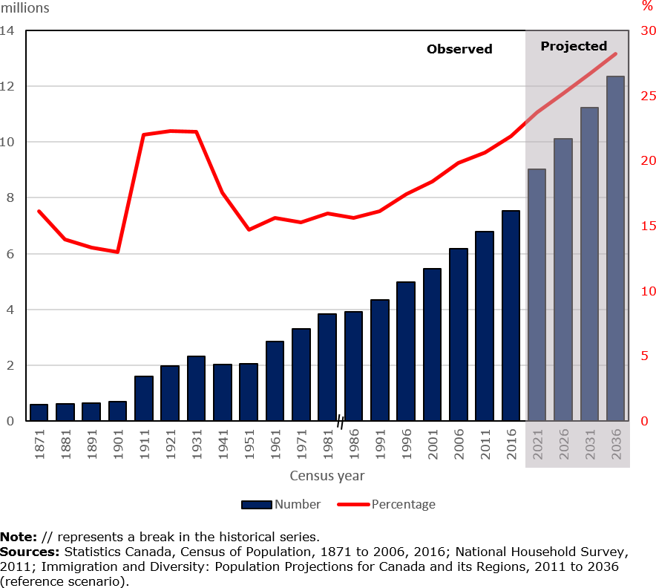
Number & Proportion of Foreign-born Population in Canada: 1871-2036
Notes:
This chart sows the number of population in millions on the left vertical axis and % on the right vertical axis.
On the horizontal Axis are years from 1871 to 2036. This shows a steady growth of Foreign born population in Canada which is projected to be close to 30% by 2036

Slide 4
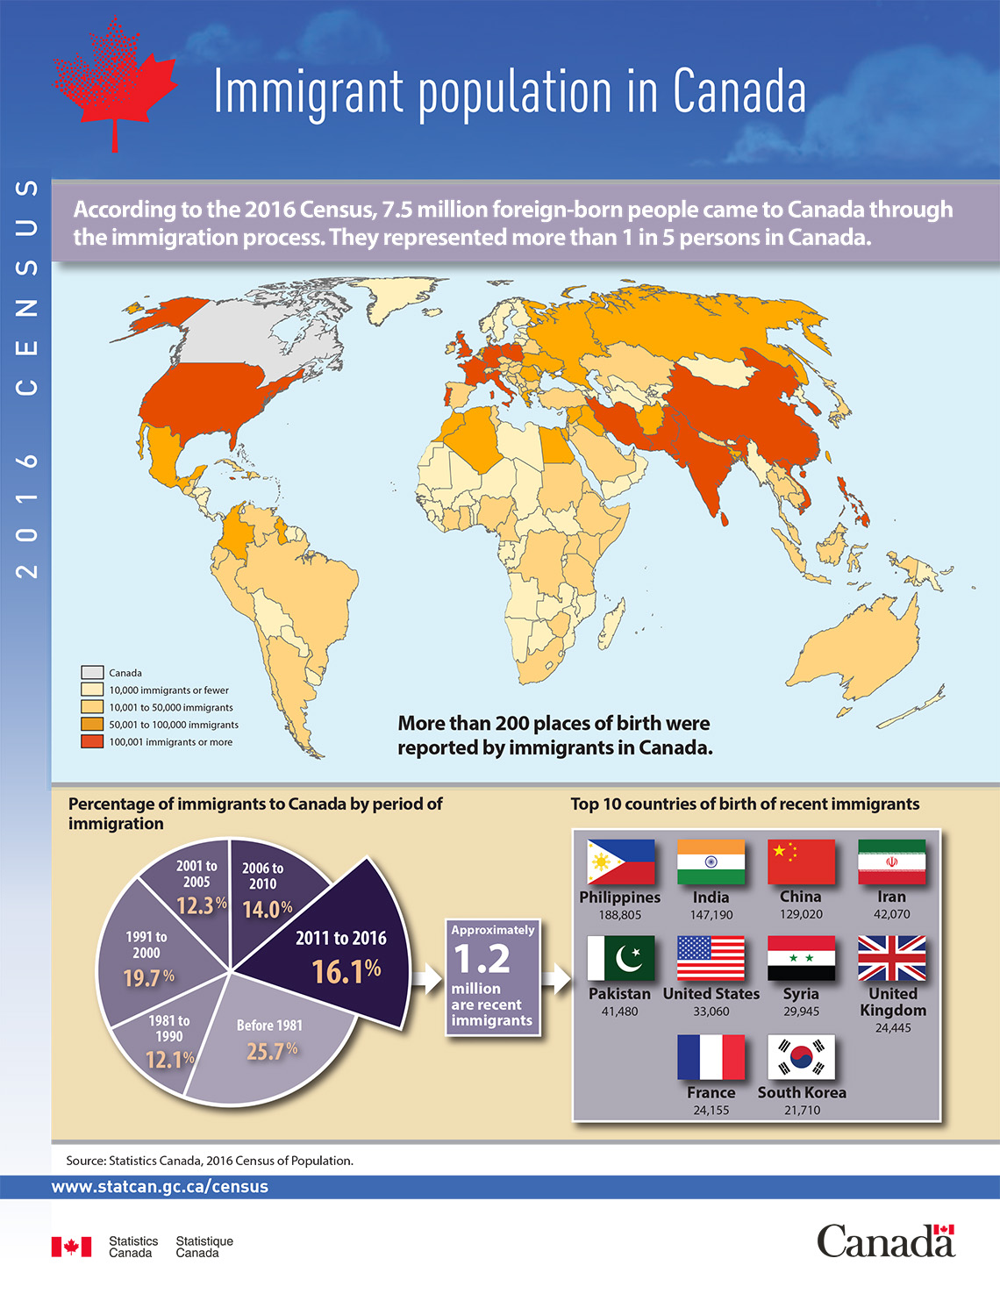
Notes:
This illustration is about the % of immigrants to Canada in 2016. The pie chart on the left shows that between 2011-2016, 16.1% or 1.2 million immigrants arrived. The top 10 source countries shown on the right are Philippines, India, China, Iran, Pakistan, USA, Syria, UK, France, and South Korea.

Slide 5
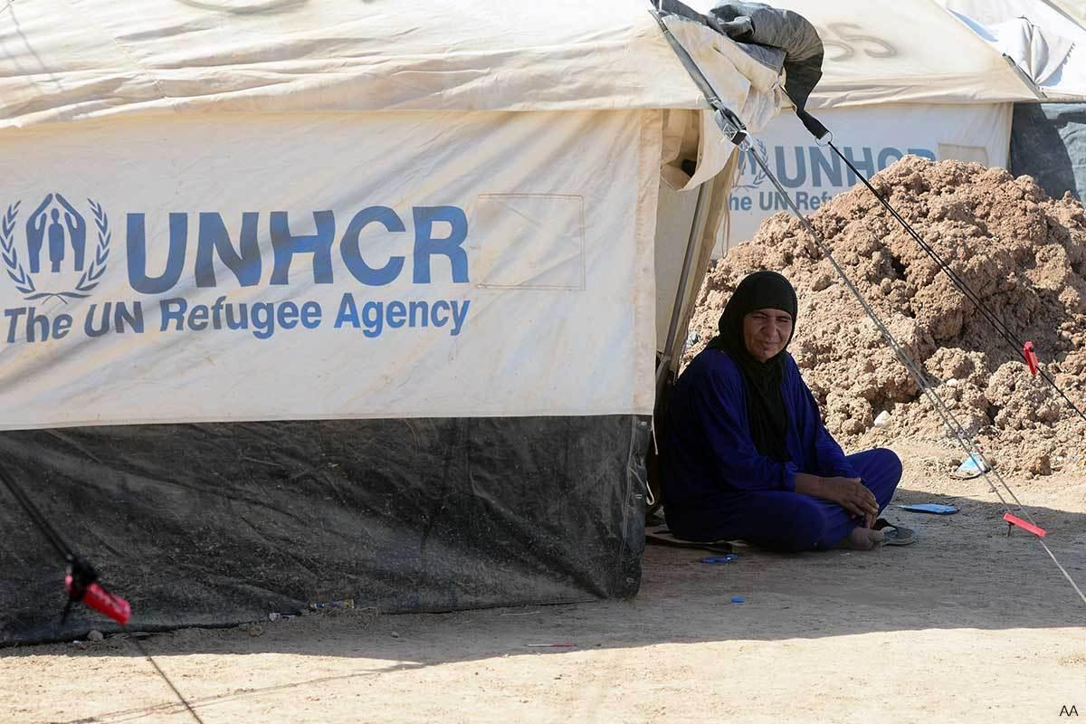


Newcomers to Canada
This Photo by Unknown Author is licensed under CC BY-SA-NC
Immigrants
Refugees
Soujourners (Temporary);
e.g., Students, Diplomats,
Business groups
Tourists
This Photo by Unknown Author is licensed under CC BY
This Photo by Unknown Author is licensed under CC BY-NC-ND

Slide 6
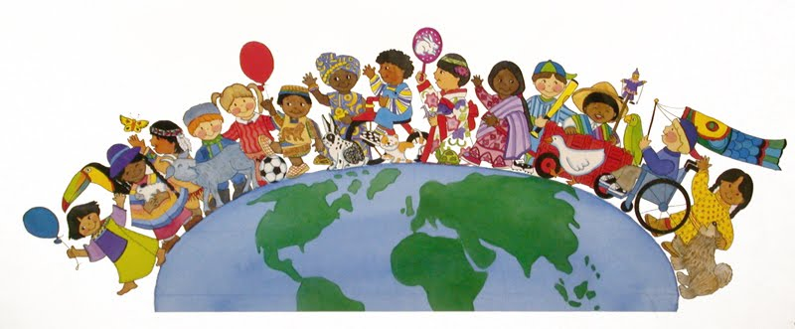
Canada’s Multiculturalism
Two principal elements of the Multiculturalism policy,
1) Maintenance of traditions
and
2) interest in positive contact with other groups
Four distinct styles of strategies emerged.
This Photo by Unknown Author is licensed under CC BY

Slide 7
John Berry's Scheme of Acculturative Attitude Styles (Berry, 1997)
 |  | Is it considered to be of value to maintain cultural identity and characteristics?
 |  | YES | NO
Is it considered to be of value to maintain relationships with other (host) groups? | YES | INTEGRATION | ASSIMILATION
 | NO | SEPARATION | MARGINALIZATION
Notes:
John Berry proposed a model to examine the acculturation process. Accordingly, a new immigrant or anyone moving from one cultural context to a different cultural context, has two questions: 1) How much of my own, home or heritage culture do I retain? Do I keep my heritage culture or let it go? And 2) How much of my new, host culture I take in? Do I take it all in or not? If each question may be answered as simple Yes or No, we get this four-fold scheme. This is described in the next slide.
If the answer is YES to both, the result is Integration- you keep your heritage culture and also mingle well with your host culture. are comfortable with both cultures.
If the answer is YES to keep my heritage culture, but NO to the accepting the new host culture, the result is Separation.
If the answer is NO to keep my heritage culture, but YES to accepting the new host culture, the result is Assimilation
If the answer is NO to both questions, the result is Marginalization.

Slide 8

Berry's Scheme of Acculturative Attitude Styles (Berry, 1997)
Integration
is most desired by the "multicultural assumption"
of maintenance and contact leading to
a positive identity and tolerance of others
(Berry 1984, 1997)
Separation
occurs when there is a group that is in an inferior
position of power desires to maintain traditional
cultural behavioral patterns, values and identities
without the acceptance of the behaviors, values or
identities of others
Assimilation
occurs whereby groups and individuals forego the maintenance of their traditional ethno-cultural heritages and take on the cultural ways of the host society.
Marginalization
"is difficult to define precisely, possibly because it is accompanied by a good deal of collective and individual confusion and anxiety. It is characterized by striking out against the larger society and by feelings of alienation, loss of identity, and what has been termed acculturative stress."
(1989, p. 4, emphasis original)
This Photo by Unknown Author is licensed under CC BY-SA-NC

Slide 9
John Berry’s Acculturation Model- Revised
Maintenance of Heritage Culture and Identity
_
_
+
+
+
Relationships sought among groups
Integration
Assimilation
Integration
Assimilation
Separation
Marginalization
Separation
Marginalization
_
Strategies of Ethnocultural
Groups
Strategies of Larger Society
Notes:
Later Berry revised his model to imply that acculturation is not simply YES-NO process. It is fluid and there is a continuum to both questions.
So in this illustration he used the circle instead of a 2 X 2 box. Also he added the Host culture’s orientation – How does the larger society feel about the newcomers?
Do they want them to Integrate? Assimilate, stay Separate or view them as Marginalized?

Slide 10
The Interactive Acculturation Model
Richard Bourhis (2010) (U of Montreal)
 |  | Host Culture’s Acceptance/Expectation
 |  | Integration | Assimilation | Separation | Marginalization
New /Acculturating Groups | Integration | √ | ? | ? | ?
 | Assimilation | ? | √ | ? | ?
 | Separation | ? | ? | √ | ?
 | Marginalization | ? | ? | ? | ?
Notes:
Bourhis elaborated on the four-stage acculturation of the newcomer with the Host culture’s attitude towards the newcomers.
If both agree on a strategy, there is no tension. However if the two groups do not align, there is a tension.

Slide 11
Berry's Scheme of Acculturative Attitude Styles (Berry, 1997)
Deculturation was defined by Berry (1984) as
a pattern that "occurs when a group's culture is not maintained and when there is no participation in the affairs of the dominant group" (p. 357).

Slide 12

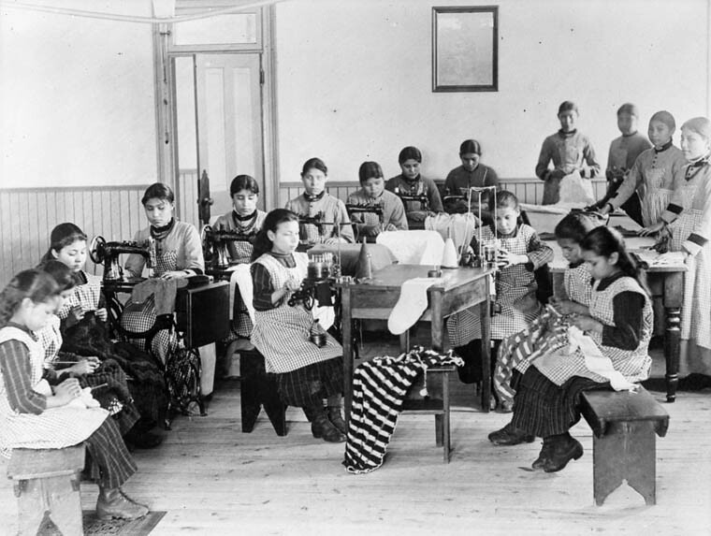
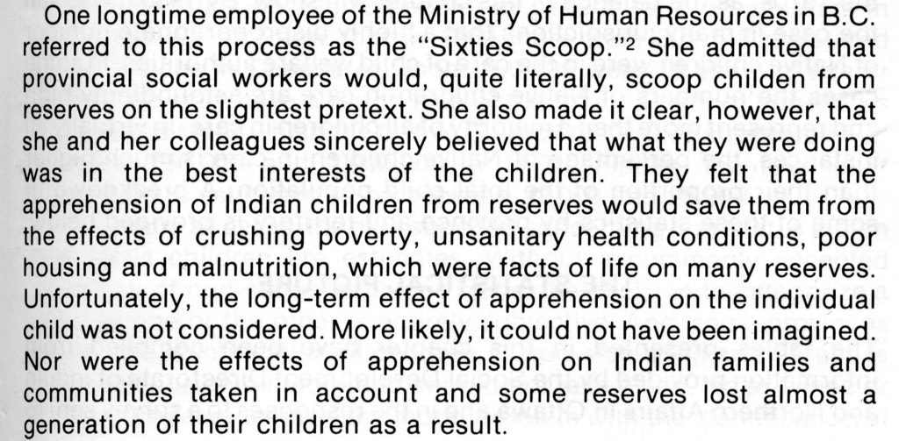
Forced Assimilation
Residential Schools:
The Tainted History in Canada
This Photo by Unknown Author is licensed under CC BY-SA
This Photo by Unknown Author is licensed under CC BY
This Photo by Unknown Author is licensed under CC BY-ND

Slide 13

Acculturative Stress
has been characterized as:
one form of stress that is due to
challenges in the process of acculturation.
It has been observed as: "a particular set of stress behaviours . . .lowered mental health status (especially anxiety, depression), feelings of marginality and alienation, heightened psychosomatic symptom level, and identity confusion.“ (Berry et al., 1992, p. 284).
"Social support" or having "supportive relationship with both cultures" and "links to one's heritage are associated with lower stress." (Berry, 1997, p. 25).
Higher levels of education have also been associated with lower levels of stress (Berry, 1997).
This Photo by Unknown Author is licensed under CC BY-NC

Slide 14

Voluntariness of Contact and Acculturative Stress
Voluntary people (immigrants, sojourners and ethnic groups) are less likely to be stressed than involuntary peoples (refugees).
Berry, Kim, Minde, & Mok (1987)
Immigrants:
Koreans in Toronto had a mean stress score = 3.08
Refugees:
Vietnamese in Kingston, mean stress score = 5.61
Sojourners:
Malaysian in Kingston, mean stress score = 6.08
Chinese students, Queens University,
means stress score = 3.42
This Photo by Unknown Author is licensed under CC BY-SA-NC

Slide 15

Acculturation and Ethnic Minority Youth
Acting Together:
Community-University Research Alliance Project
at KPU
This Photo by Unknown Author is licensed under CC BY-SA-NC
* 145 ethnic minority youth in high school Grade 8
* Spoke language other than English before age 5
72 males, 73 females
Mean age 13.1, SD .41

Slide 16
 | Integration | Separation | Assimilation | Marginalization
Life Satisfaction | r .16 p .050 | NS | NS | r - .23 p .046 (Boys only)
Self-Esteem | r .16 p .048 | NS | r - .24 p .038 (Girls only) | r - .23 p .047 (Boys only)
Self-reported Fighting | r -.17 p .043 | NS | r .24 p .043 (Girls only) | r .23 p .005
Belief Supporting Violence | r -.34 p .000 | NS | r .28 p .001 | NS
Authentic Living | r .20 p .016 | NS | r - .23 p .049 (Girls only) | NS
Notes:
The results of the study indicated that the minority youth’s Integration orientation was positively correlated with Life satisfaction, Self-esteem, and Authentic Living. Their self-reported fighting, their beliefs supporting violence were negatively correlated.
Among youth with a high score on Assimilation orientation, there was a positive correlation with Belief supporting violence, and negative correlation with Self-esteem, and Authentic Living.
Among Male Youth, high Marginalization was negatively correlated with Life satisfaction and Self-esteem. For girls with high Marginalization score, there was a positive correlation with Self-reported fighting.

