Slide 1

Culture and Health
This Photo by Unknown Author is licensed under CC BY-NC-ND
Slides created by
Dr. Gira Bhatt
Kwantlen Polytechnic University
CC BY NC-SA 4.0

Slide 2

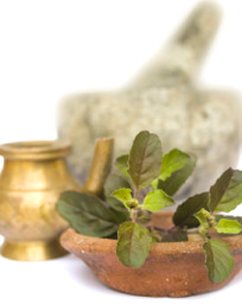

Health Belief Systems
Cultural beliefs about
  Optimal Health
  Somatization
  Causes of Illness
  Treatment
  Prevention of Illness
This Photo by Unknown Author is licensed under CC BY-ND
This Photo by Unknown Author is licensed under CC BY
This Photo by Unknown Author is licensed under CC BY-SA-NC

Slide 3


Diversity in the Health Care System
    Family & Gender Roles
    Cultural norms of Modesty
    Pregnancy & Child Birth
    Language Barriers
    Non-Verbal Behavior
    Eye-contact, Touch etc.
This Photo by Unknown Author is licensed under CC BY-SA-NC
This Photo by Unknown Author is licensed under CC BY-SA
This Photo by Unknown Author is licensed under CC BY-NC

Slide 4


Implications for Treatments
Inter-cultural Miscommunication?
Vietnamese words that translate
"feeling hot" don't mean "fever".
What they mean is "I don't feel well" and generalized malaise.
If Vietnamese patients are asked,
"Have you ever had hepatitis?"
the translator may translate that into "liver disease" and liver disease in Vietnam means itching…
Similarly, the kidney is the center of sexual potency to Indo-Chinese and Vietnamese, and therefore
"kidney trouble" may mean decreased libido or other sexual difficulty.
This Photo by Unknown Author is licensed under CC BY
This Photo by Unknown Author is licensed under CC BY-SA-NC

Slide 5

Implications for Treatments
Some Eastern tradition is rooted in beliefs that women must rest after having a baby.
They often lay on a bed that has hot coal under it for heat.
The practice is based on belief that heat is good for some ailments and cold is good for others.
In Western cultures, this may be problematic because the hygiene of postpartum patients is important part of discharge instructions and women are encouraged to shower.
This intervention with water that at times can be cold is not always acceptable to women from these cultures
This Photo by Unknown Author is licensed under CC BY-NC-ND

Slide 6

Covid-19 :Role of Culture in Compliance to Health Orders
“Tight” and “Loose” Cultures:
Gelfand, Raver, Nishii, Leslie, & Lun (2011)
33 nations study
Tight cultures
- strong social norms
- high acceptance of behavioral constrains
-low tolerance for deviant behavior
e.g., Japan, Singapore,
Loose cultures
- weak social norms
- high tolerance of deviant behavior
- low acceptance of behavioral constrain
e.g., USA, Netherland
This Photo by Unknown Author is licensed under CC BY-SA

Slide 7
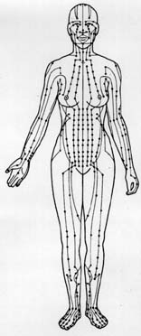
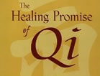
Health Beliefs and Practice: China
The core beliefs are rooted in “CHI” ( life Energy )
Belief that Chi flows through the meridian “channels” in the body
This Photo by Unknown Author is licensed under CC BY-NC-ND
This Photo by Unknown Author is licensed under CC BY-NC

Slide 8

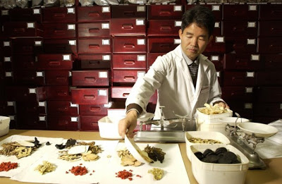
Chinese Health Beliefs
Imbalance or blockage of Chi is believed to be the cause of illness.
Massage, Acupuncture, Tai-Chi
practices are aimed at restoring and maintaining the flow of Chi
Treatment includes illness-specific soups made from natural herbs, dried insects, animal parts
This Photo by Unknown Author is licensed under CC BY-NC-ND
This Photo by Unknown Author is licensed under CC BY-SA-NC

Slide 9
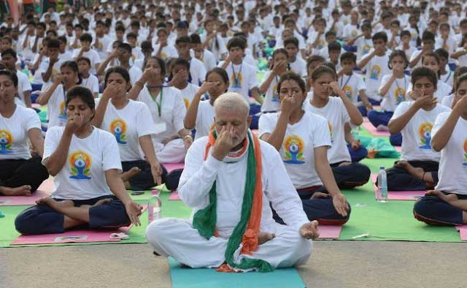
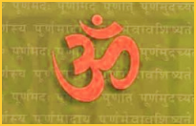
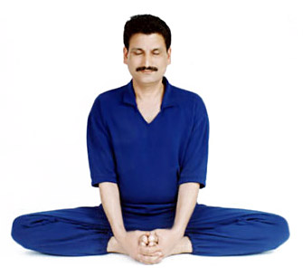
Yoga and Ayurveda:
Health System of Ancient India
  Holistic- Similar to Hippocrates
  Integrated approach to “Body & Mind”
  Cleansing of the mind and the body
  Balancing the mind and the body
  Natural remedies- Herbs, Massage, Yoga,
This Photo by Unknown Author is licensed under CC BY
This Photo by Unknown Author is licensed under CC BY-SA
This Photo by Unknown Author is licensed under CC BY-NC-ND

Slide 10
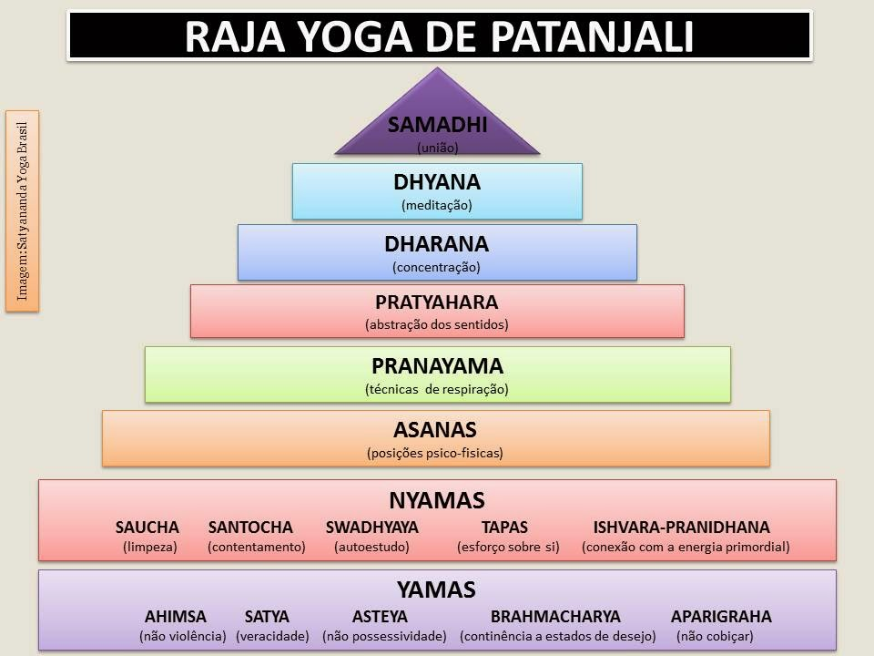
YOGA System of India : A holistic System for the mind and the body
Patanjali, an ancient Yogi, a scholar wrote Yoga Sutras
Proposed “8-fold path” to the Supreme state of Being
Right Restraints: “Don’ts” (YAMA)
Right Conduct : “Do’s” (NIYAMA)
Postural Practices (ASANA)
Breathing Exercise (PRANAYAMA)
Withdrawal of senses from their objects
Concentration (DHARANA)
Contemplation (DHYANA)
Trance (SAMADHI) :
The Supreme State of Being
This Photo by Unknown Author is licensed under CC BY-NC-ND

Slide 11
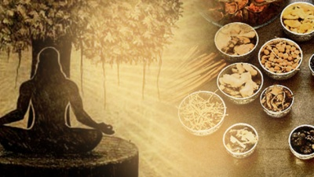
Yoga System of India
Why is Yoga a holistic system?
It provides a code of conduct for daily life
such as non-violence, truth
(The first two steps)
It provides details of physical exercises
including breathing practices
(Step 3, 4) to stay physically healthy and
supple – necessary for meditation
It is a gradual system of stabilizing the mind through a series of meditative steps (Steps 5 through 8) reaching the state of complete calmness and detachment from the worldly concerns.
This Photo by Unknown Author is licensed under CC BY

Slide 12

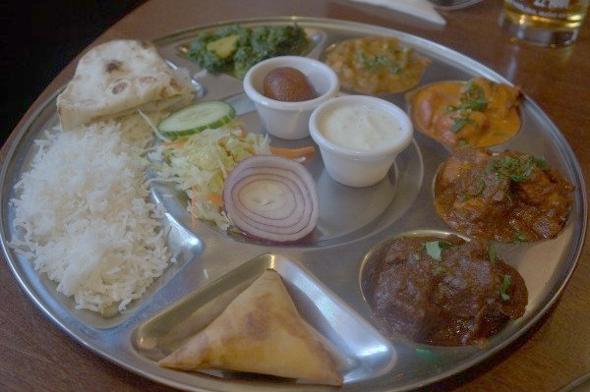

Health Beliefs in India
Focus on natural herbal remedies
e.g., Turmeric – Part of daily diet
Mostly vegetarian diet
Focus on prevention of illnesses
Focus on life attitudes
* Somewhat passive acceptance
of life events
This Photo by Unknown Author is licensed under CC BY
This Photo by Unknown Author is licensed under CC BY-SA-NC
This Photo by Unknown Author is licensed under CC BY-SA

Slide 13
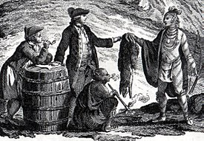
Indigenous Health
Tainted history
Contacts with European settlers
led to diseased never known before
among the Indigenous peoples
Need for research on population specific
illnesses and treatments
This Photo by Unknown Author is licensed under CC BY-SA

Slide 14


Indigenous Health Beliefs
Holistic Approach
Deep connection with land and nature
Traditional Healers, Midwives
Healing Circles
This Photo by Unknown Author is licensed under CC BY-SA
This Photo by Unknown Author is licensed under CC BY-SA

