Slide 1
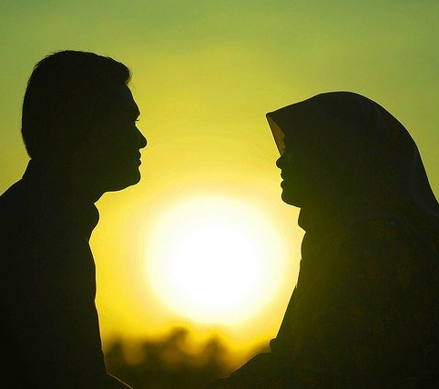
Culture and Attraction
This Photo by Unknown Author is licensed under CC BY
Slides created by
Dr. Gira Bhatt
Kwantlen Polytechnic University
CC BY NC-SA 4.0

Slide 2
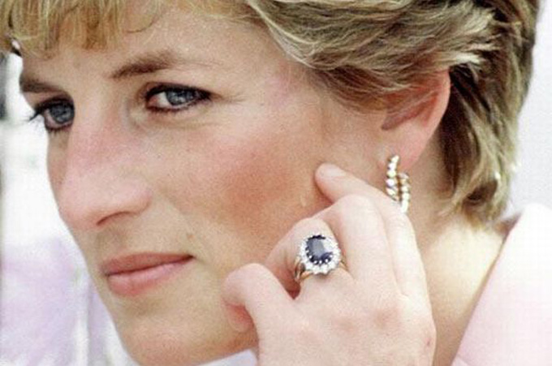
Universal Standards of Attractiveness
-Clear Complexion: Face without blemishes
This Photo by Unknown Author is licensed under CC BY-NC-ND

Slide 3

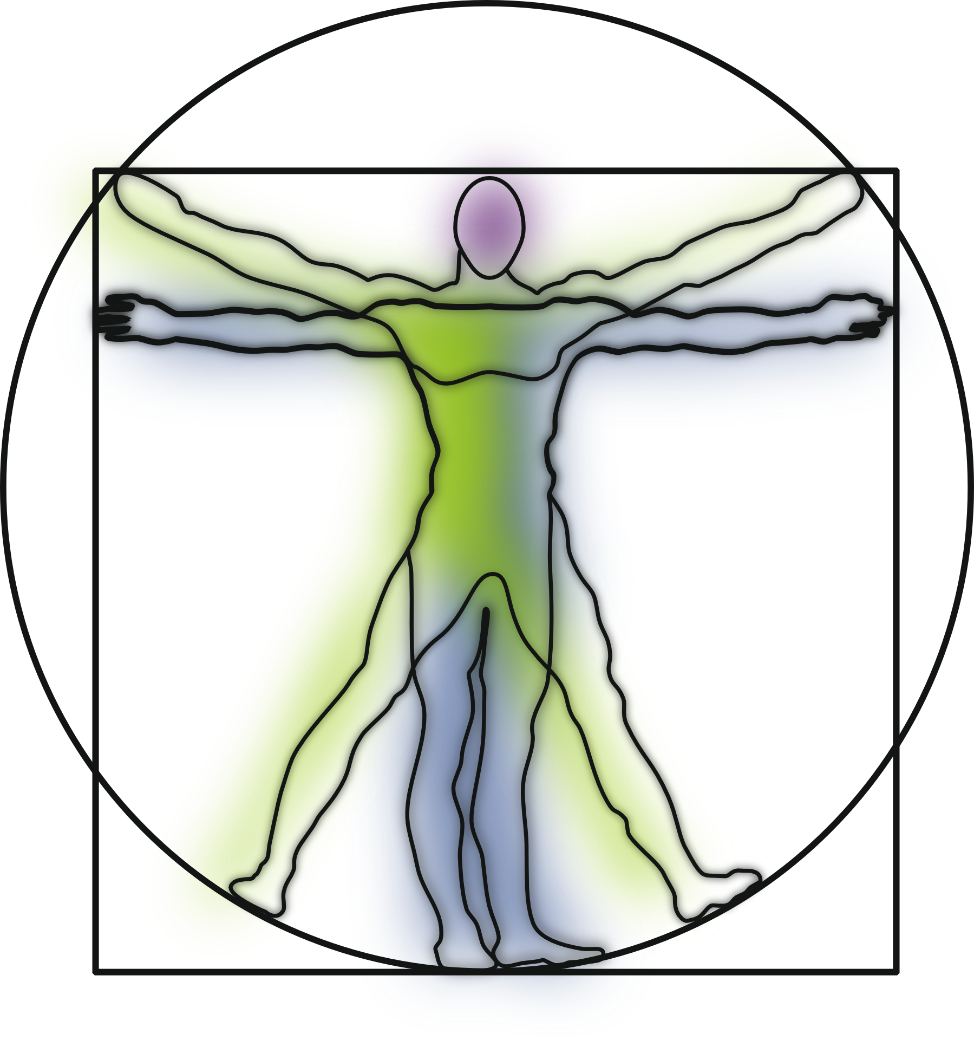
Universal standards of attractiveness
This Photo by Unknown Author is licensed under CC BY-NC
Symmetry of Face and Body
is perceived as attractive
This Photo by Unknown Author is licensed under CC BY-NC
Slide originally created by Dr. Debra Dell
Athabasca University
Modified by Dr. Gira Bhatt
Kwantlen Polytechnic University
CC 2.0
Notes:
This Photo by Unknown Author is licensed under CC BY-NC
https://pixabay.com/en/vitruvian-man-anatomy-science-151866/

Slide 4

Universal standards of attractiveness
The preference for average
Slide originally created by Dr. Debra Dell
Athabasca University
Modified by Dr. Gira Bhatt
Kwantlen Polytechnic University
CC 2.0
Notes:
Image from: https://pixabay.com/en/woman-face-contour-empty-burnout-65061/
"Women, Face, Contour" by geralt is in the Public Domain, CC0

Slide 5
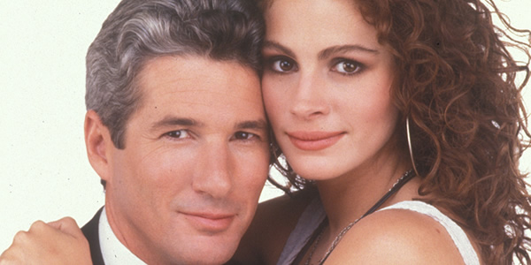
Universal standards of attractiveness
Evolutionary Perspective
Universally,
Men value physical attractiveness
Women value social status and resourcefulness
This Photo by Unknown Author is licensed under CC BY-NC-ND
Notes:
Image Juliette Bricker with permission

Slide 6
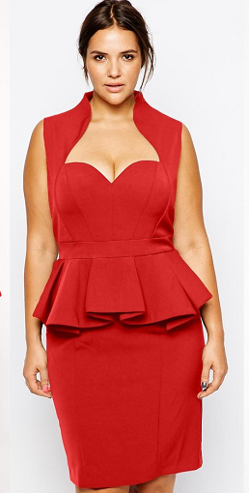
Universally,
Men have a preference for women with a low waist-to-hip ratio
(i.e., large hips and a small waist),
a shape that is likely to indicate fertility.
This Photo by Unknown Author is licensed under CC BY-NC-ND
Notes:
Images: https://pixabay.com/en/pregnant-pregnant-woman-m-mother-2640994/
https://pixabay.com/en/art-auguste-rodin-bronze-famous-1301872/
https://pixabay.com/en/belly-body-calories-diet-exercise-2354/
"Pregnant, Pregnant Women" by Fotorech is in the Public Domain, CC0
This Photo by Unknown Author is licensed under CC BY
"Belly, Body, Calories" by PublicDomainPictures is in the Public Domain, CC0

Slide 7

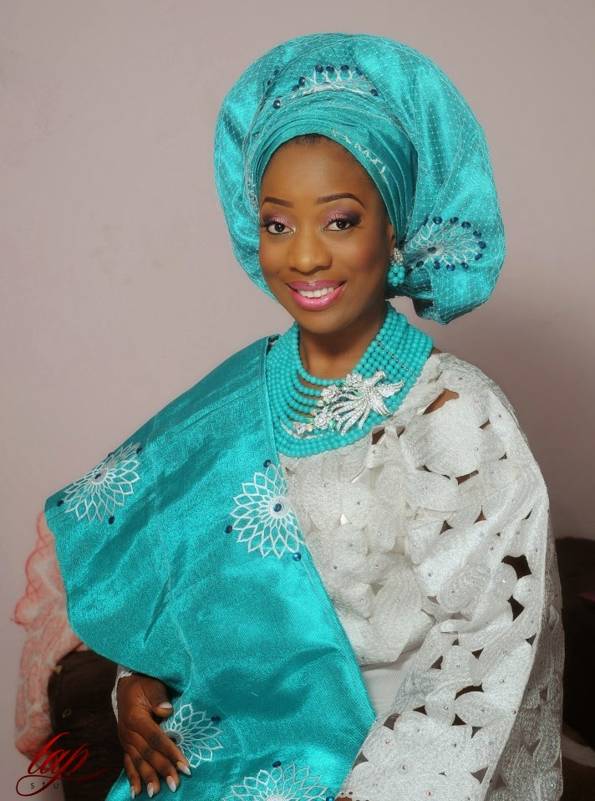

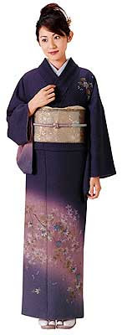
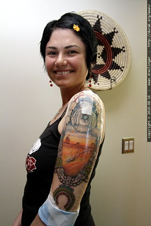
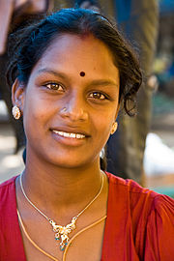
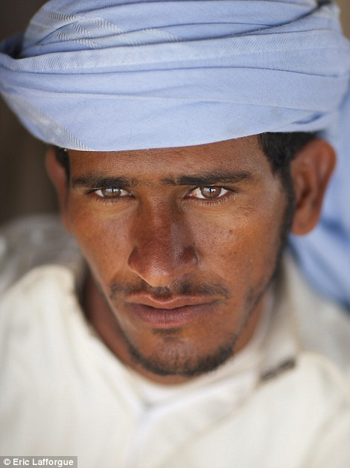
What Specific features are considered attractive
varies across culture fluid
This Photo by Unknown Author is licensed under CC BY-NC-ND
This Photo by Unknown Author is licensed under CC BY-SA
This Photo by Unknown Author is licensed under CC BY-SA
This Photo by Unknown Author is licensed under CC BY-SA-NC
This Photo by Unknown Author is licensed under CC BY-NC
This Photo by Unknown Author is licensed under CC BY-SA
This Photo by Unknown Author is licensed under CC BY
Notes:
This Photo by Unknown Author is licensed under CC BY-NC-ND (Marylyn Munroe)
This Photo by Unknown Author is licensed under CC BY-NC (Japanese woman)
This Photo by Unknown Author is licensed under CC BY-NC-ND (Kate Moss)
This Photo by Unknown Author is licensed under CC BY-NC-ND (African)
This Photo by Unknown Author is licensed under CC BY-SA-NC (Indigenous)

Slide 8
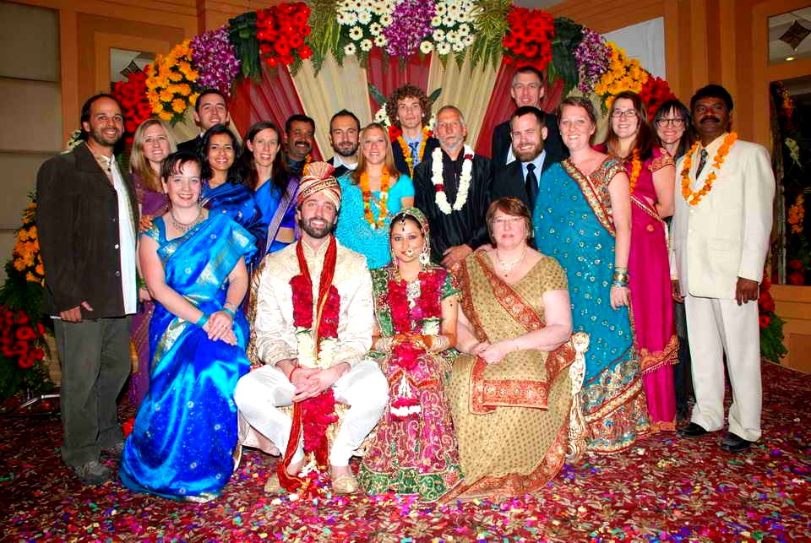

Dating and Falling in Love are not universal
Many cultures have “arranged marriages”
Arranged marriage
- Alliance between two families
- Family background, dowry, values, class,
- Elders can maintain control over family
Love marriage
- Union of two individuals
- Date, romance, love, companionship
- Little role played by elders
This Photo by Unknown Author is licensed under CC BY-SA-NC
This Photo by Unknown Author is licensed under CC BY-SA

Slide 9

Individuals in arranged marriages report being just as satisfied as those in love marriages (Hortascu, 1999)
An earlier research (Gupta & Singh, 1985) found that couples in love marriage reported high level of love in the initial years which tapers off while couples in arranged marriage reported increasing level of love in later years
This Photo by Unknown Author is licensed under CC BY-SA

Slide 10
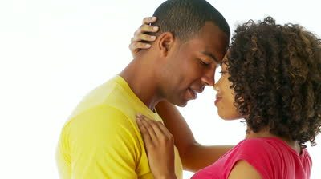
Sexuality across Cultures
* Expression of Sexuality
* Premarital Sex
* Extramarital Sex
* Homosexuality
* Chastity
This Photo by Unknown Author is licensed under CC BY-ND

Slide 11
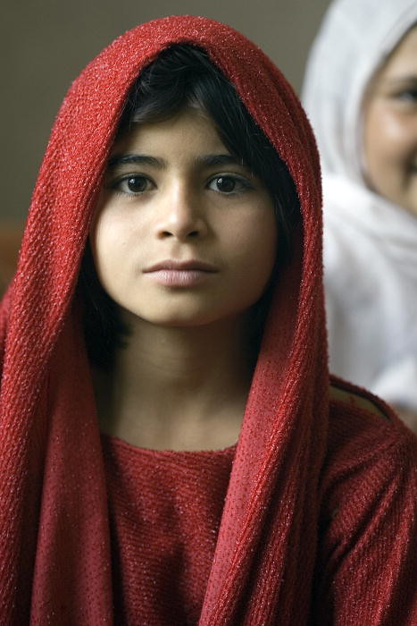
Chastity –
Not particularly important in Sweden, Denmark, Germany
Important in India, Iran, china
Honor Killing:
Stigma an stereotyping cultures
- A challenge for Acculturating groups in the Western countries
This Photo by Unknown Author is licensed under CC BY-NC-ND

Slide 12
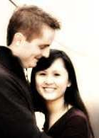
“ Mixed” (Inter-racial) Relationships
Couple in which one spouse or partner belongs to a visible minority group and the other does not, as well as couple in which the two spouses or partners belong to different visible minority groups
Stats Canada 2011: 360,000 Mixed race couples
Japanese were most likely to “marry out” (78.7%) followed by the Latin Americans (48.2%), and Blacks (40.2%)
Vancouver has more couples in mixed unions per capita than any other Canadian city, 9.6% (one in 10)
Toronto: 8.2%
This Photo by Unknown Author is licensed under CC BY-ND

