Slide 1
Using Headings Effectively
Technical Writing Essential: Chapter. 3.2
Notes:
Ch. 3.2 Headings: https://pressbooks.bccampus.ca/technicalwriting/chapter/headings/

Slide 2
What do headings accomplish?
Headings enhance readability, scan-ability, and overall professionalism of the document:
Provide an overview (Table of Contents)
Indicate the logical flow and hierarchy of ideas
Enable readers to read selectively
Provide breaks and white space
Keep readers focused
Keep the writer focused and organized

Slide 3
Tips for designing headings
To indicate hierarchical importance of different levels of headings, use the following tools strategically:
Numbering system
Font type and size
Bold and italics
Placement (indentation)
Consider the length of your document and how headings can enhance readability.
Be consistent in using one size/style/font for each heading on the same level (use Styles function in MS word)

Slide 4
Using Styles
Using the STYLES function in MS Word is essential so that you can do the following:
Automatically create a table of contents based on your headings
Allow screen readers to recognize headings, thereby making your document more accessible
See Tutorial Video on YouTube: How to create and customize headings using Styles

Slide 5
Example Heading Design – level 1
Heading: Arial bold 16 point font. Introduce with Arabic numeral; aligned with left margin. 1.5 space below (whitespace between heading and text below it)
1. Heading Level One
This is body text. This is body text. This is body text. This is body text. This is body text. This is body text. This is body text. This is body text. This is body text. This is body text. This is body text. This is body text. This is body text.
Body font: 12 point Calibri

Slide 6
Example Heading Designs - Level 2
Leave white space under the end of the previous section. There should always be slightly more white space above the heading than below it. This is body text from the previous section.
1.1. Heading Level Two
This is body text. This is body text. This is body text. This is body text. This is body text. This is body text. This is body text. This is body text. This is body text. This is body text. This is body text. This is body text. This is body text. This is body text.
Heading and text is indented 0.5” from margin;
Arial bold 14 point font; introduced with numeral and one decimal place.

Slide 7
Example Heading Design - level 3
Additional indent from margin (optional). Font Arial bold italics 14 points. Introduce with an Arabic numeral
1.1.1. Heading Three
This is body text. This is body text. This is body text. This is body text. This is body text. This is body text. This is body text. This is body text. This is body text. This is body text. This is body text. This is body text. This is body text. This is body text.

Slide 8
1. First Level Heading
Under this first level heading you will find text related to the topic indicated by the heading. It will go on for several lines or even several paragraphs. If there is a Section 1, there will also be a Section 2 in order to avoid having a lone heading at this level.
1.1. Second Level Heading
This section may align directly under the 2nd level heading, or
can align with the left margin. To avoid having a lone heading at this level, you will also have a section 1.2 and possibly 1.3, etc.
1.1.1. Third Level Heading
This third level heading is further indented, and smaller or
In italics to set it off from second level heading. Again, if
You have a 1.1.1, you should have a number 1.1.2, etc.
1.1.2. Additional Third Level Heading
Text text text text…
1.2. Additional Second Level Heading
Text, text text…
2. First Level Heading Again
Text text text text…
NOTE: Most headings should normally have a substantial amount of information under them (unlike this example).

Slide 9
Non-Numbered Headings Example
First Level Heading
Under this first level heading you will find text related to the topic indicated by the heading. It will go on for several lines. You will have additional headings at this level in order to avoid creating a lone heading.
Second Level Heading
This section may align directly under the 2nd level heading, or
can align with the left margin. To avoid having a lone heading at this level, you will have additional headings at this level.
Third Level Heading
This third level heading is further indented, and smaller or
In italics to set it off from second level heading. Again, if
You have a 1.1.1, you should have a number 1.1.2, etc.
Additional Third Level Heading
Text text text text…
Additional Second Level Heading
Text, text text…
First Level Heading with a New Topic
Text text text text…

Slide 10
How do you use headings?
Each section must have a heading, and each heading should normally have a substantial amount of text under it.
Use consistent formatting (Use STYLES in Word) for each level of heading
Make your headings accurate and descriptive
Use task-oriented headings in instructions
Use spacing tools to ensure that you have more white space above the heading than below it
Use an appropriate number of headings; as a rough guideline, aim for 2 to 4 headings per page for our assignments.

Slide 11
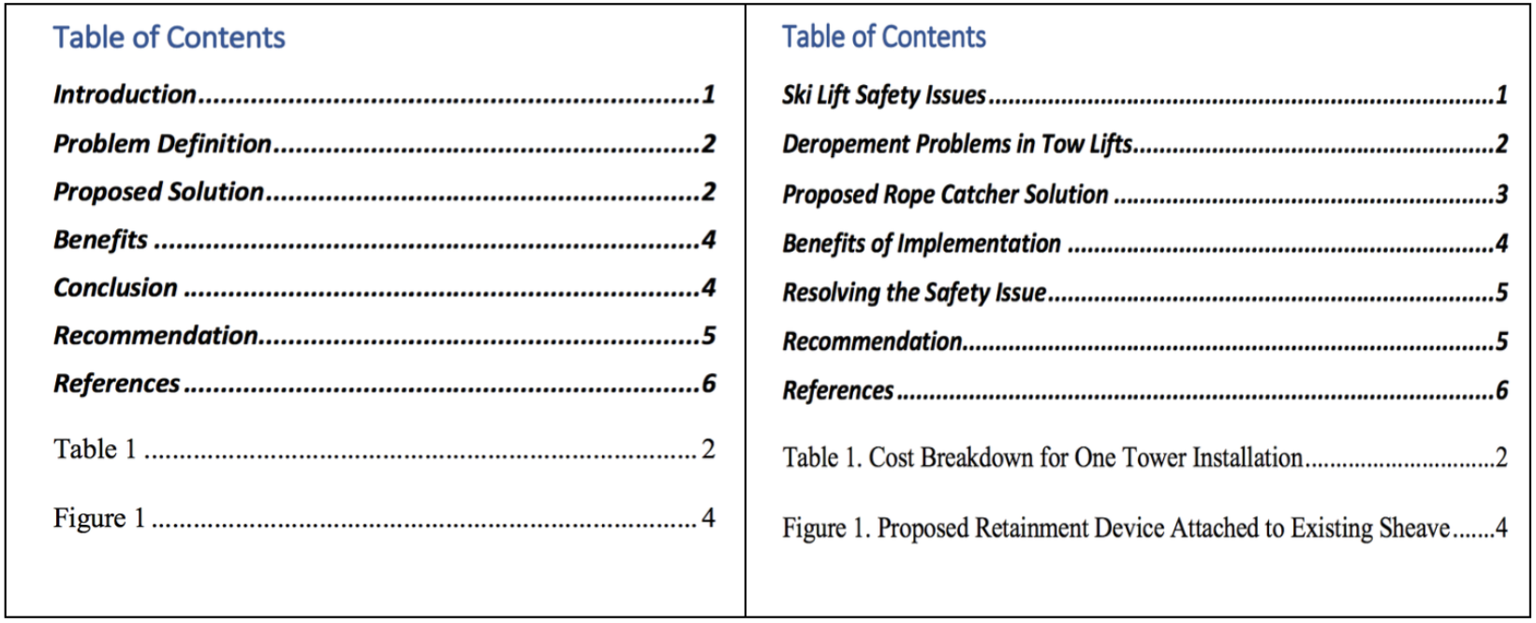
Function vs Descriptive Headings
These two tables of contents are based on the documents’ headings; one describes the FUNCTION of each section, while the other focuses more on describing the CONTENT of each sections. Which table gives you a better sense of what information the document contains? Which would allow you to read selectively?
Notes:
NOTE: scientific papers often use the FUNCTIONAL headings to follow the scientific method in their paper.

Slide 12
What to Avoid
Lone headings | Avoid having just one heading at a particular level or section of your document. That is like having one item in a list.
Stacked Headings | Every heading should normally have body text under it.
Headings as list lead-ins | A list should be introduced by a grammatically correct lead-in sentence.
Headings as captions for visuals | Use “insert caption” to create correct labels for figures and tables, and place them appropriately. Headings indicate an entire section, not a single visual element.
Widows and Orphans | Use hard page breaks to avoid leaving a heading orphaned at the bottom of a page with no text below it.
Overusing Headings | It can be tempting, once you learn how, to overuse headings. Remember that headings indicate sections in your document that require development, possibly in several paragraphs. Every sentence does not require its own heading.

Slide 13
RECAP Quiz
Identify three things that headings accomplish.
What are “stacked headings and when should these be used?
True of False: “Background” or “Technical Information are examples of effective descriptive headings.
What is a lone heading?
Can a heading introduce a table in document?
True or false: 3rd level headings should be larger than 1st level headings.
True or false: There should be more white space above the heading that below.
What is a good guideline for the number of headings to use per page in assignments in this course?

